Slide 1
Breaking Down Barriers in the Land of the Dinosaurs: Developing a Strategic Social Collaboration Strategy in the Real World
SPTechCon Boston 2014
September 17, 2014
Susan Hanley
www.susanhanley.com

Slide 2

“Collaborative working”
“Employee engagement”

Slide 3

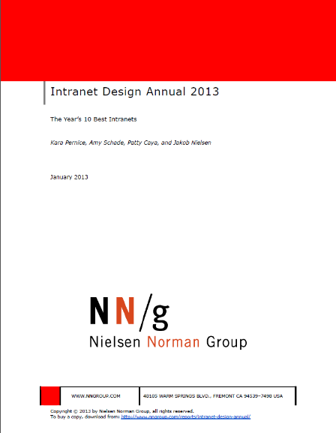
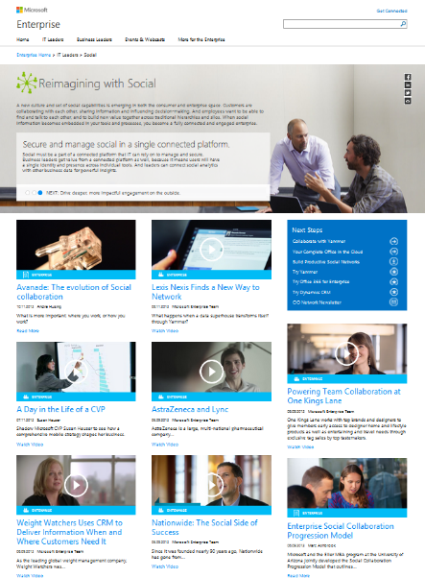
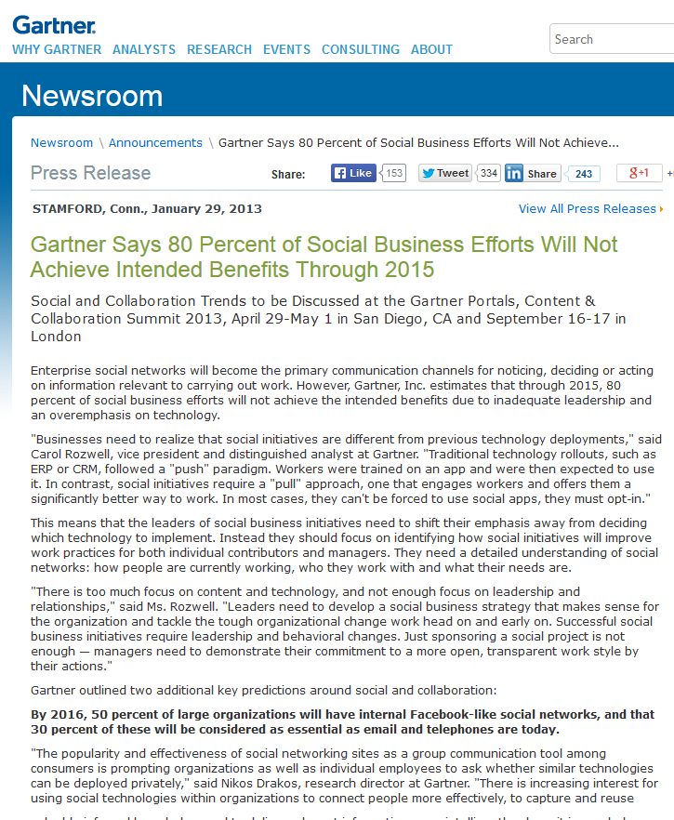
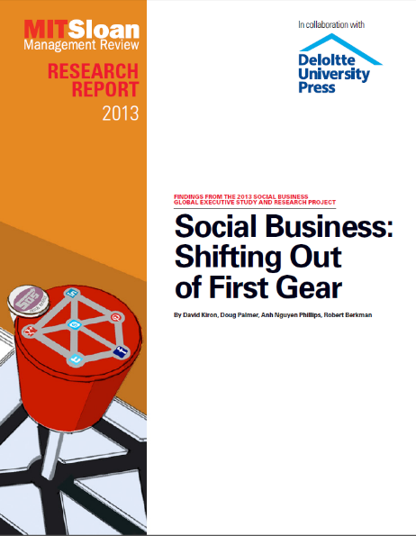

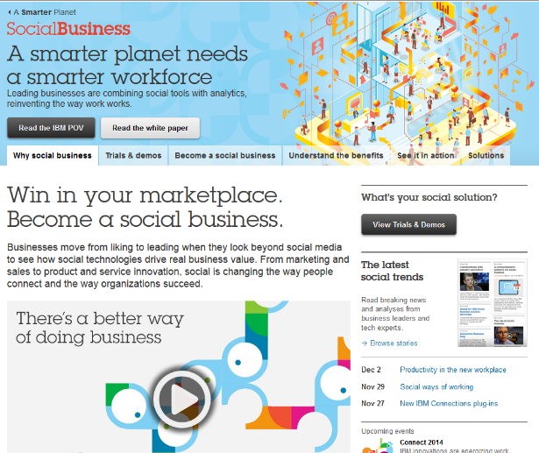
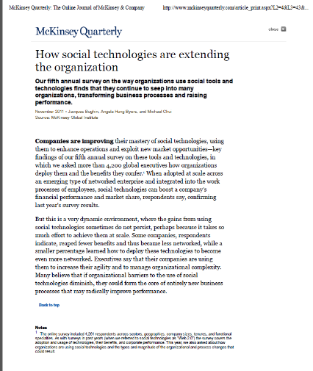

Slide 4

Adoption is not about age

Slide 5
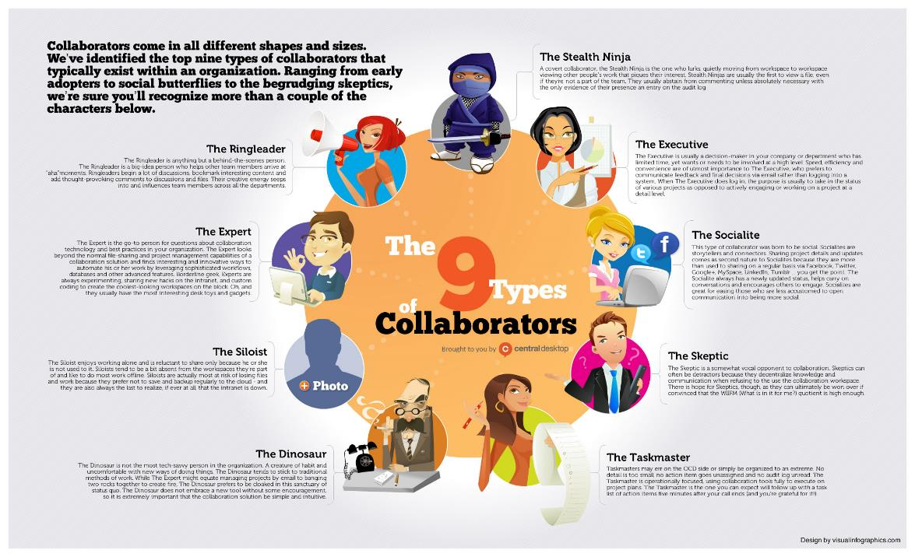
http://www.centraldesktop.com/infographics/collaboration-personas-the-9-types-of-collaborators.jpg

Slide 6
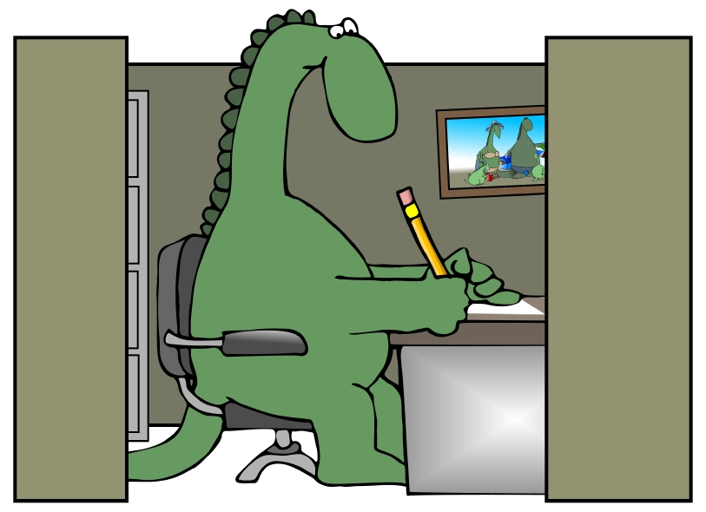
Thinking like a dinosaur is a way of working and a mindset –
not an age!

Slide 7



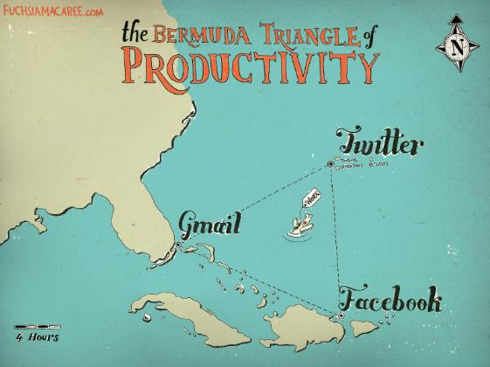
Not aligned with our culture
Too many competing priorities
Lack of proven business case

Slide 8

Knowledge is power
Command and control
Fear of rejection
Fear of change
Not aligned with our culture

Slide 9

Flavor of the month
Collaboration talk combined with individual tasks and goals
Organizational ADD
Too many competing priorities

Slide 10
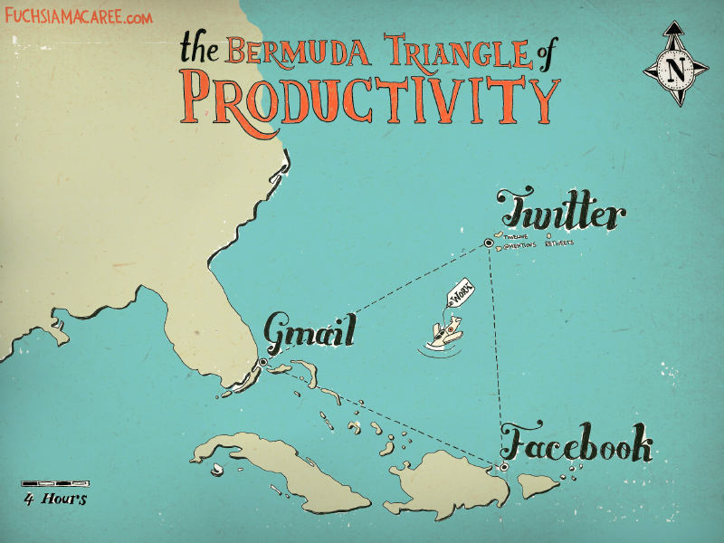
Lack of a proven business case

Slide 11

Getting Social with SharePoint 2013
Yammer/
Newsfeed
Blogs
Wikis
Community Sites
(Discussion Boards)
Profile
(About Me, Ask Me About, Skills, Interests)

Slide 12

A Roadmap to Overcome Barriers
Understand the comfort zone
Recruit friends
Clearly identify the business problem
Understand your culture
Show me!

Slide 13

#1 Clearly identify the business problem
  Which existing business processes would benefit from social capabilities?
  How will you measure success?

Slide 14

We collaborate in the context of a business activity, process, or task.
We engage to solve problems – to get something done!

Slide 15

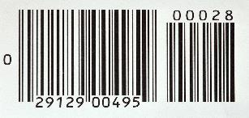


Which use cases? Focus on the critical moments of engagement and work backwards
Sales
Product Development
Resource Planning
Customer Support
Sales team on-boarding
Sales team training and mentoring
Engineer struggling with a problem
Project Manager looking for the most qualified resources for a project
Services agent working trying to solve a customer problem

Slide 16

Which use cases? Measurable results!

Slide 17

#2 Understand your culture
“The greatest benefits will be realized by organizations that have or can develop open, non-hierarchical, knowledge sharing cultures.”
McKinsey Global Initiative: “The social economy: Unlocking value and productivity through social technologies,” July 2012.

Slide 18

Case Study: Aligning and creating the right culture
Organizational Goals
Minimize cost and risk of reinventing the wheel in a global organization
Build inventory of best practices and expertise on core topics
Leverage expertise across the globe
Solution
Topic-focused Communities of Practice with SharePoint 2010
Moving to SharePoint 2013/Yammer

Slide 19
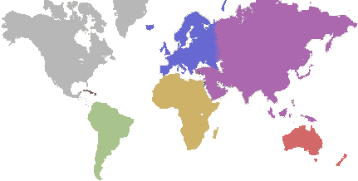
A relatively new production plant manager in Egypt had some questions about the best ways to handle green corn during a delicate stage of the process.
Late in his day, he posted a query in the Production Technologies community because he wasn’t sure to whom he should send an email (and his boss was out of the office).

Slide 20

When the plant manager returned to work the next morning, he found 10 responses.
Three responses were about two proposed solutions to his problem. The rest were commentary and shared experiences from others.
Meanwhile, colleagues from around the world saw the post and offered suggestions.
Benefit: Solutions offset the risk of losing $120,000 of pre-commercial seed value.

Slide 21

Senior manager’s email made it not only safe to ask questions – but admirable.
Community became one of the busiest in the company.
Other communities follow the lead – taking a cue from what worked and what was recognized and valued.
“Thanks for posting your question. Now we have more searchable data in the system on green corn processing. I’d love to see this happen more often in the future.”

Slide 22
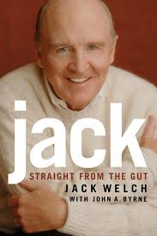
Social is an HR value
Do you have a hero culture?
What is valued?
“For our entire history, we had rewarded the inventor or the person who came up with the good idea. Boundaryless would make heroes out of people who recognized and developed a good idea, not just those who came up with one. As a result, leaders were encouraged to share the credit for ideas with their teams rather than take full credit themselves. It made a huge difference in how we all related to one another.”

Slide 23
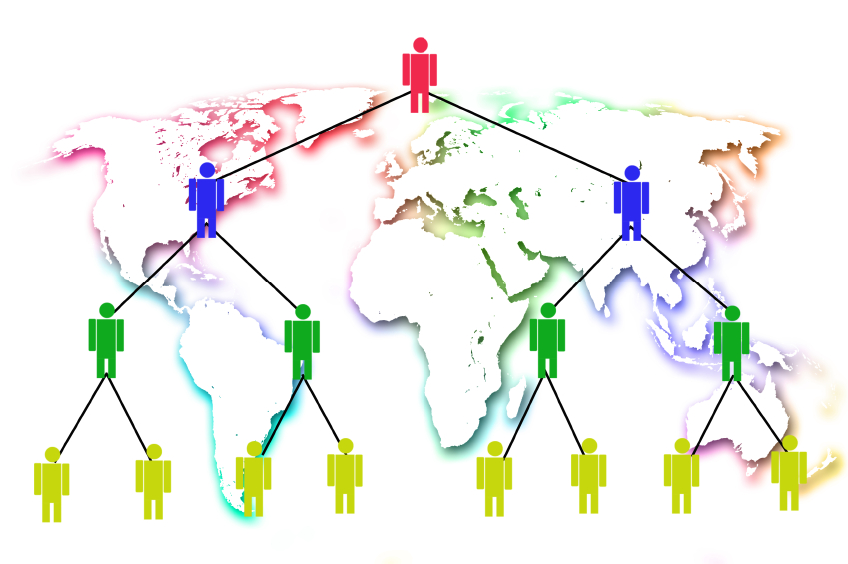
Social helps you scale
True conviction among top leaders
Encouraging “both sides” of helping events
Reinforce norms with formal processes and roles (e.g. design reviews)
Leave slack in employee’s schedules

Slide 24

#3 Recruit friends

Slide 25

Leaders model the behavior
“No involvement by leaders,
no commitment by employees.
No exceptions.”
Vala Afshar, Chief Marketing and Customer Officer at Enterasys

Slide 26
Tips for getting leaders engaged
Jams – targeted, real time collaboration
Focused messaging – e.g. travel logs
“Like” what ever they do
Make it easy
  Mobile
  Start where they are: keep it in the comfort zone
Find an ally – it only takes one … with one success

Slide 27
A word of caution from Sam Marshall:
[Social networks] appeal because they do away with power and hierarchy.
On the other hand, they seem to need leadership support before they take off.
Isn’t that asking turkeys to vote for Christmas?
No wonder some leaders are wary of them. We’d do much better if our claims about ESNs were less about workplace revolution and more about improving working life for everyone.

Slide 28

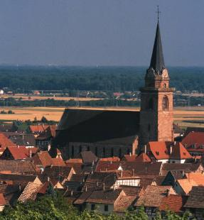

It takes
a village

Slide 29

Champions
Encourage and promote people and conversations
Monitor conversations
Curate stories
Celebrate successes
Handle negative situations
Educate and welcome
Nurture members – inspire engagement
Remove roadblocks

Slide 30
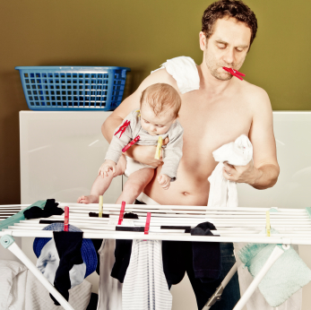
Who makes a good champion?
Strong organizational and multitasking skills
Approachable, empathetic, and patient
Inspired by people
Inspires others
Transparent and diplomatic
Expertise or experience in the community subject area
Confident and passionate about the vision
Comfortable with technology

Slide 31

Why does this work?
Nothing happens without a readiness to change.
It’s important to replace old habits with new ones.
Peer support and pressure drive change.
Sponsorship deepens commitment and sparks results.
Community without hierarchy is a catalyst for change.
You are the company you keep.
Continuous introspection is key.
Changes in practice may represent breakthroughs.
It pays to acknowledge small wins.
The goal is progress, not perfection.
Harvard Business Review: Managing Change One Day at a Time, July-August 2014
http://hbr.org/2014/07/managing-change-one-day-at-a-time/ar/1

Slide 32

Celebrate your champions

Slide 33
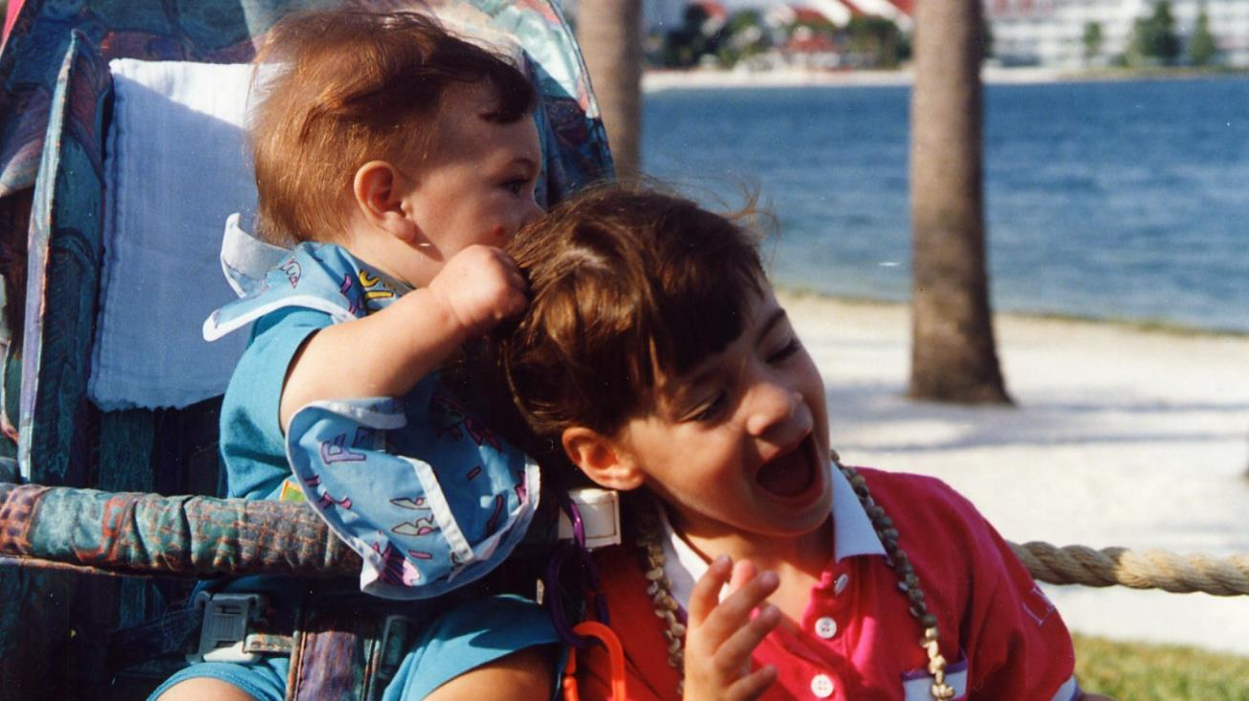
#4 Understand the comfort zone for your users

Slide 34
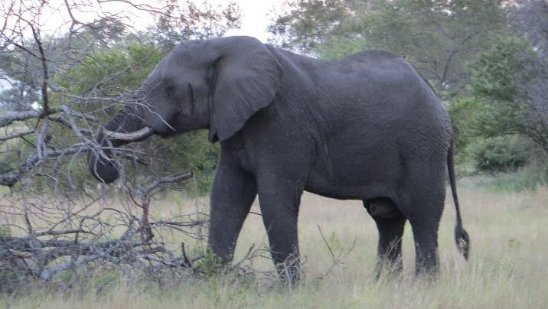

If you want to remove a big barrier to getting people to engage with social tools, find a way to keep your users in their COMFORT ZONE,
even if it’s only just to get started.

Slide 35

Case Study: E-mail Integration
Organizational Goals
Engage congregations in communities of practice focused on expanding the reach of the Union
Build inventory of practices and expertise on core topics
Help congregations function better as sacred communities by providing opportunities to collaborate with others
Solution
The Tent: Extranet
Community Sites based on SharePoint 2013 Online
Connects different groups by role (Temple Administrators), by topic (Fundraising), or by attribute (small congregations)

Slide 36

So, what happened?
They had the right stuff …
The initial reality …
Existing solution no longer supported – so people have to change
New solution provided enhanced functionality – especially SEARCH
Existing communities – both in real life and online – with real need to connect
Designated moderators to support and engage

Slide 37
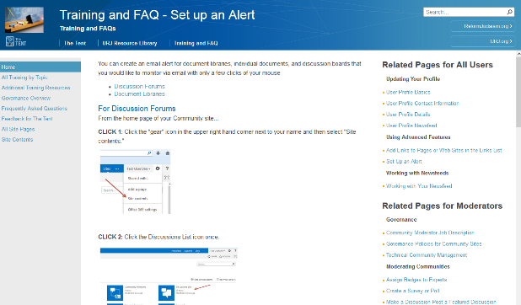
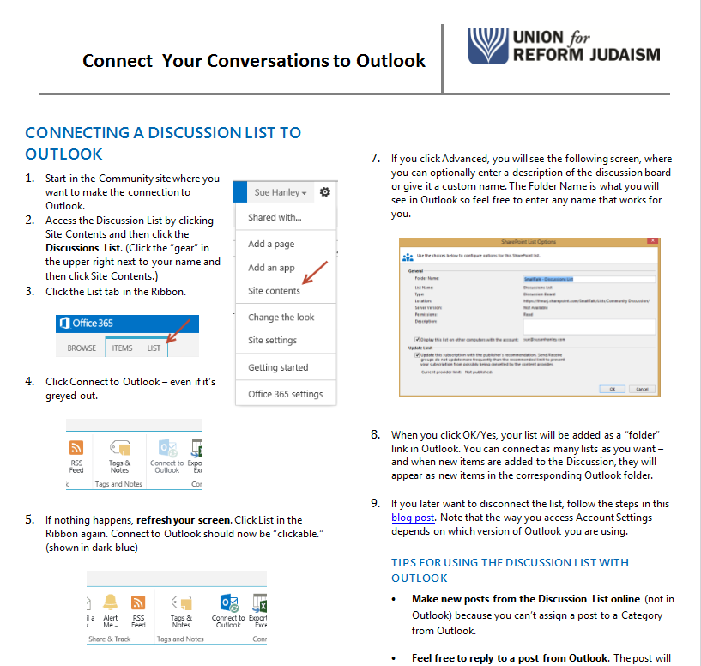
Until, … connect to email!

Slide 38
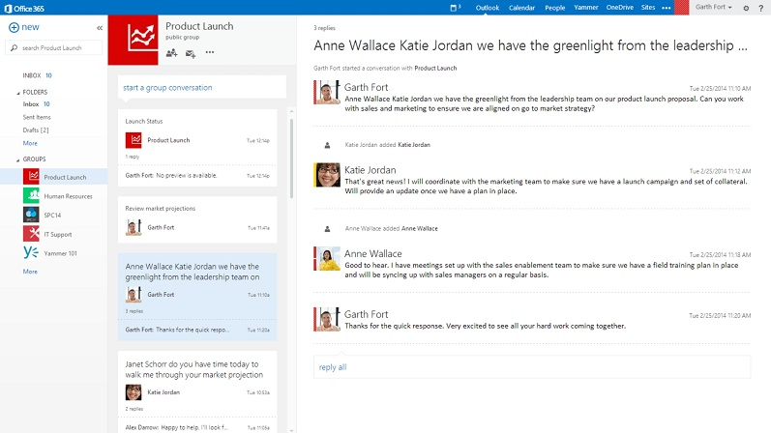
And it’s only going to get better!

Slide 39
Now … results!
Benchmarking/Best Practices
  Provides validation to board, saves time, eliminates false starts
  Do you provide these services?
  How do you do it?
Document Sharing/Document Starters
  Saves time and money for not just the original poster – but for other members with similar issues
  Policies
  Employee Manual
  Templates
Information Sharing
  Saves time and money, improves quality of outcomes, avoid potential litigation, increase revenue
  Legal rulings
  Tax implications
  Best practices
Help/Locate Expertise
  Saves time and money, improves quality of outcomes
  Grant applications
  Compliance
Resource Gathering/ Expense Sharing
  Saves time, increases connections among members
  Shared expenses
  Booth staffing

Slide 40
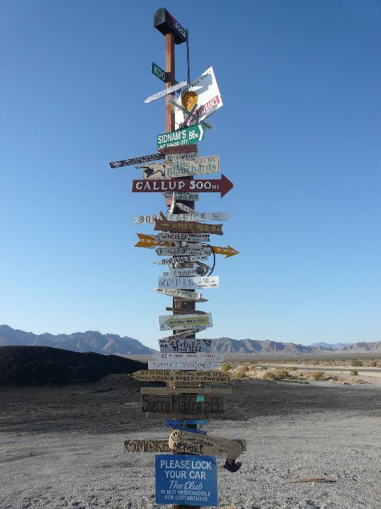
What makes a good post? What business scenarios should you post about?
Provide simple guidance about what is OK and what is not OK
Provide “what goes where” examples
#5 Show me!

Slide 41
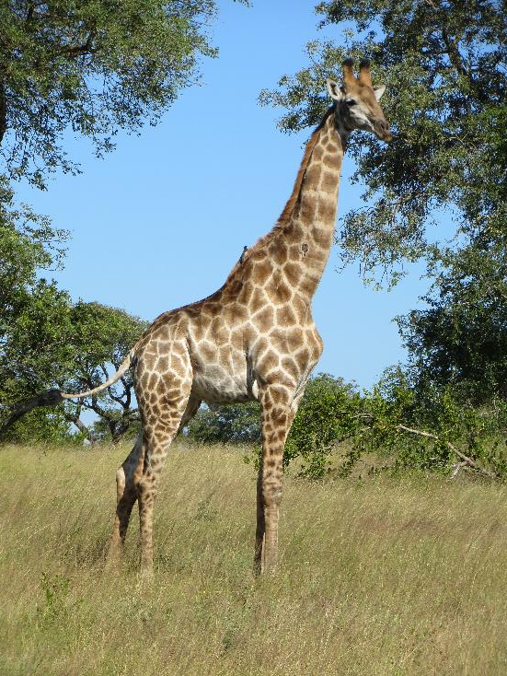
Tips from Stan Garfield at Deloitte Global Services:
Share a link. “Here is a link to the latest Forrester Wave report on social networking.”
Ask a question. “Has anyone encountered this problem before, and if so, how was it solved?”
Find a resource. “Looking for a specialist in retirement benefits to help win a bid in Calgary.”
Answer a post. “Here are links to three relevant quals in the quals database.”
Recognize a colleague. “Thanks to @dpalmer for hosting an excellent planning session today.”
Inform about your activities. “Will be in the Philadelphia office today; does anyone wish to meet?”
Suggest an idea. “Local office TV screens should display the global Yammer conversation stream.”

Slide 42

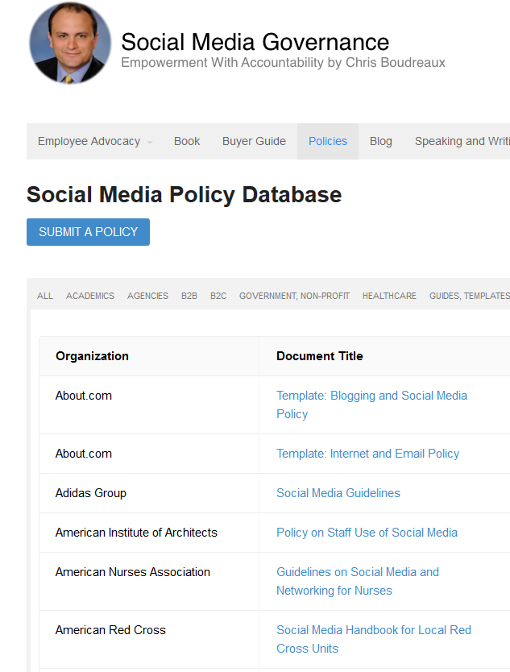
Social moves quickly … have governance guidelines in place before situations arise
http://socialmediagovernance.com/policies/

Slide 43


Clear, simple guidance to change some habits
Private
Assign a Task
External
Q & A
Not sure who knows
FYI

Slide 44

Don’t underestimate
the importance
of training

Slide 45
Breaking down the barriers
Not aligned with our culture
Too many competing priorities
Lack of proven business case
Engage and nurture champions … and leaders
Make it easy
Promote great stories
Embrace the comfort zone
Align where work gets done
Engage and nurture champions … and leaders
Provide examples
Train!
Start with a meaningful business problem
Measure what matters
Collect and share stories … all the time … at every opportunity
Don’t think it has to be only you – get your village universe to help!

Slide 46

It’s not a sprint, it’s a journey …
You don’t need 100% adoption to be successful
Align where work gets done
Lead the way – with champions
Be patient – change takes time

Slide 47

… to get to this moment …

Slide 48
… it’s evolution, not a revolution!

Slide 49






About me
sue@susanhanley.com
www.susanhanley.com
susanhanley
Governance
User Adoption
Metrics
Information Architecture
Knowledge Management
susanhanley
www.slideshare.net/susanhanley
http://www.networkworld.com/blog/essential-sharepoint/

Slide 50
Resources
https://about.yammer.com/yammer-blog/tips-guides
https://about.yammer.com/success/engage/
Successful Social Intranets: Creating business value through strategic alignment and adoption planning http://www.digitalworkplacegroup.com/resources/download-reports/successful-social-intranets/
Moving Beyond Marketing: Generating Social Business Value Across the Enterprise, MIT Sloan Management Review, July 14, 2014. http://sloanreview.mit.edu/projects/moving-beyond-marketing/
Deloitte research white paper “Social software for business performance - The missing link in social software: Measureable business performance improvements.”
  http://www.deloitte.com/assets/Dcom-UnitedStates/Local%20Assets/Documents/TMT_us_tmt/us_tmt_ce_socialsoftware_fullreport_0209111.pdf
IDEO’s Culture of Helping, Harvard Business Review, January-February 2014 http://hbr.org/2014/01/ideos-culture-of-helping/ar/1
Managing Change One Day at a Time, July August 2014, Harvard Business Review. http://hbr.org/2014/07/managing-change-one-day-at-a-time/ar/1
User Adoption Strategies: Shifting Second Wave People to New Collaboration Technology by Michael Sampson
Essential SharePoint 2013 by Scott Jamison, Susan Hanley, and Chris Bortlik

