Slide 1


Breaking Down Barriers in the Land of the Dinosaurs:
Developing a Strategic Social Collaboration Strategy in the Real World
Susan Hanley
SharePoint Fest DC
April 10, 2015
www.susanhanley.com
©2015

Slide 2

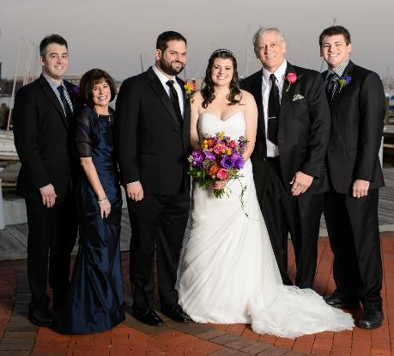






About Me
President, Susan Hanley LLC
Led national Portals, Management Collaboration, and Content practice for Dell
Director of Knowledge Management at American Management Systems
Information Architecture
User Adoption
Governance
Metrics
Knowledge Management
Intranets & Portals
Collaboration Solutions
sue@susanhanley.com
susanhanley
www.susanhanley.com
www.networkworld.com/blog/essential-sharepoint

Slide 3

“Collaborative working”
“Employee engagement”

Slide 4

Engagement really matters!
Engaged
According to Gallup, engaged employees exhibit:
37% less absenteeism
25-49% less turnover
27% less employee theft
18% higher productivity
16% higher profitability
Productive
Profitable
Source: http://www.gallup.com/consulting/121535/employee-engagement-overview-brochure.aspx

Slide 5
Collaboration matters too!
Engaged
Organizations with a strong learning and collaborative culture are:
92% more likely to develop novel products and processes
52% more productive
56% more likely to be first to market with their products and services
17% more profitable than their peers
Productive
Profitable
Source: David Mallon, High-impact learning culture: The 40 best practices for creating an empowered enterprise. Berson by Deloitte, June 10, 2010. <http://www.bersin.com/Store/Details.aspx?id=12171>

Slide 6


Slide 7


Slide 8

It’s about organizational change …

Slide 9

… and improving the velocity of information that informs decisions.

Slide 10


Slide 11


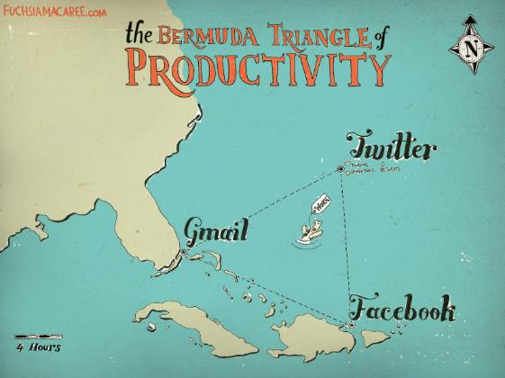
Not aligned with our culture
Too many competing priorities
Lack of proven business case

Slide 12

Knowledge is power
Command and control
Fear of rejection
Fear of change
Not aligned with our culture

Slide 13

Flavor of the month
Collaboration talk combined with individual tasks and goals
Organizational ADD
Too many competing priorities

Slide 14
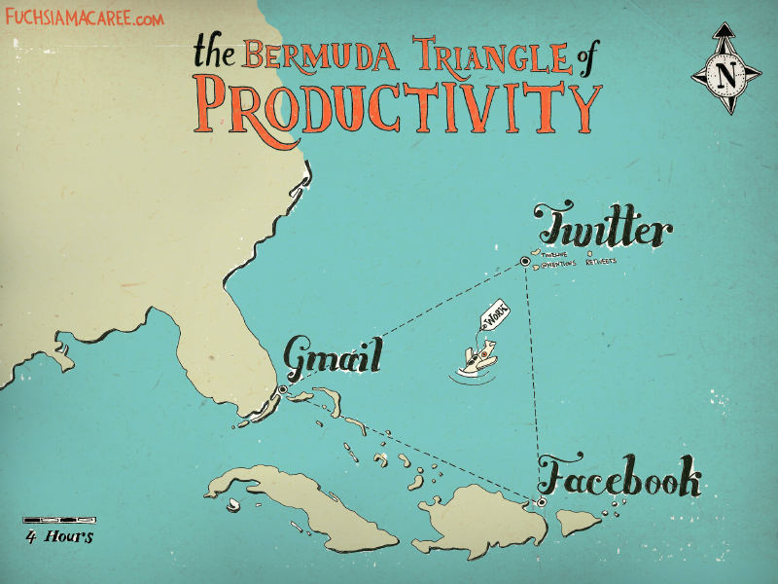
Lack of a proven business case

Slide 15

A Roadmap to Overcome Barriers
Understand the comfort zone
Recruit friends
Clearly identify the business problem
Understand your culture
Show me!

Slide 16

#1 Clearly identify the business problem
Which existing business processes would benefit from social capabilities?
How will you measure success?

Slide 17

We collaborate in the context of a business activity, process, or task.
We engage to solve problems – to get something done!

Slide 18




Which use cases? Critical moments of engagement, processes with bottlenecks, processes with lots of exceptions
Sales
Product Development
Resource Planning
Customer Support
Sales team on-boarding
Sales team training and mentoring
Engineer struggling with a problem
Project Manager looking for the most qualified resources for a project
Services agent working trying to solve a customer problem
Field feedback to HQ

Slide 19

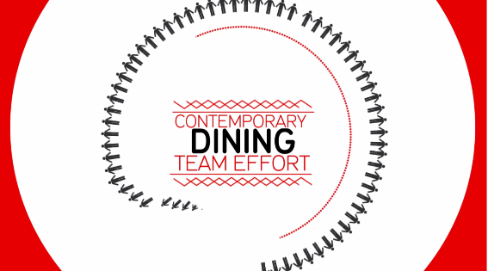
Field Feedback to HQ
Launch video that provides a scenario for users – to help provide context for using Yammer
https://vimeo.com/70377670

Slide 20

Onboarding
Paycor Inc said it would have forecast $2 million more in 2015 revenue if it had hit its 2014 hiring goals for new sales reps in 2014. The time spent bringing new reps up to speed means the company doesn’t see the full benefit of their productivity until 12 to 18 months into their tenure.
Source: http://www.wsj.com/articles/why-its-so-hard-to-fill-sales-jobs-1423002730

Slide 21

#2 Understand your culture
“The greatest benefits will be realized by organizations that have or can develop open, non-hierarchical, knowledge sharing cultures.”
McKinsey Global Initiative: “The social economy: Unlocking value and productivity through social technologies,” July 2012.

Slide 22

Case Study: Aligning and creating the right culture – in the context of a critical decision
Organizational Goals
Minimize cost and risk of reinventing the wheel in a global organization
Build inventory of best practices and expertise on core topics
Leverage expertise across the globe
Solution
Topic-focused Communities of Practice

Slide 23
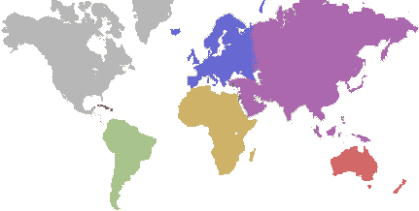
A relatively new production plant manager in Egypt had some questions about the best ways to handle green corn during a delicate stage of the process.
Late in his day, he posted a query in the Production Technologies community because he wasn’t sure to whom he should send an email (and his boss was out of the office).

Slide 24

When the plant manager returned to work the next morning, he found 10 responses.
Three responses were about two proposed solutions to his problem. The rest were commentary and shared experiences from others.
Meanwhile, colleagues from around the world saw the post and offered suggestions.
Benefit: Solutions offset the risk of losing $120,000 of pre-commercial seed value.

Slide 25

Senior manager’s email made it not only safe to ask questions – but admirable.
Community became one of the busiest in the company.
Other communities follow the lead – taking a cue from what worked and what was recognized and valued.
“Thanks for posting your question. Now we have more searchable data in the system on green corn processing. I’d love to see this happen more often in the future.”

Slide 26

Collaboration is an HR value …
Do you have a hero culture?
What is valued?
“For our entire history, we had rewarded the inventor or the person who came up with the good idea. Boundaryless would make heroes out of people who recognized and developed a good idea, not just those who came up with one. As a result, leaders were encouraged to share the credit for ideas with their teams rather than take full credit themselves. It made a huge difference in how we all related to one another.”

Slide 27
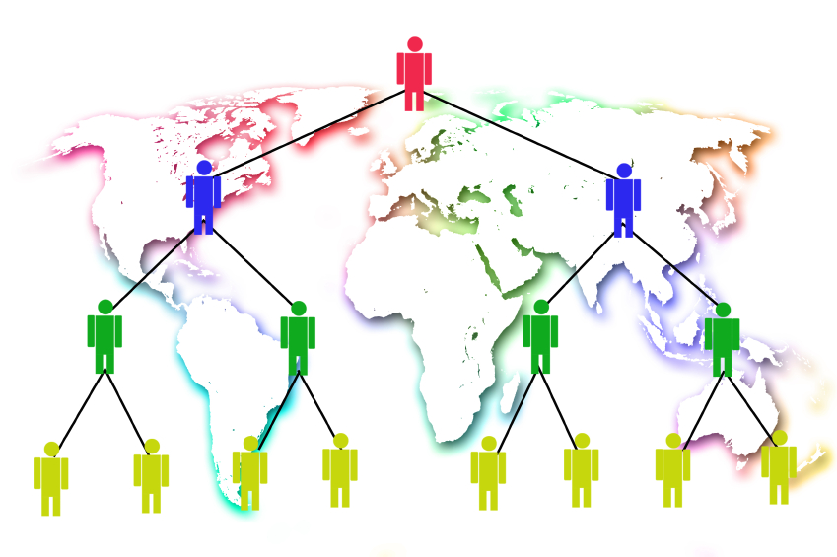
… critical for scale
True conviction among top leaders
Encouraging “both sides” of helping events
Reinforce norms with formal processes and roles (e.g. design reviews)
Leave slack in employee’s schedules

Slide 28

#3 Recruit friends

Slide 29

Leaders model the behavior
“No involvement by leaders,
no commitment by employees.
No exceptions.”
Vala Afshar, Chief Marketing and Customer Officer at Enterasys

Slide 30
Tips for getting leaders engaged
Jams – targeted, real time collaboration
Focused messaging – e.g. travel logs
“Like” what ever they do
Make it easy
Mobile
Start where they are: keep it in the comfort zone
Encourage leaders to say “thank you”
Find an ally – it only takes one … with one success

Slide 31

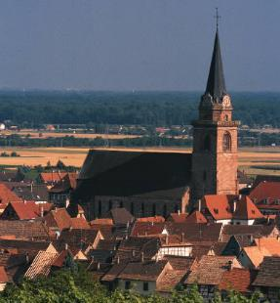

It takes
a village

Slide 32

Champions
Encourage and promote people and conversations
Monitor conversations
Curate stories
Celebrate successes
Handle negative situations
Educate and welcome
Nurture members – inspire engagement
Remove roadblocks

Slide 33

Who makes a good champion?
Strong organizational and multitasking skills
Approachable, empathetic, and patient
Inspired by people
Inspires others
Transparent and diplomatic
Expertise or experience in the community subject area
Confident and passionate about the vision
Comfortable with technology

Slide 34

Why does this work?
Nothing happens without a readiness to change.
It’s important to replace old habits with new ones.
Peer support and pressure drive change.
Sponsorship deepens commitment and sparks results.
Community without hierarchy is a catalyst for change.
You are the company you keep.
Continuous introspection is key.
Changes in practice may represent breakthroughs.
It pays to acknowledge small wins.
The goal is progress, not perfection.
Harvard Business Review: Managing Change One Day at a Time, July-August 2014
http://hbr.org/2014/07/managing-change-one-day-at-a-time/ar/1

Slide 35
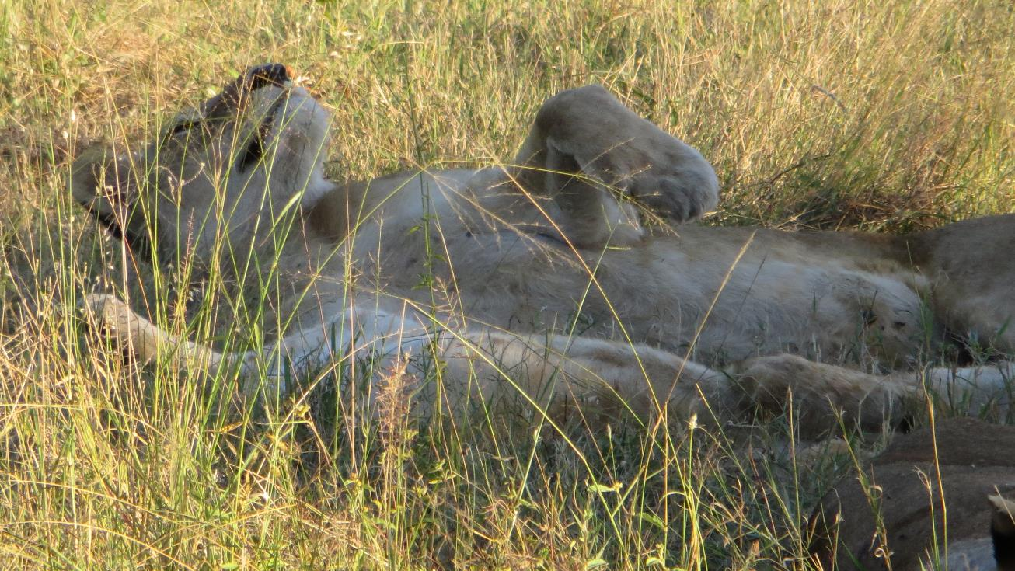
#4 Understand the comfort zone for your users

Slide 36
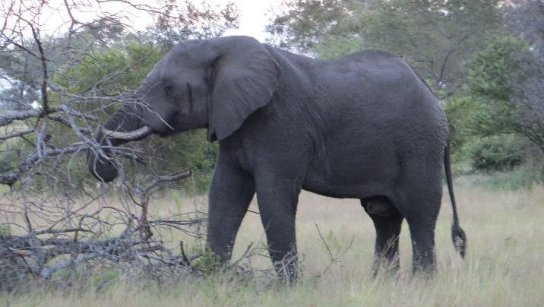

If you want to remove a big barrier to getting people to engage with social tools, find a way to keep your users in their COMFORT ZONE,
even if it’s only just to get started.

Slide 37

Case Study: E-mail Integration
Organizational Goals
Engage congregations in communities of practice focused on expanding the reach of the Union
Build inventory of practices and expertise on core topics
Help congregations function better as sacred communities by providing opportunities to collaborate with others
Initial Solution
The Tent: Extranet
Community Sites based on Office 365
Connect different groups by role (Temple Administrators), by topic (Fundraising), or by attribute (small congregations)

Slide 38

So, what happened?
They had the right stuff …
The initial reality …
Existing solution no longer supported – so people have to change
New solution provided enhanced functionality – especially SEARCH
Existing communities – both in real life and online – with real need to connect
Designated moderators to support and engage

Slide 39

Until, … access with existing ID via email

Slide 40

What makes a good post? What business scenarios should you post about?
Provide simple guidance about what is OK and what is not OK
Provide “what goes where” examples
#5 Show me!

Slide 41
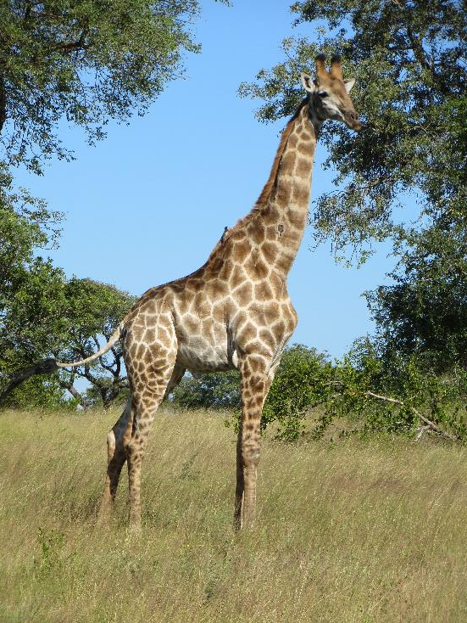
Tips from Stan Garfield at Deloitte Global Services:
Share a link. “Here is a link to the latest Forrester Wave report on social networking.”
Ask a question. “Has anyone encountered this problem before, and if so, how was it solved?”
Find a resource. “Looking for a specialist in retirement benefits to help win a bid in Calgary.”
Answer a post. “Here are links to three relevant quals in the quals database.”
Recognize a colleague. “Thanks to @dpalmer for hosting an excellent planning session today.”
Inform about your activities. “Will be in the Philadelphia office today; does anyone wish to meet?”
Suggest an idea. “Local office TV screens should display the global Yammer conversation stream.”

Slide 42
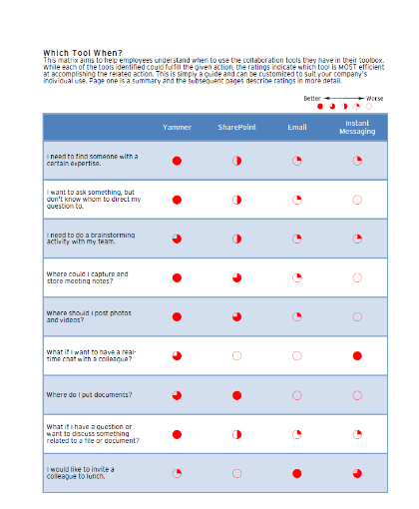
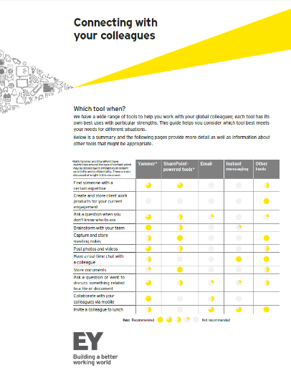
Share “which tool to use when”
https://www.yammer.com/itpronetwork/uploaded_files/31720747
https://www.yammer.com/itpronetwork/uploaded_files/32178728

Slide 43

Clear, simple guidance to change habits
Private
Assign a Task
External
Q & A
Not sure who knows
FYI

Slide 44

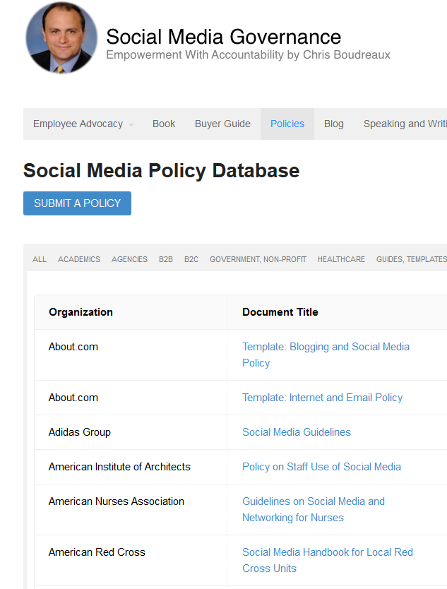
Social moves quickly … have governance guidelines in place before situations arise
http://socialmediagovernance.com/policies/

Slide 45


Slide 46

Don’t underestimate
the importance
of training

Slide 47
Breaking down the barriers
Not aligned with our culture
Too many competing priorities
Lack of proven business case
Engage and nurture champions … and leaders
Make it easy
Promote great stories
Embrace the comfort zone
Align where work gets done
Engage and nurture champions … and leaders
Provide examples
Train!
Start with a meaningful business problem
Measure what matters
Collect and share stories … all the time … at every opportunity
Don’t think it has to be only you – get your village universe to help!

Slide 48

It’s not a sprint, it’s a journey …
You don’t need 100% adoption to be successful – you need meaningful outcomes
Align where work gets done – and you’ll get those outcomes
Lead the way – with champions, community managers,mentoring, and training
Be patient – change takes time but it also takes passion and sustained effort

Slide 49

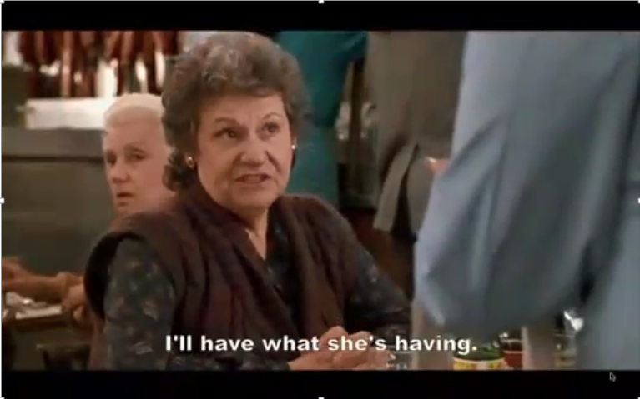
… to get to this moment …

Slide 50
… it’s evolution, not a revolution!

Slide 51
Resources
Office 365 Network > Yammer & Enterprise Social Group
https://about.yammer.com/yammer-blog/tips-guides
https://about.yammer.com/success/engage/
Successful Social Intranets: Creating business value through strategic alignment and adoption planning http://www.digitalworkplacegroup.com/resources/download-reports/successful-social-intranets/
Moving Beyond Marketing: Generating Social Business Value Across the Enterprise, MIT Sloan Management Review, July 14, 2014. http://sloanreview.mit.edu/projects/moving-beyond-marketing/
Deloitte research white paper “Social software for business performance - The missing link in social software: Measureable business performance improvements.”
http://www.deloitte.com/assets/Dcom-UnitedStates/Local%20Assets/Documents/TMT_us_tmt/us_tmt_ce_socialsoftware_fullreport_0209111.pdf
IDEO’s Culture of Helping, Harvard Business Review, January-February 2014 http://hbr.org/2014/01/ideos-culture-of-helping/ar/1
Managing Change One Day at a Time, July August 2014, Harvard Business Review. http://hbr.org/2014/07/managing-change-one-day-at-a-time/ar/1

Slide 52
Resources
User Adoption Strategies: Shifting Second Wave People to New Collaboration Technology by Michael Sampson
Essential SharePoint 2013 by Scott Jamison, Susan Hanley, and Chris Bortlik
http://www.zdnet.com/article/the-growing-evidence-for-social-business-maturity/
http://www.mckinsey.com/insights/organization/building_the_social_enterprise
http://www.mckinsey.com/insights/high_tech_telecoms_internet/six_social-media_skills_every_leader_needs
http://www.mckinsey.com/insights/high_tech_telecoms_internet/the_social_economy
Prove It: Using Analytics to Drive SharePoint Adoption and ROI
Improve It: second edition of Prove It. Due out May 2015. Major focus on enterprise social metrics and adoption.

