Slide 1
We built it, why won’t they come?
Practical advice to overcome user adoption and change hurdles
Susan Hanley
Susan Hanley LLC

Slide 2

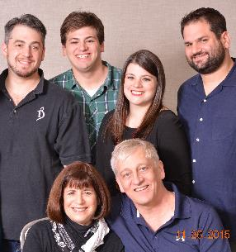



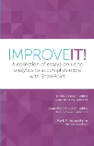

About Me
President, Susan Hanley LLC
National Practice Lead: Portals, Management Collaboration, and Content practice at Dell
Director of Knowledge Management at American Management Systems
Information Architecture
User Adoption
Governance
Metrics
Knowledge Management
Intranets & Portals
Collaboration Solutions
www.improveit.how
sue@susanhanley.com
susanhanley
www.susanhanley.com
www.networkworld.com/blog/essential-sharepoint

Slide 3
User Adoption
User Engagement

Slide 4

But wait, then why are we here?
Tip # 1: Adoption is not the end game
RESULTS

Slide 5
Results mean …
The average time to on-board a new employee went from 3 months to 3 weeks
Customer satisfaction scores increased by 20%
Average profitability per client engagement increased by 10%
Revenue increased by 10% with no increase in headcount
RESULTS
ADOPTION

Slide 6



We built it, why don’t users just come?
Adoption rarely happens all at once
WIIFM
The solution has to be worth adopting

Slide 7

Tip # 2: Adoptable solutions solve measurable problems

Slide 8

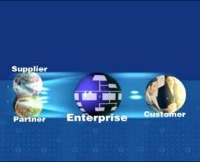
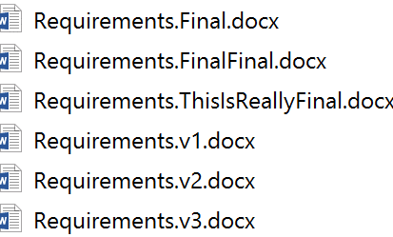
Real World Collaboration Challenges
Curing Versionitis
Finding Expertise
Sharing with Partners and Customers

Slide 9



More Collaboration Challenges
Collecting and Tracking Information
Managing Tasks and Projects
Keeping People Informed

Slide 10

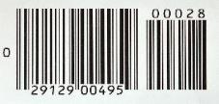


Real World Enterprise Social Challenges
Sales
Product Development
Resource Planning
Customer Support
Sales team on-boarding
Sales team training and mentoring
Engineer struggling with a problem – find answers quickly
Feedback “crowd-sourcing”
PM looking for the most qualified resources for a project – expertise location
Services agent working trying to solve an unusual customer problem
“Organic” knowledge base

Slide 11



Engaging content
Accurate, useful, timely, relevant
Well written
Written for the web

Slide 12

Tip # 3: It’s personal

Slide 13
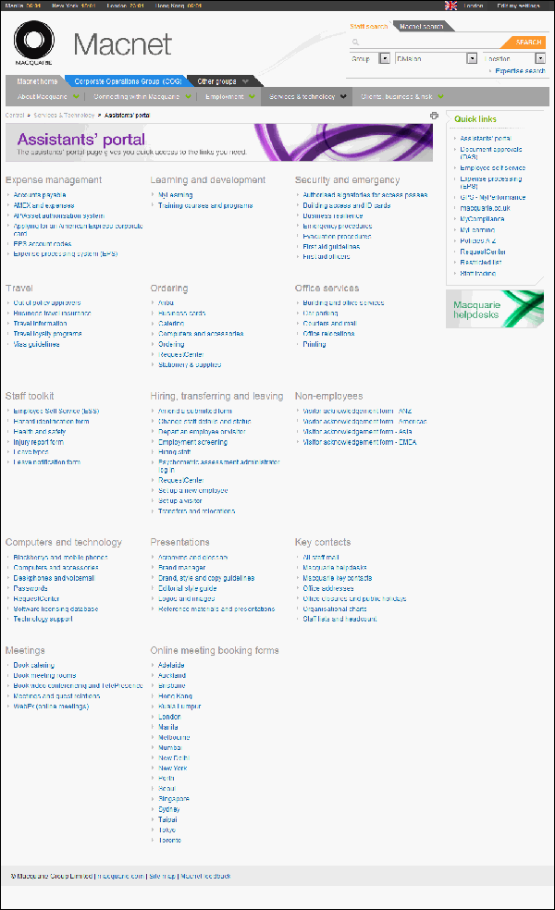
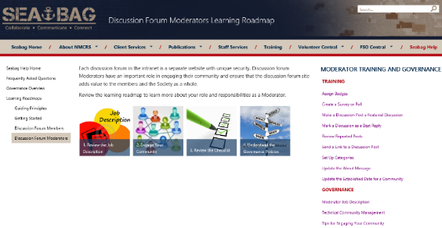
All about my ROLE!

Slide 14
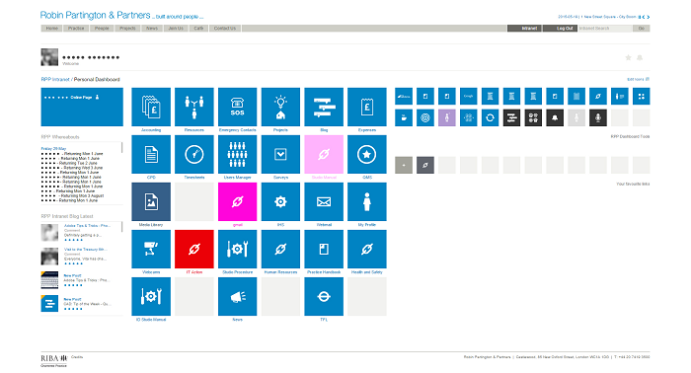
“Our intranet is a tool which allows us to make business decisions therefore it cannot be overcomplicated or distracting, making our designs concise, sharp and distinct.”

Slide 15

Tip # 4: It’s about change

Slide 16


Why is change so hard?
You
Deep experience with technology and concept
Seeing the solution for the first time
Recognize the need for the solution
Possibly unaware or unconvinced of the need
Convinced the product works
Skeptical about whether the product works
“Customer”

Slide 17
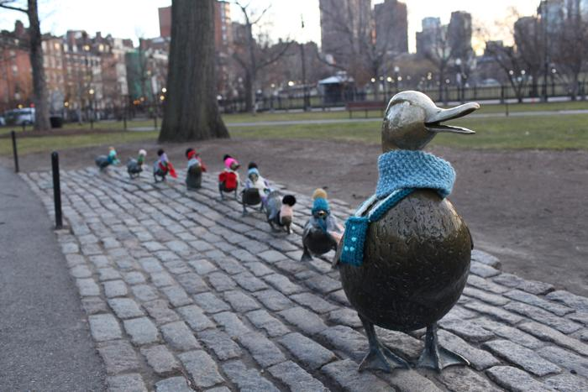
The
9X Effect
A new product has to offer a 9 X
improvement over the existing solution in order to be immediately or easily adopted.*
*Gourville, John T., “Why Consumers Don’t Buy: The Psychology of New Product Adoption.” Harvard Business School Note #504-056 (Boston: Harvard Business School Publishing, 2004).

Slide 18
Ease in to change …
Start small
Keep it simple
Consider your culture
Consider the “long wow” – help users create new habits

Slide 19
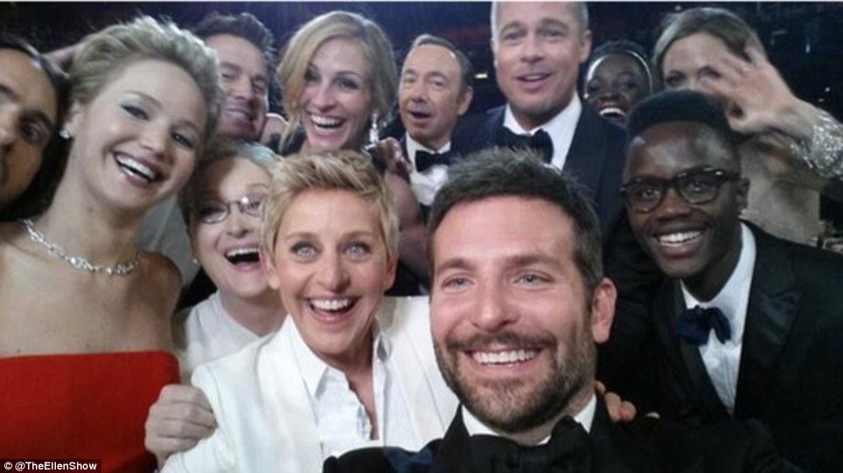
Tip #5: Engage some helpers

Slide 20

Leaders model the behavior
“No involvement by leaders,
no commitment by employees.
No exceptions.”
Vala Afshar, Chief Marketing and Customer Officer at Enterasys

Slide 21

But it’s not just the leaders …
Identify and engage your Mikeys

Slide 22

“Organizations can’t change their culture unless individual employees change their behavior – and changing behavior is hard.
Many change programs focus on providing strategies, technologies, and training – but often this is not enough.
When it comes to modifying deeply ingrained behavior, 12-step programs have a superior track record.
They use incentives, celebration, peer pressure, coaching to adopt new habits, negative reinforcement, and role models – things organizations can draw on.”
Harvard Business Review: Managing Change One Day at a Time, July-August 2014
http://hbr.org/2014/07/managing-change-one-day-at-a-time/ar/1

Slide 23

Tip # 6: It’s all about comfort

Slide 24



Plan a training roadmap – for comfort
Don’t assume it’s intuitive
One size does not fit all
Don’t try to train all at once

Slide 25

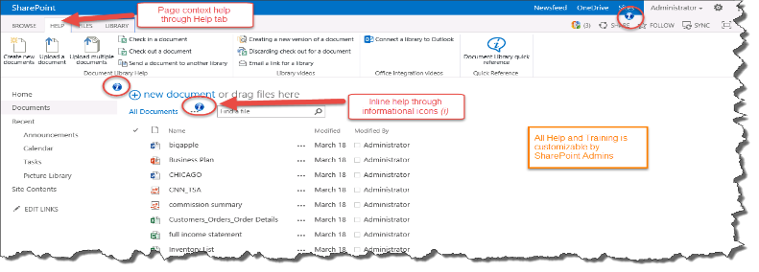
Just-in-Time/In Context Training
Context sensitive Help items:
Videos | Images/Screenshots
Documents | Links
    www.visualsp.com

Slide 26


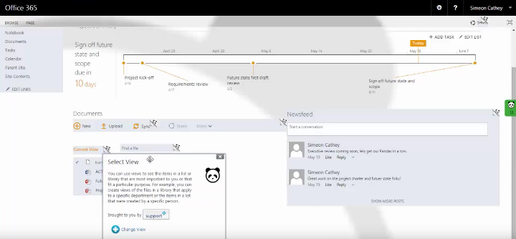
Just-in-Time/In Context Training
    www.contentpanda.com

Slide 27

Train teams together

Slide 28

Tip # 7: It’s about communications

Slide 29

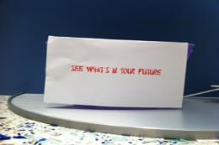

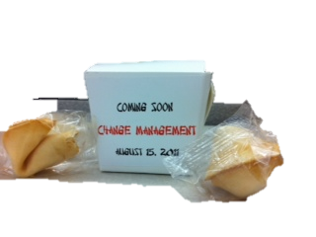


Launch ideas that worked … mostly

Slide 30

Photo Booth

Slide 31

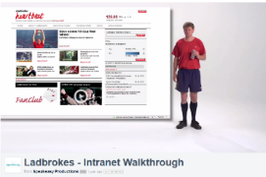
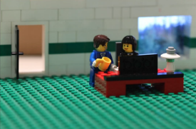
Launch Videos
http://www.scoop.it/t/intranet-launch-videos-and-teasers - comprehensive collection compiled by Ellen Van Aken
Additional examples: http://tiny.cc/ThreeSampleVideos
http://www.youtube.com/watch?v=PN1IyDvyA2o
MAN Diesel
http://vimeo.com/60729239
http://youtu.be/SinFM8hNcOg
Dartmouth-Hitchcock Intranet Home Redesign – watch the end for outtakes

Slide 32
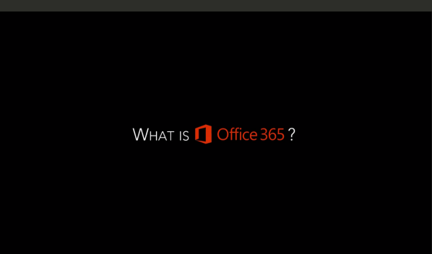
What is Office 365 Launch Video (Regis)
https://vimeo.com/regiscorp/review/125078501/68cd7832a8

Slide 33


Persistent communications that worked
30 for 30
Intranet Learning Cafés
(with great coffee)
Get Sharp on SharePoint

Slide 34
Other ideas for your communications plan
Create (and use) an “anecdote” bank
Regular “on site events” – Polls on Mondays, Conversation Topic of the Week on Tuesdays, Employee Spotlights on Wednesdays, Trivia on Fridays
Leverage existing meetings and events
Target your messages
Did you know …? (tip of the day)
Portal Minute at the start of company meetings
Weekly recap
“Look what they did” success stories
Cafeteria table toppers
Message board/break room announcements or posters
Desktop wallpaper
Usability testing

Slide 35

Tip # 8: It’s about support

Slide 36



It takes a village
Seed the organization with evangelists
Plan ongoing support
Make sure the help desk is prepared
  Pilot team
  Volunteers
  Employee advocates
  Office Hours
  Center of Excellence
  (Just-in-Time) Training and Documentation

Slide 37
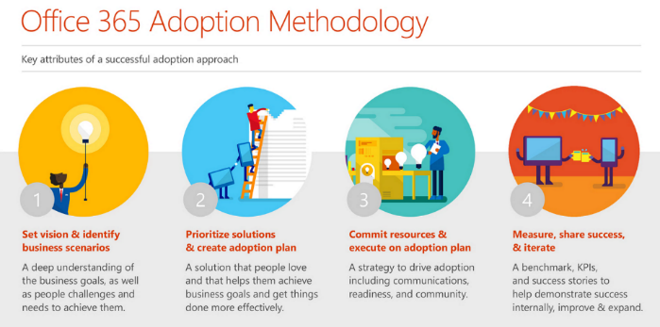
You are not alone – lots of help from Microsoft: fasttrack.office.com

Slide 38
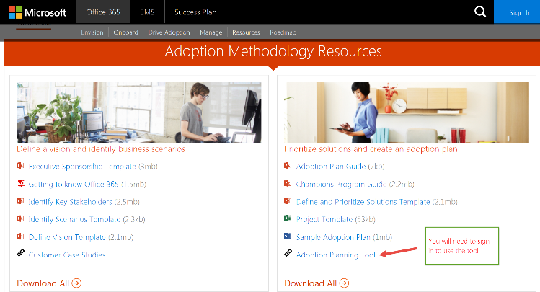
Adoption Planning Tool
fasttrack.office.com

Slide 39

Tip # 9: Don’t forget the fun!

Slide 40
Incentives and rewards help kick-start
Scavenger Hunt
Points, Badges, Prizes
Five for Five
“Profile Week”
FOOD!

Slide 41



People-based scavenger hunt
https://www.thoughtfarmer.com/blog/pennstate/

Slide 42


Fun with food
SharePointoberfest - inebriate while you collaborate!
CollaBOOration - A Ghoulish Guide to Metadata
SharePointgiving –
Give thanks to document workflow and approval

Slide 43

Recognition and rewards must
align with desired outcomes

Slide 44
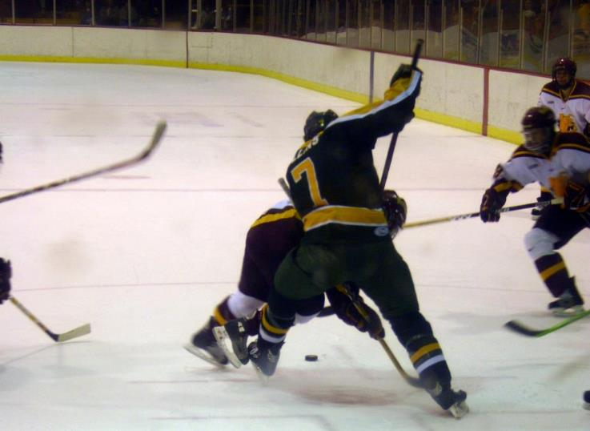
Take a lesson from hockey –
don’t just track goals, also track and encourage assists

Slide 45

Tip # 10: It’s about listening, and …

Slide 46
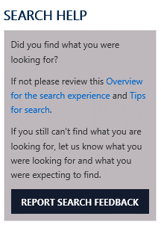


...allow users to provide feedback …
Feedback identifies challenges
Ask for feedback-everywhere
Conduct
usability tests,
LISTEN and OBSERVE

Slide 47

… but don’t be afraid to enforce

Slide 48

Tip # 11: You’re never done

Slide 49

Not everyone will be happy (initially) - look for the wins!
Keep it “organic” - have a plan for change.
It’s not “once and done.”

Slide 50

Tip # 12: It’s about sharing

Slide 51












The Tips
Adoption is not the end game
Adoptable solutions solve real problems
It’s personal
It’s about change
Engage some helpers
It’s about comfort
It’s about communications
It’s about support
It’s about fun!
It’s about listening, but …
You’re never done
It’s about sharing

Slide 52


Slide 53
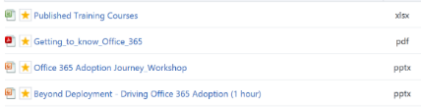
User Adoption Resources
General
  Read User Adoption Strategies: Shifting Second Wave People to New Collaboration Technology by Michael Sampson
  Jakob Nielsen’s Alertbox: http://www.useit.com/alertbox/ (Current Issues in Web Usability)
    Reference article about social features on intranets: http://www.nngroup.com/articles/intranet-social-features/
SharePoint and Office 365
  Fasttrack.office.com
  Office 365 Network on Yammer: Driving Office 365 Adoption group
  Essential SharePoint 2013
  Practical Framework for SharePoint Metrics
  ImproveIT

Slide 54
Thanks for watching!

