Slide 1


Taming the Wild, Wild West: Creating a Practical (and Consumable) Governance Plan
Susan Hanley
SharePoint Fest DC
April 9, 2015
www.susanhanley.com

Slide 2

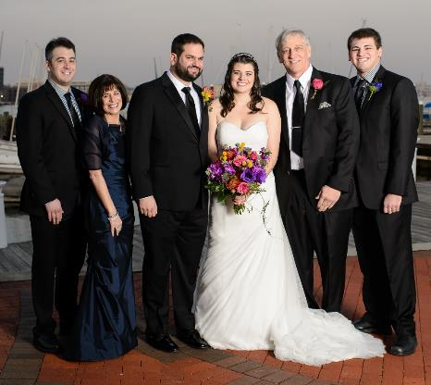

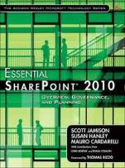
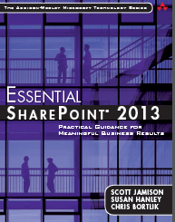



About Me
President, Susan Hanley LLC
Led national Portals, Management Collaboration, and Content practice for Dell
Director of Knowledge Management at American Management Systems
Information Architecture
User Adoption
Governance
Metrics
Knowledge Management
Intranets & Portals
Collaboration Solutions
sue@susanhanley.com
susanhanley
www.susanhanley.com
www.networkworld.com/blog/essential-sharepoint

Slide 3
Agenda
What do we really mean by governance?
Preparing to develop your governance plan – asking the right questions
Making it real – communicating and monitoring - just in time, consumable governance in action

Slide 4



Governance =
Technology Assurance
(application management,
IT governance)
Information Assurance
Guidance

Slide 5

Why care about governance?
Business Results!

Slide 6

Most of the documents contained duplicative information.
One employee’s Social Security number was in 93 different non-password protected documents.
“The No. 1 reason this happens is because companies have so much historical data and they don’t even know where it is.”
Sony Hack Exposed Personal Data of Hollywood Stars
http://online.wsj.com/articles/sony-pictures-hack-reveals-more-data-than-previously-believed-1417734425

Slide 7



It really should be pretty simple … and directly tied to business goals …
Current State
Desired Future State – “manicured” and compliant!

Slide 8

… and aligned with the reach and importance of the information
One size does not fit all

Slide 9

Governance in Three Words
No Sharp Edges

Slide 10

Start with 4 key principles
Because that will drive how strict you need to enforce your rules
1. Align with business goals/
regulations

Slide 11
Start with 4 key principles
Because you shouldn’t have to invent everything new and you may need to
“design them in”
1. Align with business goals/ regulations
2. Align with existing policies

Slide 12
Start with 4 key principles
3. Understand existing teams and roles
1. Align with business goals/ regulations
Because people already have jobs and you may need to define new roles or relationships
2. Align with existing policies

Slide 13
Start with 4 key principles
3. Understand existing teams and roles
1. Align with business goals/ regulations
Because if job descriptions need to be changed, you’d better have some support
4. Engage with HR.
2. Align with existing policies

Slide 14

Put together the right team – small, inclusive, empowered
Put together the right team –
small, inclusive, empowered

Slide 15
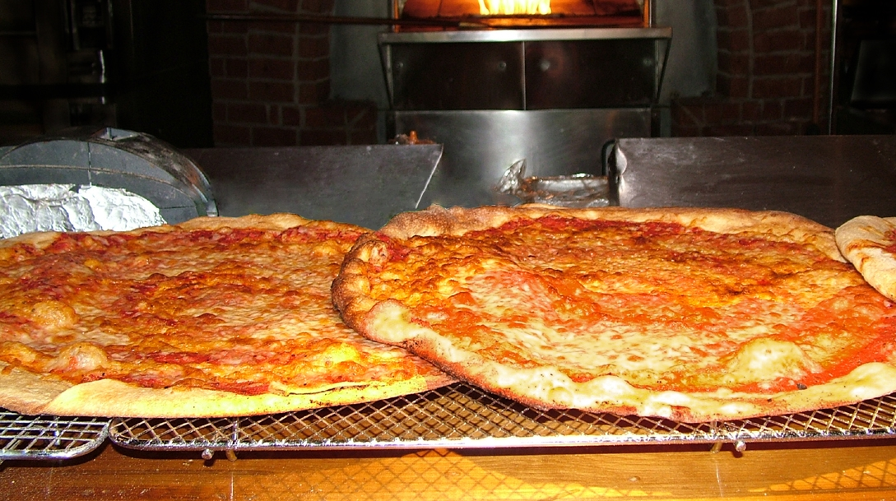
“If you can’t feed a team with two pizzas, it’s too large.”
Jeff Bezos, Founder of Amazon

Slide 16

Have the right conversations

Slide 17
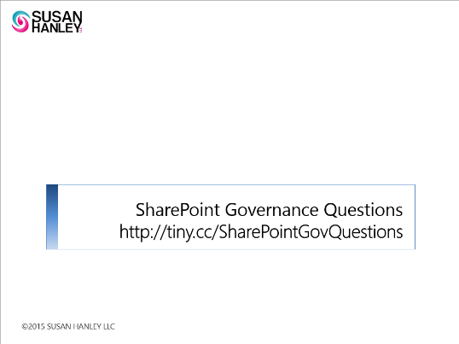
What types of overall corporate policies for information management, business, or technology management apply to the solution? Are there existing legal, IT and information management policies that SharePoint solutions must follow?
Use of IT Resources
Electronic Communications
Social Media Policy
Protection of Personally Identifiable Information
Records Management
How are these policies enforced in other systems? (Look for opportunities to leverage existing processes and have the conversation about how governance within SharePoint can be aligned with governance in other systems.
Is there an expectation around how often content or entire sites need to be reviewed to ensure that information is kept up-to-date and is reliable?
For example, is it required that all sites be “re-certified” on an annual basis?
For example, is it required that individual documents be reviewed on an annual or more frequent basis?
Do the same review requirements apply to all types of sites?
More than 100!
Updated Regularly
SharePoint-ish, but not exclusively
On prem and
cloudy
Governance Question | Decision
Suggestion: Add a third column for traceability and store the whole thing in a SharePoint list

Slide 18

Is there a penalty for non-compliance?
Is there a penalty for non-compliance?

Slide 19
Topic-focused Meetings – scheduled with appropriate attendees
Vision and Overview – Core Team
Enterprise Decisions – Core Team
  Compliance
  Training
  Access
  Provisioning
Enterprise Decisions – + Legal/Records Management
Records Management
Enterprise Decisions – + Communications + HR + Legal
  Personal Sites/Social Features
Enterprise Decisions – + Communications
  Branding and Functionality
  Information Architecture (Branding, Page Layout)
Enterprise Decisions – Core Team
  Information Architecture (Content Organization)
  Content Life-cycle Management
  Operational Decisions
Roles and Responsibilities – Core Team
Site/Solution-Specific Decisions – “Owners” of each solution
Vision and Overview: Core Team
Enterprise Decisions: Core Team
  Compliance
  Training
  Access
  Provisioning
Enterprise Decisions: + Legal/Records Management
Records Management
Site/Solution-Specific Decisions: “Owners” of each solution
Enterprise Decisions: + Communications + HR + Legal
  Personal Sites/Social Features
Enterprise Decisions: + Communications
  Branding and Functionality
  Information Architecture (Branding, Page Layout)
Enterprise Decisions: Core Team
  Information Architecture (Content Organization)
  Content Life-cycle Management
  Operational Decisions
Roles and Responsibilities: Core Team

Slide 20
My lessons learned about the “governance conversations”
Get the right people in the room
Distribute the questions in advance
No more than 2-3 hours per conversation
Not all in the same week, please

Slide 21


Two types of governance answers
POLICIES
GUIDELINES
Compliance-focused
Few
Enforceable
Automated compliance checking/prevention
Grounded in business value
Relevant to each user
Sensible
Delivered in context

Slide 22
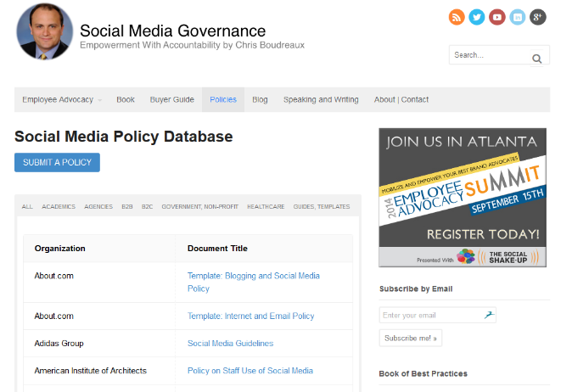
Examples of Enterprise Social Governance Plans
http://socialmediagovernance.com/policies.php

Slide 23


It takes
a village

Slide 24






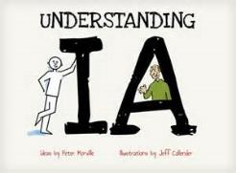


Enterprise SharePoint Roles
CKO
HR
Comms
Executive Sponsor
Steering Committee
Help Desk
Infrastructure Support/Admin
Coaches
CIO
Evangelists/ Moderators
IT Owner
Information Architect
Application Development
Training and Comms

Slide 25



Enterprise Intranet Roles
CKO
HR
Comms
We’re All responsible,
but the Owner is accountable.
Intranet Steering Committee
Intranet Business Owner
Managing Editors
Visitors
CIO
Information Architect
Intranet IT Owner
Content Authors
Training and Comms

Slide 26
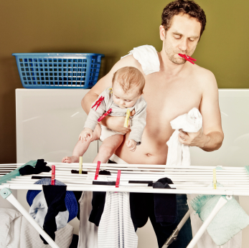
Who makes a good coach/evangelist?
Strong organizational and multitasking skills
Approachable, empathetic, and patient
Inspired by people
Inspires others
Transparent and diplomatic
Expertise or experience in the community subject area
Confident and passionate about the vision
Comfortable with technology

Slide 27


Got Team Sites? Then: Similar Roles for each site
Site Sponsor/ Business Owner
Solution Analyst
Content Authors/ Contributors
Site Manager/ Contact/ Editor
Site Visitors

Slide 28


How will you provide guidance and direction?
How will you
tell the story?

Slide 29
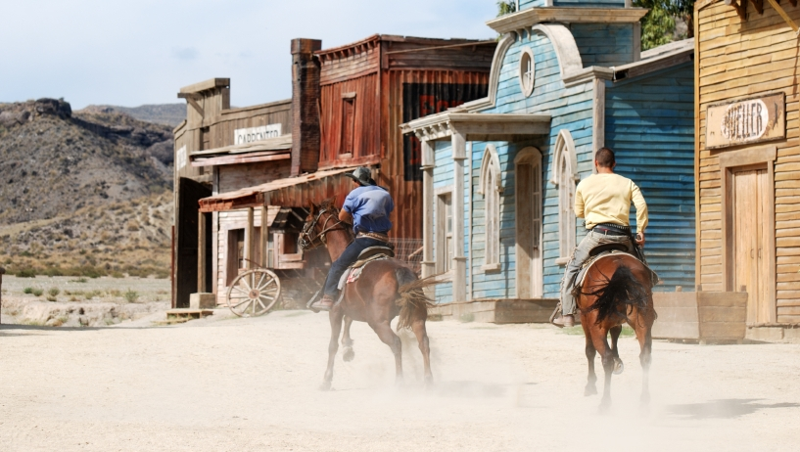


Typical Governance Plan

Slide 30
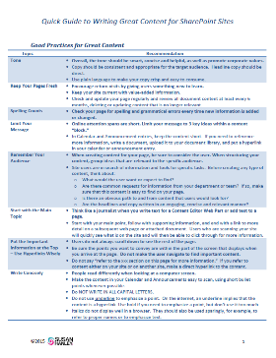
Principles of “Consumable” Governance
Automated – don’t make me think!
No big documents or long pages
“Quick Guides”
Integrated with training
Online and interconnected
Delivered in context
http://tiny.cc/SPContentAuthoring

Slide 31


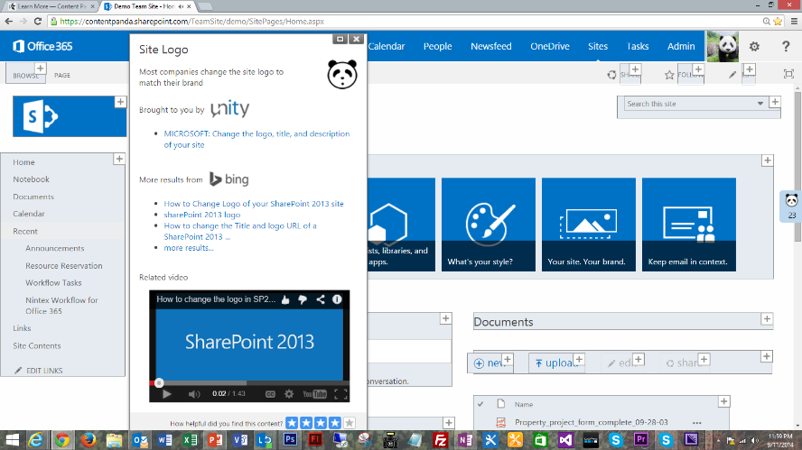
What does “in context” look like?

Slide 32

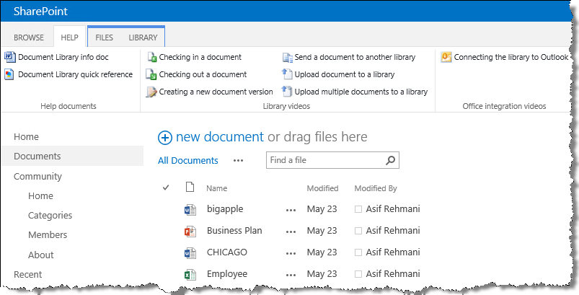
What does “in context” look like?

Slide 33
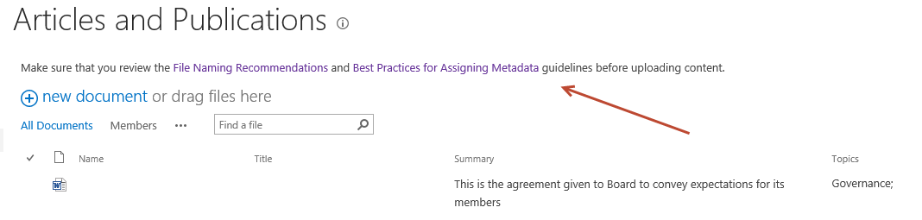
What does “in context” look like?
Link to governance about documents from the places where users upload documents

Slide 34
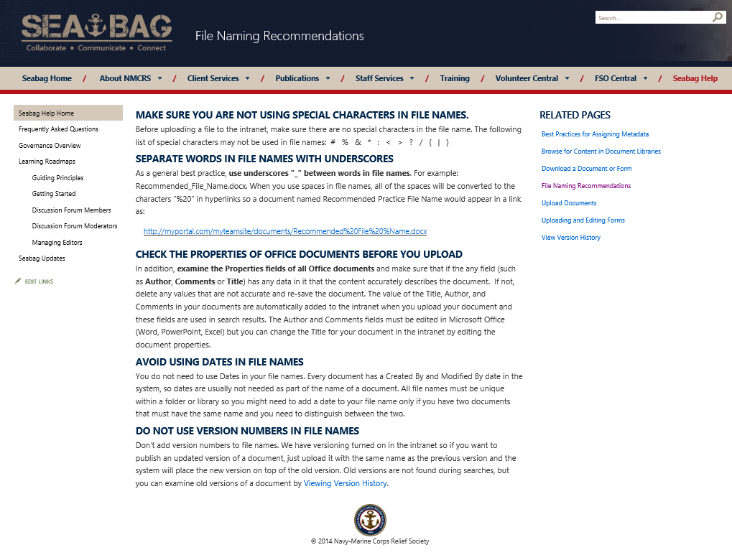
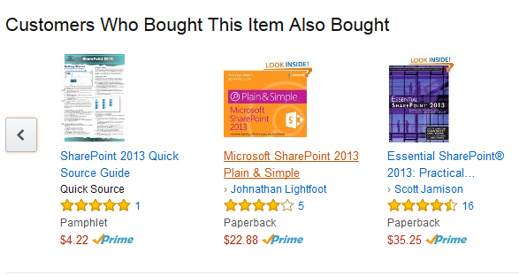
Small chunks of content

Slide 35
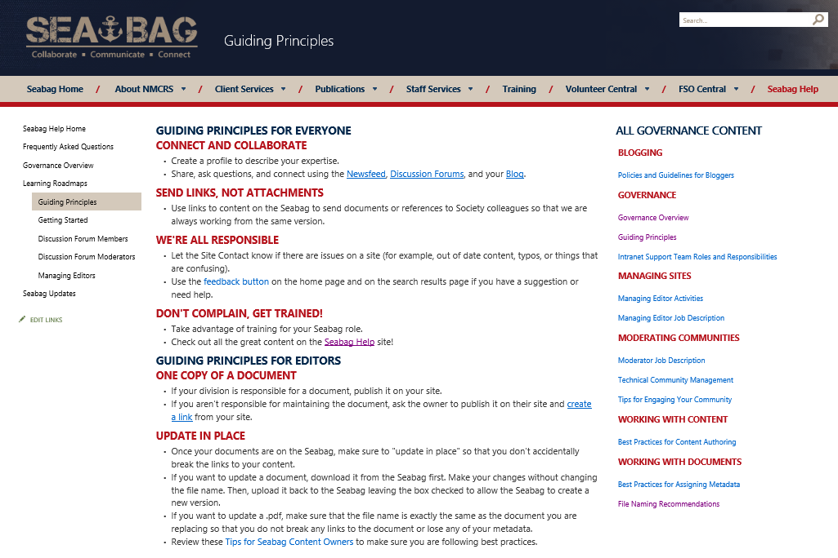
Short, consumable guiding principles

Slide 36
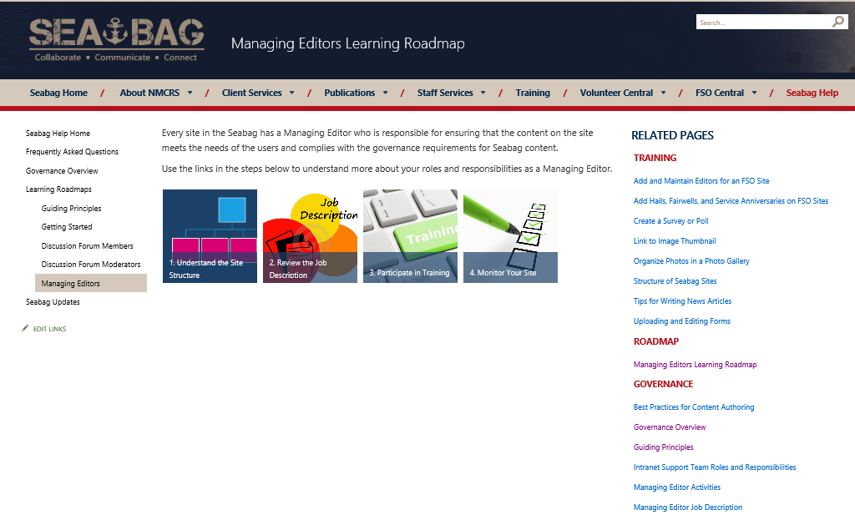
Context: Role-Based Roadmaps

Slide 37





Socialize, Promote, Verify
Socialize
Find Champions
Communicate persistently
Be responsive
to feedback
Trust,
but verify

Slide 38
… and incorporate into training
Governance
Training

Slide 39
Lessons Learned
It’s really about both assurance and guidance – and it takes COMMITMENT
No one cares about governance – until you make it all about them!
Less is more – avoid unnecessary bureaucracy – and long documents
Small chunks of consumable content – just in time!
Build best practices into your site templates and automate everything you can
A governance plan doesn’t replace training
… and training should include governance

Slide 40
Resources

Slide 41
Links
Governance Questions: http://tiny.cc/SharePointGovQuestions
Content Authoring Quick Guide: http://tiny.cc/SPContentAuthoring
Social Media Policy Examples
http://socialmediagovernance.com/policies.php
Detailed Instructions on How to Create a “Consumable” SharePoint Governance Site http://tiny.cc/SPGovStepbyStep
Governance Site (.wsp) http://tiny.cc/SPGovSiteTemplate
  Works only in Office 365 (see instructions on next page)

Slide 42
Using the Template (Office 365 Enterprise License Only)
Create a new Site Collection using the Team Site template.
Enable the SharePoint Server Publishing Infrastructure site collection feature.
From Site Settings, go to Galleries > Solutions and upload the .wsp file to the solutions gallery and activate it.
Go to Site Contents and create a New Subsite using the Governance Site Template (found in the Custom tab.) You can use all the default site settings.
Your new site will have a home page and 3 content pages. You will need to “re-point” the Related Pages web parts to the Site Pages library on your site per the instructions in this deck.
All of the Site Columns and Content Types described in this presentation will be there.

Slide 43
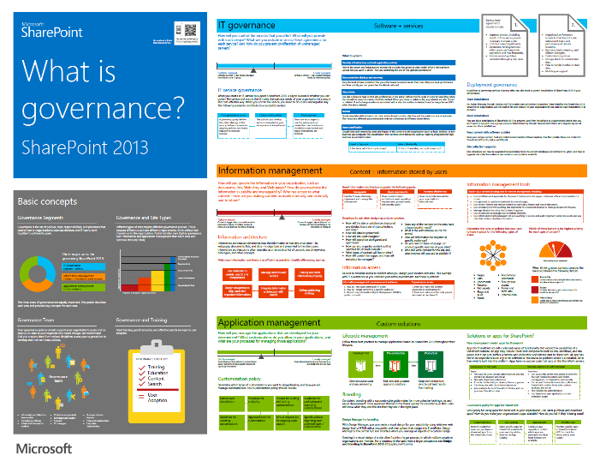
Microsoft Resources about SharePoint Governance
https://technet.microsoft.com/en-us/library/ff598584.aspx

