Slide 1

This is not your grandmother’s SharePoint site!
Exploring the New Community Site Template in SharePoint 2013
Sue Hanley
sue@susanhanley.com
@susanhanley
SPTechCon Boston
August 2013
©2013 SUSAN HANLEY LLC

Slide 2



Examples of business scenarios enabled with Community Sites
Moderated Support Forum
“Crowd-sourced” Knowledge Exchange
“New Starters” or Interns Community
Customer Community
Notes:
Moderated support forums are an example of where you might have previously used a traditional discussion list to allow people to ask and answer questions with both crowd-sourced and authoritative answers – such as Tech Support
A community for a role (Volunteers, Interns, New Employee) can also be helpful. URJ and NMCRS using to share best practices in crowd sourced knowledge exchange.
Knowledge exchanges are analogous to what the KM Community calls “Communities of Practice” or “Communities of Interest.”

Slide 3
Agenda
What is a community? What are we talking about?
How do communities drive business value?
How does SharePoint support communities (and how does Yammer fit in)?
What is in the Community Site Template?
What do I really need to know?

Slide 4

Groups of people who share a concern or a passion for something they do and learn how to do it better as they interact regularly
What is a community?
Etienne Wenger and Jean Lave, 1991

Slide 5




Communities make companies more adaptable
Engaged Employees
Increased Innovation
Better Communication
Improved Customer Experience
http://www.gallup.com/consulting/121535/employee-engagement-overview-brochure.aspx
Notes:
Why communities? Communities help reduce the FRICTION in organizations. Whether formal or informal, communities help break down silos and encourage the free flow of knowledge from the people who HAVE it to the people who NEED it.
According to Gallup, organizations in the top quartile for engagement have:
37% less absenteeism
18% higher productivity
25-49% less turnover
27% less employee theft
16% higher profitability
Source: http://www.gallup.com/consulting/121535/employee-engagement-overview-brochure.aspx

Slide 6
Successful communities blend offline and online to foster relationships
Monthly calls
Conferences
“Knowledge Sharing” Days
User groups
Innovation jams
Discussion boards
Face-to-face meetings
Notes:
SharePoint Communities can create one type of PLACE, but to be CLEAR, it often takes MORE than just ONLINE PLACE to build RELATIONSHIPS.
SIKM Leaders is a large and engaged community. They meet in person once/year and have monthly calls with invited speakers.
Innovation jams: facilitated online sessions pioneered by IBM

Slide 7
Communities are not Teams
TEAMS
COMMUNITIES
Driven by deliverables with shared results
Created organically with many objectives
Membership defined by task
Membership defined by knowledge
Roles for members remain consistent
Members take on new roles based on interest and need
… and you can enable Community Features on Team Sites if you want to
Dissolved when mission accomplished
Exists while members believe they can contribute or gain from it
Notes:
Until 2013, SharePoint’s templates were primarily focused on project teams, but also persistent team that meet most of these characteristics.
But look at the criteria for a community of practice – these are not the same as project teams, communities are not necessarily defined by deliverables, they are fundamentally about sharing and exchanging knowledge and expertise.
The new Community Site template was designed to recognize this – to create a different type of online collaboration space for people with a shared interest or expertise.
These are not RULES, but general characteristics.
Teams, on the average, are SMALLER than Communities. BUT, that doesn’t mean that you don’t want a discussion board on your team site – when it comes to Team Sites, you actually have two choices – a SITE FEED or a DISCUSSION BOARD. You want to choose 1, but not both.

Slide 8

SharePoint 2010 provided support for Communities
… but SharePoint 2013 brings communities to life!

Slide 9


But wait …
Notes:
But wait, you say. Is there an elephant in the room? What about Yammer? Isn’t Yammer all about Communities?

Slide 10

SharePoint Community vs. Yammer Community
SharePoint Site
Discussion List
Gamification
Members
Categories
Community Site
Newsfeed replacement
Groups instead of Categories
Not yet fully integrated
Cloud-only

Slide 11
What is Microsoft doing internally?
Employees have options
  SharePoint Online Site
  Yammer Group
Teams that rely on document management prefer SharePoint Sites
Teams that are more focused on conversations lean towards Yammer
Increasingly -> Yammer feed inside SharePoint team site
Community Sites: moderated support communities (HR, legal affairs)
Notes:
Source:
http://www.zdnet.com/how-Microsoft-is-using-yammer-inside-the-company-7000014592/ (April 26, 2013)
http://blogs.msdn.com/b/microsoftenterpriseinsight/archive/2013/04/25/making-Microsoft-a-connected-enterprise-with-yammer-and-sharepoint.aspx

Slide 12
What’s in the Community Site template?
Discussion List
Join Feature
Categories
Members
About
Reputation/Gamification
Moderation

Slide 13
Discussion List – the main event

Slide 14
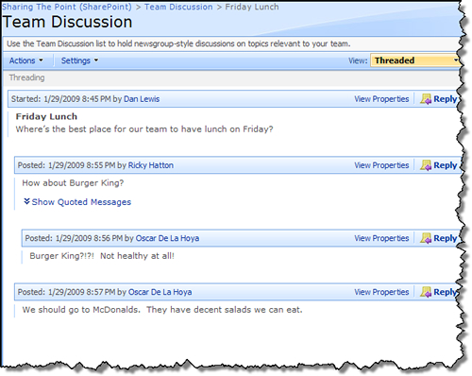
In case you forgot, here’s a Discussion List in SharePoint 2010
Notes:
Engaging, right? ☹ Not exactly.

Slide 15
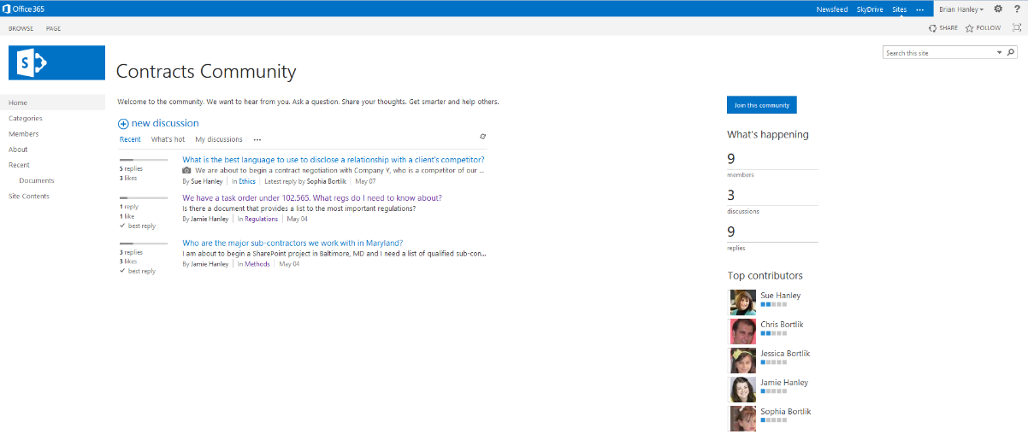
Become a member by joining
Built in views to look at different content
Easily monitor “health”
Content “reputation”
See who is engaged

Slide 16
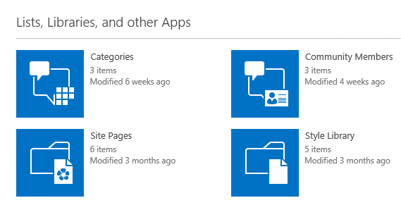
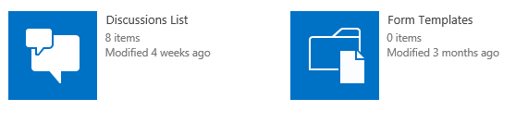
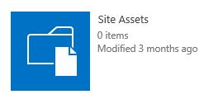
What do you get in the Community Site template?

Slide 17

What’s not in the template (at least not by default)?
Document Library
Notes:
If you expect that people will upload documents as part of their discussion QUESTIONS or ANSWERS, you SHOULD add a doc lib

Slide 18
Create and Join

Slide 19
Creating a new Community Site
New site collection or sub-site?
  Microsoft recommends new site collection because
    You never know which communities will take off and separate site collections are more scalable
    Some features only work if your community site is a separate site collection – e.g.“auto-approval”
But, you don’t have to – the Community Site template is available as a sub-site template

Slide 20
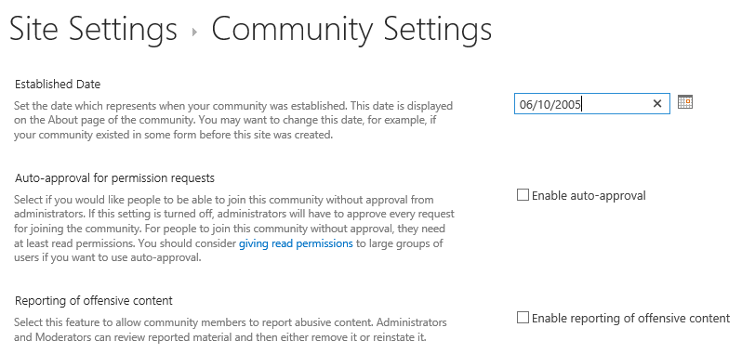
Community Settings
Only available if your community is an independent site collection
Auto-approval:
When a user joins, they are automatically moved from the Visitors to the Members group – and they automatically FOLLOW the site.
It’s OK to lurk. ☺
Share with READ if you enable auto-approval.

Slide 21
What does it mean to JOIN a community?
In unique site collections with auto-approval, you get moved from Visitors to Members security group.
In sub-sites or unique site collections, you are now FOLLOWing the site.
Your name and reputation appear in the Members view.

Slide 22
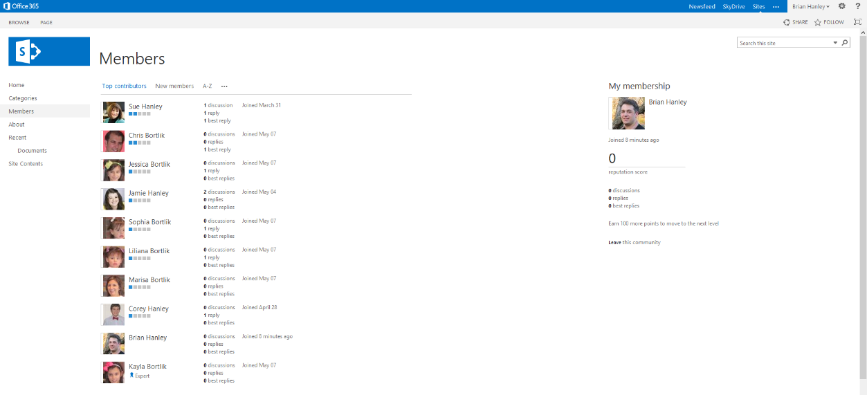
Notes:
People who have CHOSEN to join in an independent SITE COLLECTION. People who have joined OR made their first post in a SUB-SITE.
Not the same as Members security group.

Slide 23

Some additional ways a Community Site template is different from a Team Site template
Default permissions for Members group is CONTRIBUTE (not EDIT)
Sites created with the Community Site template automatically appear in the Community Portal (which is security trimmed)
New security group: Moderators
Oops – another type of Member
Notes:
Community sites have the security group called MEMBERS, but they also have a new list called Members. The Members list shows which users have explicitly joined the community – and just to make things REALLY confusing, Members in the Members list have nothing to do with Members in the Security group

Slide 24

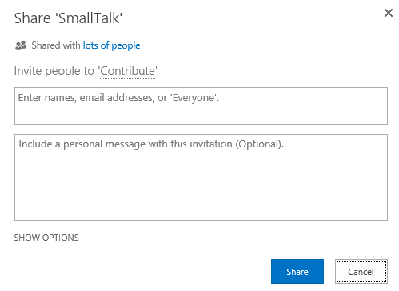
Set up best practice
Configure first
Then, invite users
Notes:
Share the site with other users only after you are done configuring. That way, the site will not be surfaced in the Community Portal while you are working on it.
Check to see if you are in the members list, since you created the site. If you are not really a member of this community, be sure to remove yourself before turning the site over to the Moderator.

Slide 25
If you create Communities as sub-sites …
Consider whether they are private or public.
  If public, Share with EVERYONE as Members. That way, anyone can post.
  If private, Share with the appropriate people as Members so that they can post.
Auto-approval doesn’t work, so if you want membership to have an approval process, you will need to enable that on the Discussion List.
Members security group does not equal Members list.

Slide 26
Post

Slide 27
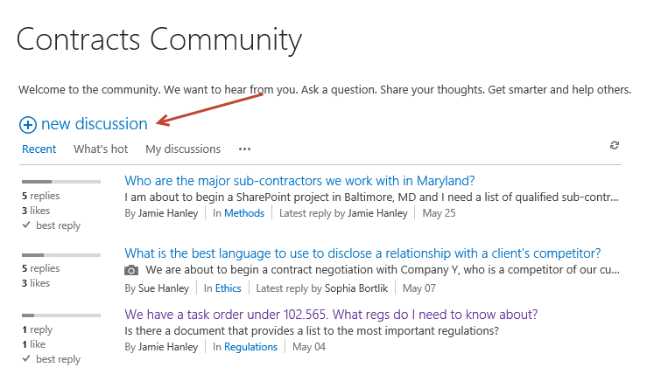
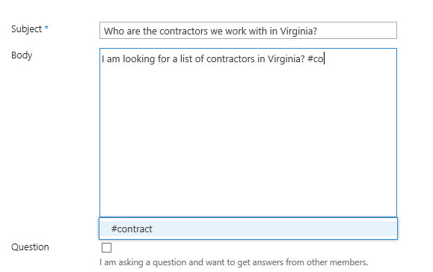
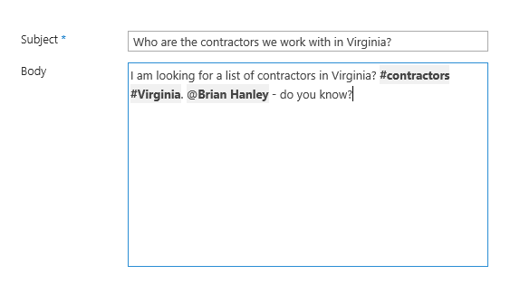
Posting is easy – no training required
… except for new concepts like #Hashtags and @Mentions if these are new to your users

Slide 28
Categories – focus the conversation

Slide 29
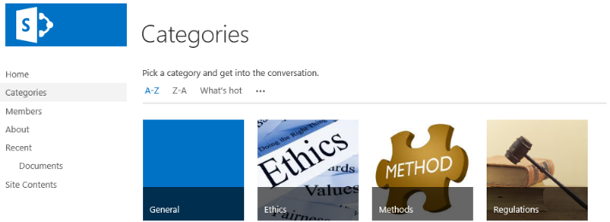
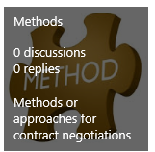
Categories
Categories provide a way to focus conversations
Set up by the Moderator or Site Owner
Each term can have:
  Category Name: 1-2 words
  Image: store in Site Assets
  Description: short phrase that explains the focus
Notes:
Tip: Categories sort in alpha order. If you don’t want General to show up first or in the middle, consider re-naming it to something like Unassigned.
SharePoint creates automatic views for all categories – and when you Feature a discussion or name it as a Best Reply, the only way to see it is from the Category view.

Slide 30
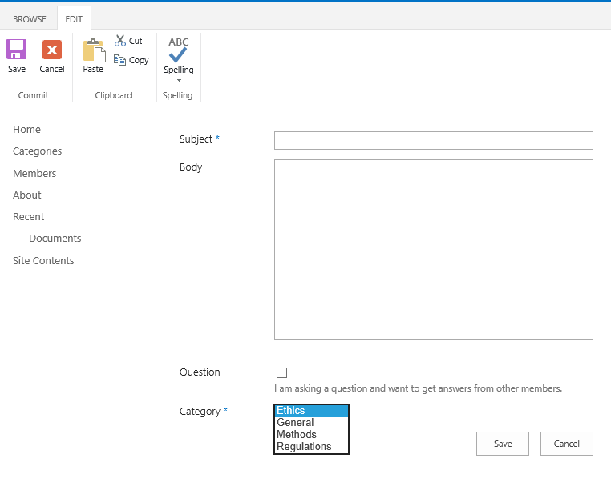
Categories show up in a dropdown for users (in alpha order). The first category is the default.
Notes:
Notice that General shows up in between Ethics and Methods – which is not really a good thing. There are a easy ways to avoid this:
Name the category (blank space) General so it sorts first.
Re-name it Unassigned or something that sorts at the end.
Adding a “sort order” column will not fix this so you just need to decide how much this matters. It really depends on how LONG the list of categories is.

Slide 31
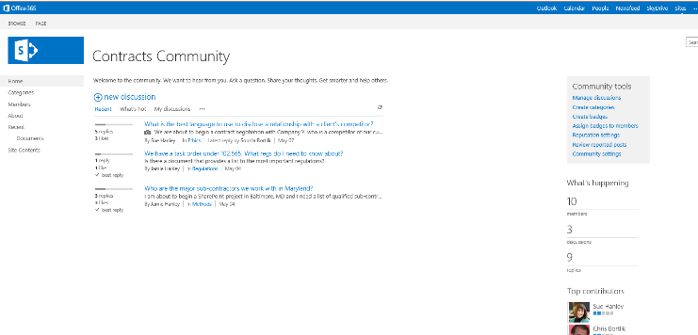
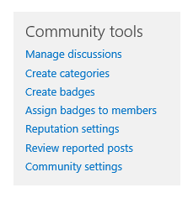
Moderators create and manage Categories from Community tools
Notes:
Community tools is a web part that only Site Owners and moderators can see.

Slide 32
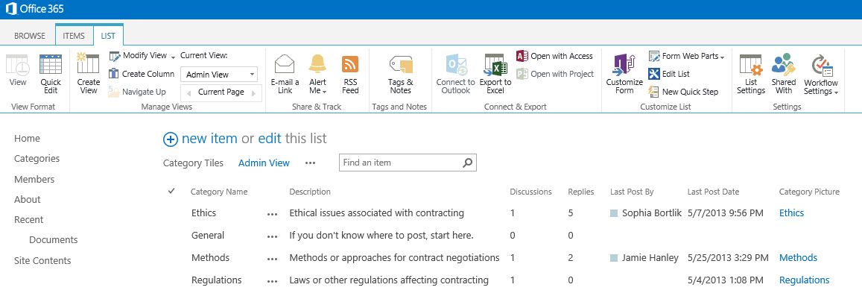

Slide 33
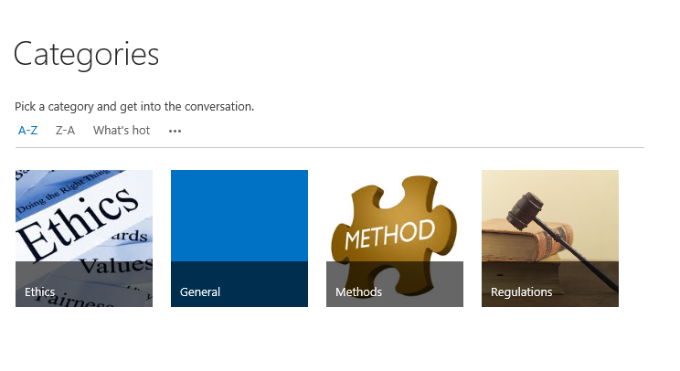
Category Tips
Rename the default “General” to something like Unassigned or “ General” to change the sort order
7 +/- 2
Go broad, not narrow - be sure names are clearly mutually exclusive

Slide 34
Reputation/
Gamification

Slide 35
Gamification and Communities
Gamification is the application of game elements and game mechanics to non-game problems, such as business and social impact challenges.
Notes:
Out of the box, the only place SharePoint 2013 supports gamification and reputation is with COMMUNITY FEATURES.

Slide 36
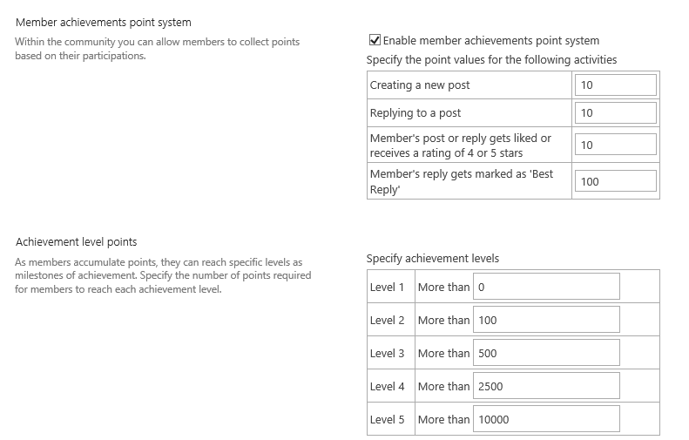
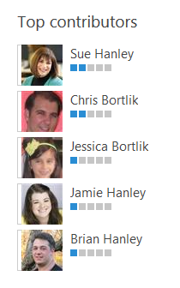

Game elements: Points, Badges, and Leaderboards
Notes:
I don’t have universal advice for what the points values should be, but here’s what we have learned:
Don’t award a lot of points for asking if you are primarily supporting a Q&A community.
If the goal is to get ANSWERS, bump up the REPLY values.
Consider bumping up LIKES and RATINGS – as long as you are comfortable that no one is going to “GAME the GAME.”
Be careful about even using the BEST REPLY feature – very often, there isn’t just one BEST REPLY.
However, you CAN ask moderators to summarize the “good answers” and then create a consolidated post that they will award the “BEST REPLY” status. That’s OK, as long as the consolidated post is written by the MODERATOR, who can have a GIFTED BADGE.
But, when you do that, be sure to add some LIKES or RATINGS to those answers that you used to create the “fake” BEST REPLY so that your contributors are recognized.

Slide 37
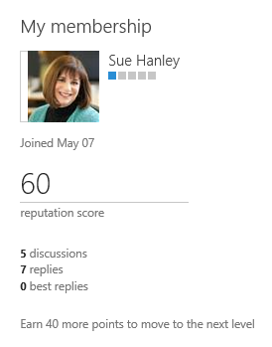
Members have earned or “gifted” reputation scores

Slide 38
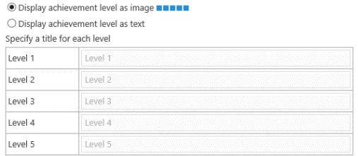
Is this appropriate for your Community objectives?
Only recognizes four events
  Create a post
  Reply to a post
  Post or reply gets liked or receives a rating of 4 or 5
  Post marked as “best reply”
No recognition for other contributions – like documents
Reputation is community-specific, not “rolled up” in the user profile
Limited achievement level representation (badges) without customization
You may want a third-party friend (e.g. Badgeville)
Notes:
Accenture has a very sophisticated (and custom) gamification approach. They use 5 levels of achievements:
Novice
Problem Solver
Expert
Master
Visionary
At AMS, we used another way of assigning expertise levels:
Knows About – You have information about the subject and can help direct inquiries.
Functional – You have used the discipline and can apply it to moderately complex problems.
Advanced – You have used the discipline extensively and can assist others in applying it to complex problems.
Expert – You are experienced in all aspects of the discipline and are able to develop creative solutions to complex problems. You can educate others.

Slide 39

Is gamification appropriate for your opportunity?
Motivation: Where would you derive value from encouraging behavior?
Meaningful choices: Are your target activities sufficiently interesting?
Structure: Can the desired behaviors be modeled through a set of algorithms?
Potential conflicts: Can the game avoid conflicts with existing motivational structures?
Notes:
Don’t just ASSUME that gamification is right for your scenario. Try, but learn about it first.
Bottom line for my clients: THEY ARE TURNING POINTS OFF. You pretty much get the same features with points on or off. They like the Leaderboard, but not the Points.

Slide 40

What do my clients like about “gamification” in their communities?
Notes:
Well for the most part, the HATE the concept. That said, what they really do like, at least in one very active community, is the easy ability to figure out who is dominating the conversation with inane questions or continuously answering just to hear himself talk.
BUT – you don’t need to enable points to see who is the most active. “Top Contributors” are tracked even when achievement points are disabled. The points just add a VISUAL to the chatter boxes.

Slide 41
Moderation – the key to successful communities

Slide 42
Communities need moderation/ management
Encourage and promote people and conversations
Monitor conversations
Curate stories
Celebrate successes
Handle negative situations
Educate
Nurture members – inspire engagement
Remove roadblocks
Manage the technical environment
Notes:
This is important – it’s less about the technical things that Moderators do and more about the organizational things that they do to keep the community ALIVE!

Slide 43
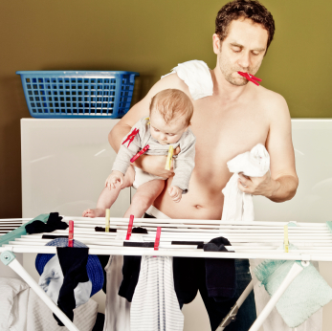
Who makes a good moderator?
Strong organizational and multitasking skills
Approachable, empathetic, and patient
Inspired by people
Inspires others
Transparent and diplomatic
Expertise or experience in the community subject area
Confident and passionate about the vision
Comfortable with technology
Committed
Notes:
Strong organizational and multitasking skills
Approachable, empathetic, and patient – interested in engaging with other members of the community
Inspired by people – willing to promote the success of others and, where necessary, work behind the scenes
Inspires others
Transparent and diplomatic – able to handle negative situations tactfully
Expertise or experience in the community subject area – but doesn’t need to be the top level Subject Matter Expert but is well connected
Confident and passionate about the vision for the community
Comfortable with technology – willing to invest the time to learn how to use the SharePoint community tools

Slide 44
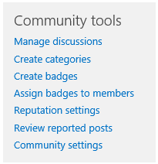

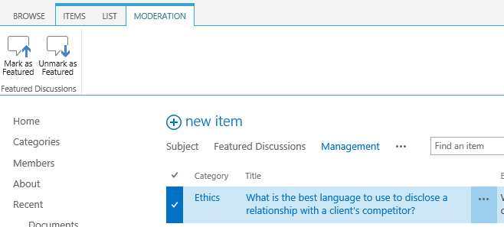
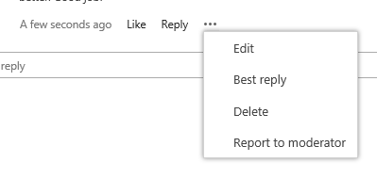
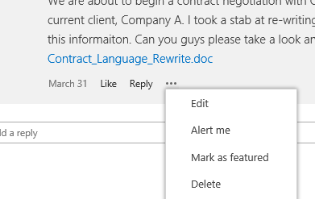
Moderators get special powers
Notes:
But, they will also need training – so don’t ignore this. Moderators have EDIT privileges on pages in your Community site. This can be dangerous if they don’t know how to use their powers.
It’s a bit like the Greatest American Hero – he had the suit but he didn’t know how to use it.

Slide 45
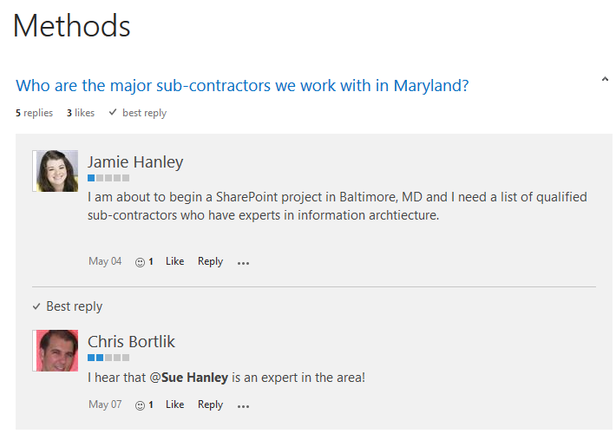
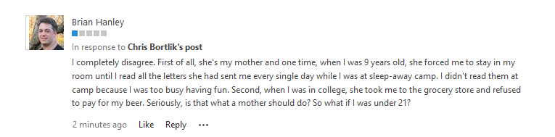
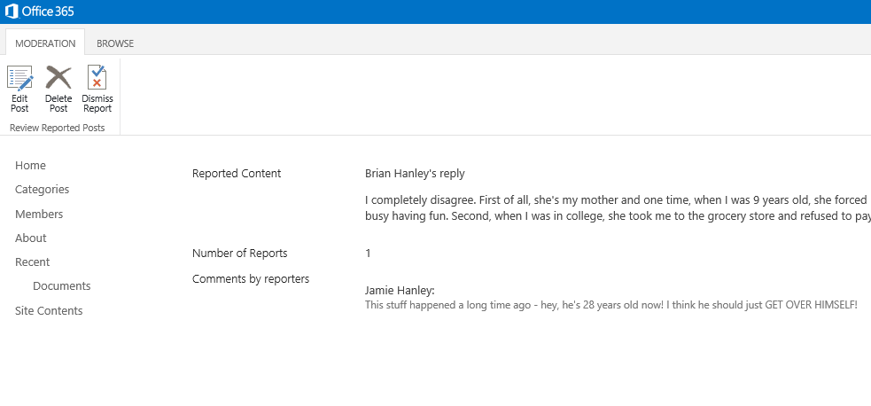
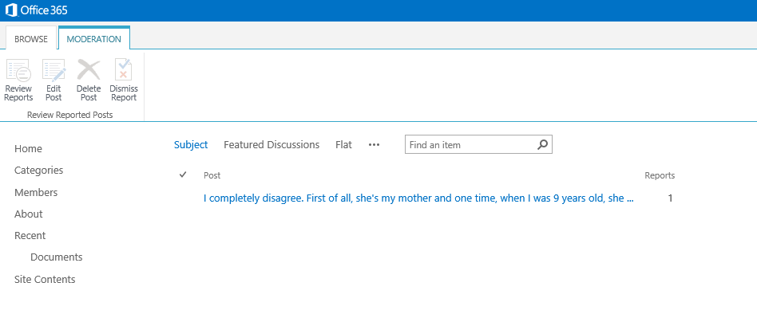
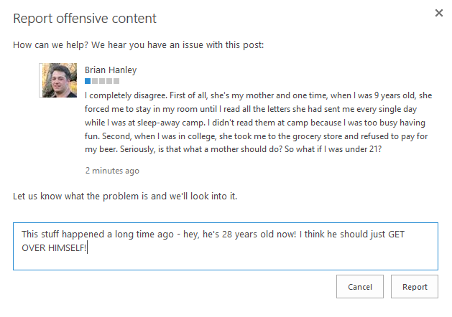
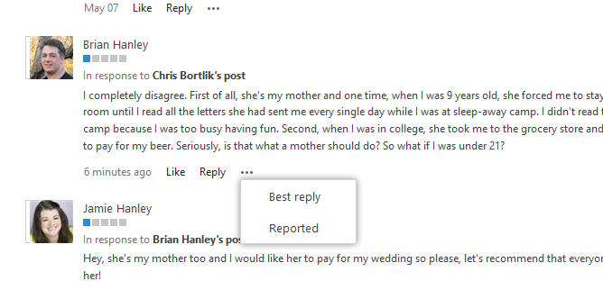
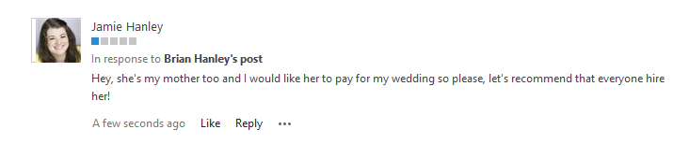
Moderators can also get alerted about bad behavior

Slide 46

Key to community success? Pay attention to the health of your community!
Notes:
In the KM space, we call this the sense of ALIVENESS of the community.
Communities that are “alive” do not always provide direct value to the organization (although this is usually the case), but they are without question providing value to the membership because the vibrancy of activity comes directly from member involvement.
One way assess the value of a community to its members is to conduct a periodic “health check,” looking for symptoms that indicate that the community may be in need of an intervention (not unlike a “shot in the arm”) or may be ready for dissolving or transforming.
The measures of community health are somewhat different depending on where the community is in its lifecycle, not unlike the measures of health in people, which may be different at different ages.
The health measures can be divided across three dimensions:
Sense of community: the “connectedness” of the members
Domain of practice: the knowledge domain covered by the community
Infrastructure and management support: the support elements critical to community survival.

Slide 47
Key take-aways
Use the Community Site template if it meets your business needs
Community Sites tend to be more successful if they are aligned with existing business communities – larger audiences are helpful
Communities are most successful with cultivation and nurturing by a committed Moderator
Communities are integrated – with search, documents, and with the Newsfeed (#hashtags and @mentions work in discussions just like the Newsfeed)
Gamification is ONLY about conversations – so be sure that what you get “out of the box” meets your needs
If you have too many communities, it’s hard to figure out where to go to have a conversation – so be careful about how many community sites you create
Understand how people work in your organization – if you are an email driven culture, encourage people to set up alerts on the discussion list in the communities in which they are a member or connect their community discussion lists to Outlook.

Slide 48


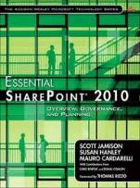
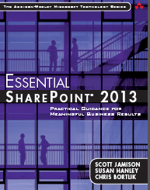


Independent consultant specializing in
  Governance
  User Adoption
  Metrics
  Information Architecture
  Knowledge Management
  Portals, Intranets, Collaboration Solutions
Led national Portals, Management Collaboration, and Content practice for Dell
Director of Knowledge Management at American Management Systems
sue@susanhanley.com
susanhanley
www.susanhanley.com
http://www.networkworld.com/community/sharepoint

Slide 49

Questions?

Slide 50
BONUS SLIDES

Slide 51
What if you want documents?
Super cool-ish feature if you add a document library

Slide 52
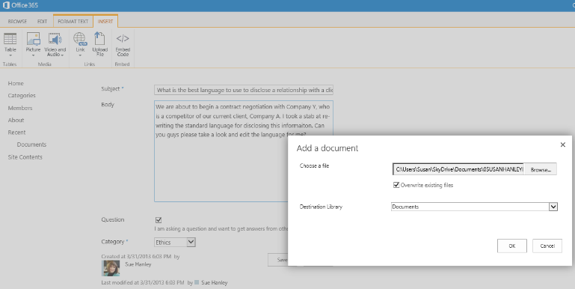
Create a discussion post where you want to add a document for reference
1. Create the post
2. Click Insert file

Slide 53
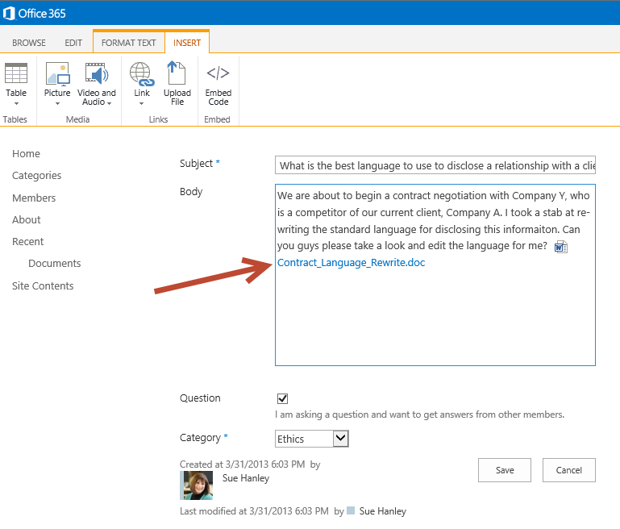
SharePoint automagically creates a link to the document in the discussion post
Notes:
Why is this so cool? Because it forces documents to be where they are supposed to be – in document libraries and not as attachments to lists!!
But, it’s not perfect:
When a user clicks on a document link in a discussion post there is a bit of good and bad:
User forced to download from the link (not the greatest experience)
A (not really practical) work around is to ask the poster to edit the source code on the post and add ?web=1 to the document URL to open in Office Web App
Another code-based work around would be to change the user experience automatically (to add the ?web=1) – or open the document in the context.

Slide 54
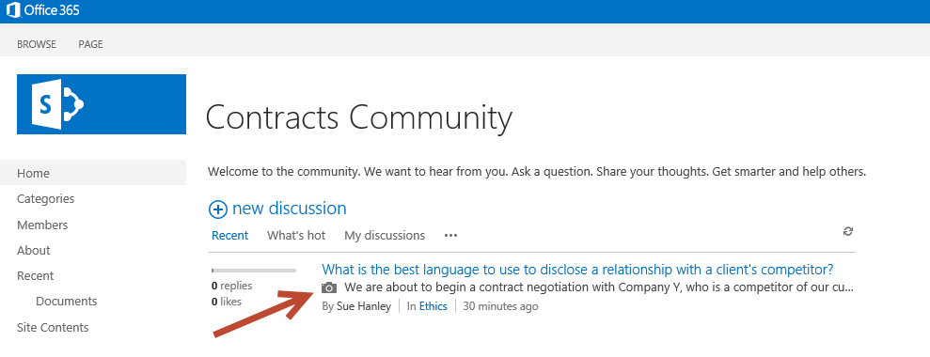
Posts with links (or images) have a camera icon
Notes:
This might be confusing to people because the camera icon doesn’t mean picture, it just means link to SOMETHING.

Slide 55
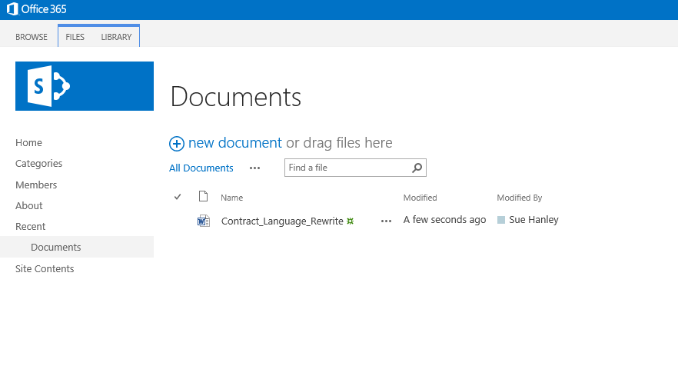
And the document lands in the document library!
Notes:
Exactly where it belongs!
And, if you have metadata in your document library, your user will be prompted for the metadata!

Slide 56
But, there is a bug, so here’s a helpful hint
If you have no metadata, this will work as expected.
If you do have metadata on your doc libs, the document will land in the document library BUT no link will be created … UNLESS
  You enable content types for the library AND
  At least two content types are visible and can be selected by the user in that library.
User experience is not the greatest – doesn’t show in web app, user required to open or save.
Notes:
Note: if you can force the addition of the same content type twice via code (you can’t do this in the UI), you can accomplish the same thing as having two content types.

Slide 57
Sue’s Community Site Tips
AKA: Mistakes you don’t have to make on your own!

Slide 58
Tips and hints
Use a Site Collection for each Community if you can
  Best for scaling and long term growth
  Only way auto-approval works
How Auto-Approval Works
  With Auto Approval, you would Share your Community site with all Visitors.
  When a visitor lands on the site, they cannot enter any content until they Join the community by clicking the Join this community button.
  When that happens:
    User is automatically moved from Visitors to Members security group
    Default permissions for Members = Contribute
    User automatically Following the site

Slide 59
Tips and hints
PERMISSIONS for COMMUNITY SUB-SITES
If you use a sub-site for your Community site that you want everyone to be able to visit and contribute without approval:
  Share the site with “Everyone” or “Everyone except external users” as Members (Contribute).
  This gives all users the ability to post to the discussion board or upload documents to the document libraries on the site.
  When a user lands on the site and makes a post in the discussion board, the Join button goes away (after refresh) AND they are added to the Members list for the Community (which is not the same as the Members security group although in this scenario, the user is actually in both once they have posted.)
  Users can also Join the community without making a post. In this case, their name is added to the Members list for the Community.
  In this “sub-site” scenario, users must explicitly Follow the site to have it listed on their sites page. This will be a training issue in most organizations.

Slide 60
Tips and hints
PERMISSIONS for COMMUNITY SUB-SITES
If you use a sub-site for your Community site where you want users to be able to look at the site but must be approved for membership:
  Share the site with “Everyone” or “Everyone except external users” as Visitors (Read).
  When the Visitor user lands on the site, they see the Join button and when they click the Join button or try to make a post, they see a pop-up where they can request access to the site.
  Access requests go to the Site Owner (not the community Moderator)

Slide 61
Tips and hints
Membership in Communities
  The security group Members is not the same as the Members in the Members list. This will be very clear if you are using site collections for each community. It will be more confusing if you use sub-sites.
Categories
  Change the name of General to Unassigned so it will sort towards the end of your Categories list (or put a “z” in front of the word so it will sort last or a “.” so it will sort first)
  Deleting a Category doesn’t delete the posts associated with it – but it does make the posts orphans. You can use the Manage discussions view to re-assign them to a different category.
Site Assets Library
  Make it READ only for all contributors so that users will not have this library as a default for documents.
  Do this for any other “default” libraries where you don’t want users to add documents from discussion posts.

Slide 62
Tips and hints
Document Libraries
  If you are using metadata (and you know you should be), be sure to have at least two content types in each library (at least until the bug is fixed).
User experience adding a document to a discussion post:
  If the library has folders, all documents default to the root of the library. Users are prompted for document metadata but when you upload a document from a discussion post you cannot select the folder where it supposed to go.
  If a document needs to be in a folder, it has to be moved to the folder after it has been inserted to the discussion post. User must navigate to the document library and move the document to the correct folder. This is especially important if the document is supposed to go to a secure or private folder. Again, this is a training issue.
  When a user clicks on a document link in a discussion post there is a bit of good and bad:
    User forced to download from the link (not the greatest experience)
    A (not really practical) work around is to ask the poster to edit the source code on the post and add ?web=1 to the document URL to open in Office Web App
    Another code-based work around would be to change the user experience automatically (to add the ?web=1) – or open the document in the context.

Slide 63
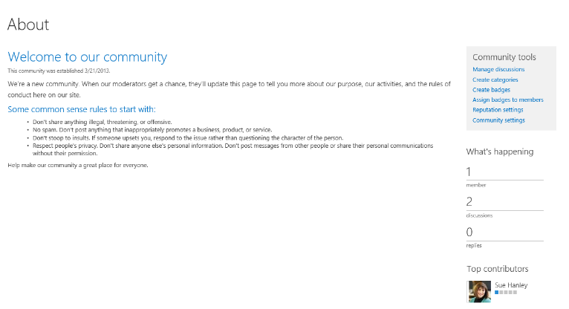
Tips and hints
Update the About Page
  Get the moderator to update the About page before you launch!
  Or, at least get rid of that first sentence.
Notes:
PLEASE get the moderator to update the default text – “When our moderators get a chance …”
This is the stupidest message possible. When they get a chance? Really?

Slide 64
Tips and hints
Moderators have super powers – teach them how to use them
  Moderators have the ability to Edit any page in the site (which they need so that they can update the About page).
  This means that Moderators should have training because they have privileges to change the look and feel of the site as well as add lists and libraries.
  Moderators can’t modify permissions or add users to the site.
“Share” the site only after you finish configuring
  Share the site with other users only after you are done configuring. That way, the site will not be surfaced in the Community Portal while you are working on it.
  Check to see if you are in the Members list, since you created the site. If you are not really a member of this community, be sure to remove yourself before turning the site over to the Moderator.

Slide 65
Tips and hints
Reputation settings
  If you don’t enable them, the Top Contributors web part will not calculate correctly.
  So, you won’t be able to tell who the top contributors really are unless you look on the Members page, which summarizes activity for each member. It’s not super easy, but you can get a sense of who is dominating.
Save as Template
  In my experience to date (August 2013), saving a custom-configured Community Site as a template and then trying to re-use it will not work. (We have tried this on prem and online and reported it to Microsoft.)
  The feature that breaks is the Category view in the site instantiated from a template. We are now using other methods (manual and AvePoint DocAve) to replicate sites where Community Features have been enabled (both Community Sites and team sites with Community Features).

Slide 66
Is this template right for you?

Slide 67
When would this template be appropriate?
Relevant business scenario
Someone committed to “nurturing” (Moderator/Leader)
Team site where you want the default privileges to be CONTRIBUTE, not EDIT
Team site where you would prefer to add a document library on your own – and thereby give it a sensible name instead of Shared%20Documents, which is what the out of the box document library is STILL called on a “regular” team site.
  Note: if you enable community features on a Team Site, SharePoint creates a second Home page under the heading Community in your Quick Launch so you now have to decide which home is home (which means one of them has to be deleted from the Quick Launch).
Scenarios where you want Member to mean what Member means in English, not in “SharePoint.”
Scenarios where you want the home page to focus on discussions, top contributors, and activity – as opposed to documents, which is what you get by default with a “regular” team site.
Scenarios where people might want to talk about documents as they upload them.
  You can do this in Yammer communities, but Yammer communities currenlty create a completely disconnected place for a document to live if you don’t first upload it to someplace where documents should live and then grab the hyperlink yourself.

Slide 68
But should I use a Team Site with community features?
The primary criteria for the community site versus a team site is one of purpose, not numbers.
The purpose of a community site is conversation.
Some communities have trouble gaining momentum around conversation topics where fewer than 200 people care about the topic and categories of the topic.
Out of the box, the community site doesn’t even have a document library other than Site Assets – which lets you know how important conversation is to communities.
The team site template is more focused on documents than conversations, though the default template does include a Site Feed, which is clearly focused on conversations, but among a small group of people focused on creating deliverables, not sharing a conversation about a topic, which is where the community site fits in.
Team sites with community features are not surfaced in the Community Portal.

Slide 69
Another plus: The Community Portal

Slide 70
The Community Portal
Aggregates all communities
  Sorts by popularity (membership, recent activity, age)
Uses search to populate
  Security trimmed – only shows what you have access to
  Shows site collections as well as sub-sites created with the Community Template (but you can scope to exclude sub-site communities)
  Won’t show Team Sites with Community features
Only one per enterprise/tenant
  Created in Central Admin or Tenant Admin
Automatically added to the Promoted Sites list on the Sites page

Slide 71
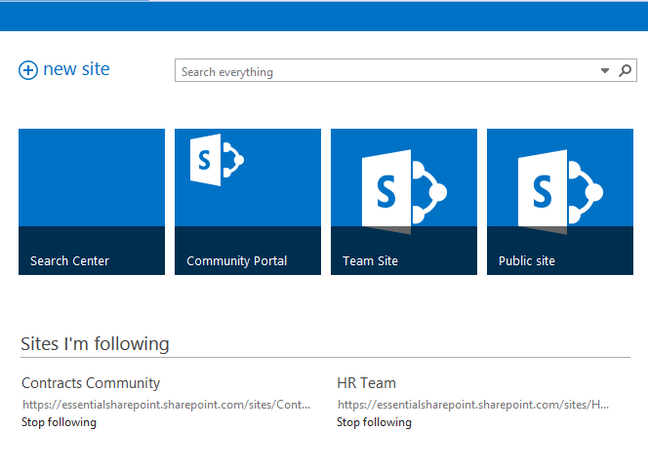
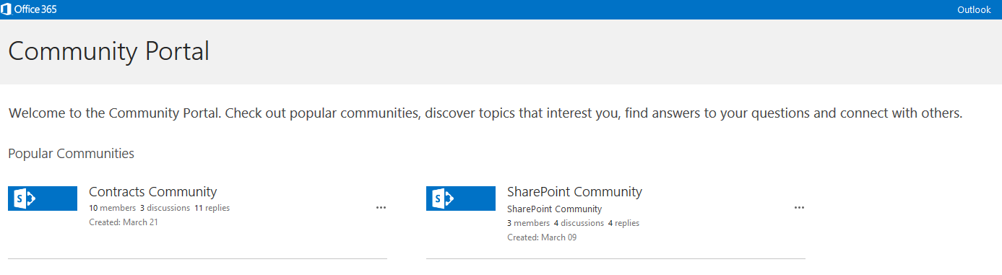

Slide 72
Notifications

Slide 73
What notifications are sent from Community Sites?
Feed notifications are sent to followers when:
  You join a Community
  You achieve a new level
  You create a new post or reply
  Your reply is marked the “Best Reply”
  You “Like” or rate a post or reply
Email notifications are sent
  When someone replies to your post

Slide 74
Community Health Measures

Slide 75
Is the Community healthy?
Focus on VALUE, not actions
Examine the conversations – look for examples
Survey members
  Ask about value
  Ask for examples
  Get ideas from the Sense of Community Index (from Community Science)
  http://tiny.cc/SenseofCommunityIndex
Helpful resource
    www.feverbee.com/measurement/
Notes:
Full URL for Sense of Community Index:
http://www.communityscience.com/pdfs/Sense%20of%20Community%20Index-2%28SCI-2%29.pdf

Slide 76
But, look at some actions
“Conversion rate” – Lurkers to Joiners
Distribution of contributors - % of members who make a contribution
Members active in the past 30 days
Contributions per active member/month
Visits per active member/month
Content popularity – most viewed or downloaded, most “liked” or rated highly
Speed of reply to discussions
% of people who join who initiate a discussion
Notes:
You are looking for both GIVERS and TAKERS. At AMS we recognized the person who created the MOST DOWNLOADED/VIEWED asset as well as the people who REPORTED VALUE by re-using an asset.

Slide 77
Measures of Community Health
 | Sense of Community | Domain of Practice
Early Stage | Core group of members beginning to form Opportunities for members to interact and develop bonds – in real time or face-to-face Consistent number of active members (or growing) Increasing level of participation by members Committed Moderator/Leader – time to moderate conversations, poll members, help broker connections, and on occasion, plan events | Focus is helping one another, developing and sharing ideas Degree to which sharing or helping occurs is frequent Q&A activity increasing Members describe what is being shared and exchanged as useful
Mature | Number and frequency of real time or face-to-face events less important Stable or increasing level of participation New people participating and emerging as core members Moderator/Leader still important, but role becomes more following up with question askers, identifying which interactions should get raised to the attention of the entire community Moderator/Leader begins to broker relationships to other communities Core group of members active – beginning to seek ways of getting new members into the core Mentoring new members important Members describe being involved as important when surveyed Rich relationships have developed that members attribute to the community | Focus becomes documenting best practices and getting emerging practitioners “up to speed” Community takes ownership of the domain Q&A activity may level off, but is consistent Community has more of a desire to influence the organization around the domain topic

Slide 78
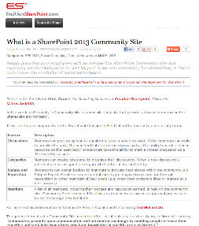
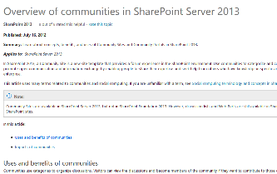
Other Resources
Nice article showing examples of Community Sites in practice https://www.nothingbutsharepoint.com/sites/eusp/Pages/What-is-a-SharePoint-2013-Community-Site.aspx
TechNet Overview of Communities http://technet.microsoft.com/en-us/library/jj219805%28v=office.15%29#uses

