Slide 1

It’s all About that Case – the business case, that is!
Demonstrating clear, measurable value from your enterprise social initiative
Susan Hanley
SharePoint Saturday DC
June 13, 2015
www.susanhanley.com

Slide 2





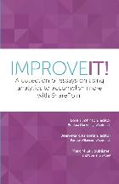



About Me
President, Susan Hanley LLC
Led national Portals, Management Collaboration, and Content practice for Dell
Director of Knowledge Management at American Management Systems
Information Architecture
User Adoption
Governance
Metrics
Knowledge Management
Intranets & Portals
Collaboration Solutions
sue@susanhanley.com
susanhanley
www.susanhanley.com
www.networkworld.com/blog/essential-sharepoint

Slide 3

“Collaborative working”
“Employee engagement”

Slide 4
Engagement really matters …
According to Gallup, engaged employees exhibit:
Engaged
37% less absenteeism
25-49% less turnover
27% less employee theft
18% higher productivity
16% higher profitability
Productive
Profitable
Source: http://www.gallup.com/consulting/121535/employee-engagement-overview-brochure.aspx

Slide 5
… and so does Collaboration
Organizations with a strong learning and collaborative culture are:
Engaged
92% more likely to develop novel products and processes
52% more productive
56% more likely to be first to market with their products and services
17% more profitable than their peers
Productive
Profitable
Source: David Mallon, High-impact learning culture: The 40 best practices for creating an empowered enterprise. Berson by Deloitte, June 10, 2010. <http://www.bersin.com/Store/Details.aspx?id=12171>

Slide 6
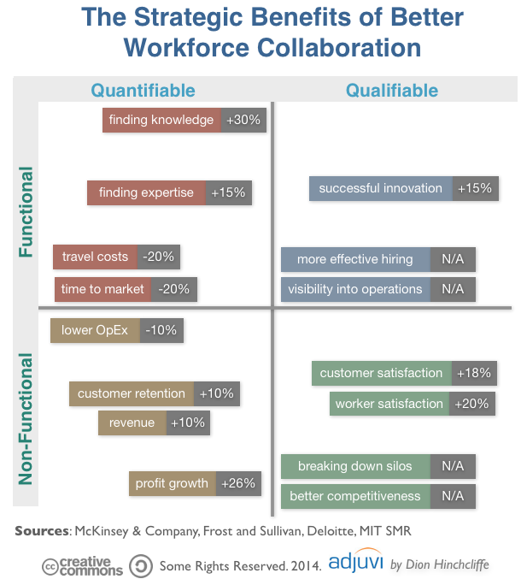
Strategic Benefits of Social Collaboration
Finding information and experts faster
Lowering operational expenses
Higher customer satisfaction and retention
Increased productivity
More successful innovation
Reduced communications costs
Lower “time to talent”
http://dionhinchcliffe.com/2015/02/05/the-strategic-value-of-social-business-what-weve-learned/

Slide 7


Have you heard the one about?
Cost of inefficiencies due to inability to find resources greater than US $5,850 per worker per year
IDC “The High Cost of Not Finding Information,” 2001.
Average worker spends 20% of the work week looking for internal information or people
McKinsey, “The social economy: Unlocking value and productivity through social technologies,” 2012.

Slide 8

Success is about organizational change …
Open
Non-hierarchical
Trust

Slide 9

… and improving the velocity of information that informs decisions.
Getting Work Done!

Slide 10

Case Study: Changing the culture – in the context of measurable critical decisions
Organizational Goals
Minimize cost and risk of reinventing the wheel in a global organization
Build inventory of best practices and expertise on core topics
Leverage expertise across the globe

Slide 11

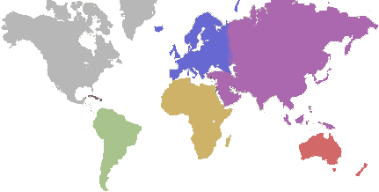
A relatively new production plant manager in Egypt had some questions about the best ways to handle green corn during a delicate stage of the process.
Late in his day, he posted a query in the Production Technologies community because he wasn’t sure to whom he should send an email (and his boss was out of the office).

Slide 12

When the plant manager returned to work the next morning, he found 10 responses.
Three responses were about two proposed solutions to his problem. The rest were commentary and shared experiences from others.
Meanwhile, colleagues from around the world saw the post and offered suggestions.
Benefit: Solutions offset the risk of losing $120,000 of pre-commercial seed value.

Slide 13

Senior manager’s email made it not only safe to ask questions – but admirable.
Community became one of the busiest in the company.
Other communities follow the lead – taking a cue from what worked and what was recognized and valued.
“Thanks for posting your question. Now we have more searchable data in the system on green corn processing. I’d love to see this happen more often in the future.”

Slide 14



Case Studies: Changing the culture by example
 | Community management has become a formal career path with a 10 week certification process Improvements such as shrinking some processes from 4 weeks to 6 days¹
 | Focus on reducing the confusion of which tools for which type of collaboration Used training program and reverse executive mentoring to shift corporate mindset 50% of employees routinely active after 18 months¹
 | “Connections Geniuses” to spur adoption of IBM Connections Evangelized impact on day-to-day work, making the impact more relevant to individual users²
¹Source: http://www.zdnet.com/article/the-growing-evidence-for-social-business-maturity/
²Source: http://www.mckinsey.com/insights/organization/building_the_social_enterprise

Slide 15
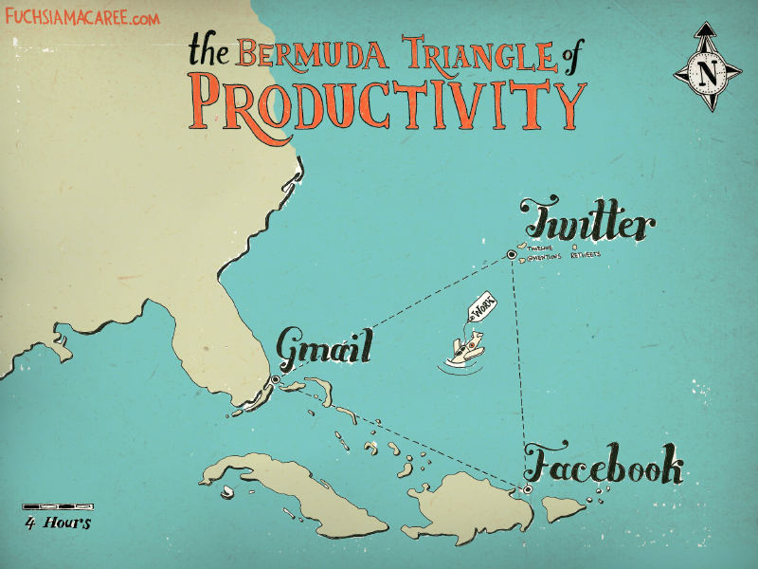
Focus on enabling existing business processes

Slide 16

Your Measurement Roadmap
1. Identify the business problem
2. Understand the stakeholders
3. Identify the measures
4. Present results

Slide 17

1. Clearly identify the business problem
Which existing business processes would benefit from social capabilities?
What information informs the decisions in those processes?

Slide 18

We collaborate in the context of a business activity, process, or task.
We engage to solve problems – to get something done!

Slide 19




Which use cases? Critical moments of engagement, processes with bottlenecks, processes with lots of exceptions
Sales
Product Development
Resource Planning
Customer Support
Sales team on-boarding
Sales team training and mentoring
Engineer struggling with a problem
Project Manager looking for the most qualified resources for a project
Services agent working trying to solve a customer problem

Slide 20

Onboarding
Paycor Inc said it would have forecast $2 million more in 2015 revenue if it had hit its 2014 hiring goals for new sales reps in 2014. The time spent bringing new reps up to speed means the company doesn’t see the full benefit of their productivity until 12 to 18 months into their tenure.
Source: http://www.wsj.com/articles/why-its-so-hard-to-fill-sales-jobs-1423002730

Slide 21

2. Understand the stakeholders
Who are they?
What keeps them up at night?
How are they already measured?
What do you need to tell them?

Slide 22
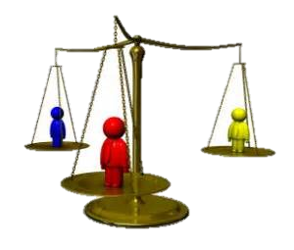

3. Identify the measures
Aligned with lifecycle stage
Collected at reasonable cost
Balanced

Slide 23

QUANTITATIVE
QUALITATIVE
Performance between points
Spot trends
Provide context
Used when numbers aren’t easy
Used at early project stages
Richer (stories)

Slide 24
Quantitative Business Metrics
Hours per week/year to execute a process
T x E x N x S
Time on Task (in minutes)
Number of Employees performing the task
Number of times per week/year a typical employee performs that task
Average loaded Salary per minute
Number of Proposals/Contracts per year
Average application training costs
“Time to talent”

Slide 25
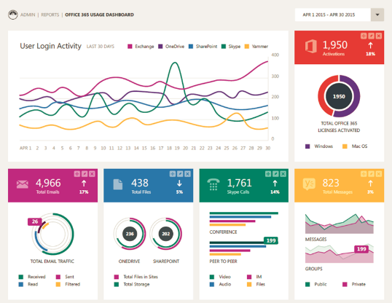
Quantitative System Metrics
Native Yammer Metrics
Third-Party Metrics (TyGraph)
Number of New Likes (for the monitoring period)
New Members
New Messages
New Private Messages
New Messages in Groups
New Files
New Pages
Total Members
Views and Downloads by Person
Percentage of Threads Responded to by User Not Mentioned
Percentage of Threads with No Replies
Groups Dashboard
YamJam Dashboard
Top Contributors
Yammer metrics will become part of the upcoming Office 365 Admin console.
For more info, watch:
https://channel9.msdn.com/Events/Ignite/2015/BRK2119

Slide 26
Look for system metrics that might be a proxy for something more valuable
Conversations that include participants who weren’t addressed or @mentioned
These are connections that would never have happened in email – which is inherently private.
Conversations with an ask for examples (that have an answer)
These shared assets might have only been exchanged privately – with more limited reach.
Conversations with a value tag (requires user training!)
E.g. #YamWin
Follow up with a survey or interview.

Slide 27

Qualitative Metrics: We need story!
Narrative is the way we simplify and make sense of a complex world.
You can’t compel change if your stakeholders don’t understand what you have done.
Stories with data provide evidence - “serious anecdotes”

Slide 28



Case Study: The Power of Story
A scientist with Thrombotic & Joint Diseases in Germany began at to isolate and culture macrophages and needed some help.
Meanwhile, two scientists in the US had deep experience in protocols for this area.

Slide 29
The German scientist poses a question in the social network.
Both US scientists quickly responded with assistance. One helped him with culturing protocols and the other helped him with information on magnetic cell sorting.
Benefit: The German scientist was able to leverage existing internal expertise and, in the process, reduce his research effort by four weeks.

Slide 30
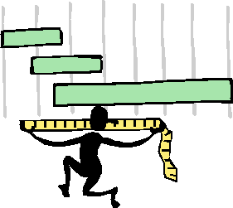
“… not everything that can be counted counts,
and not everything that counts can be counted.
-- William Bruce Cameron (sociologist)
[Informal Sociology: A Casual Introduction to Sociological Thinking (1963)]
Measure what matters

Slide 31

Focus on results
“Adoption metrics do not address what matters most to each tier of participants (employees, managers, and executives).
As long as adoption is the primary measure of success, resistance, at all levels, can block successful social software deployment.”
Source: John Hagel III, John Seely Brown, Duleesha Kulasooriya & Aliza Marks. Metrics that Matter.
<http://dupress.com/articles/metrics-that-matter/>

Slide 32
“Sometimes, the thing that matters doesn't make it easy for you to measure it.”
Number of users?
Number of activities?
Amount of time they spend on Yammer?
OK, but not as important as what those users DO with the information that they exchange!
Quote from Seth Godin: http://sethgodin.typepad.com/seths_blog/2015/02/measure-what-you-care-about-avoiding-the-siren-of-the-stand-in.html

Slide 33
Gathering metrics that matter
Try not to over-achieve
Automate where possible – look for good proxies in system metrics
Look at the process KPIs that your organization already captures
Get creative
Surveys, Usability Testing, Active Listening
Send out a “journalist”
Track by type, department, storyteller value metrics

Slide 34
Example Survey Questions
Were you able to solve a critical business problem? If so, please describe. (Or, can we talk to you?)
If given the choice, would you KEEP [the enterprise social tool]?
“Don’t take it away”
How does this COMPARE to other tools?
“User-friendliness” Rating
How easy was it to …?
“Intuitiveness” Rating

Slide 35
4. Present Results
Balanced Scorecard
Dashboard – measures plus story
“Report Card”
Talk in the language of your executives!

Slide 36
Keep in mind …
Align where work gets done
Focus on business results
Make sure someone is paying attention to metrics
Use metrics to plan change

Slide 37
Examples and Resources

Slide 38
Balanced Scorecard Example – Health Perspective
Perspective | Key Question | Measures
Health | Are people using the solution? How many? Who (which departments or roles)? | Number of users with complete profiles (overall and by department) Number of posts Number of profile searches Number of blog entries Number of likes Number of replies Number of replies by users not mentioned directly
 | Is usage sustained? | Trends over time for each of the key measures above
 | What features are used the most? | Comparison of features such as blog posts, activity posts, likes, replies

Slide 39
Balanced Scorecard Example – Capabilities Perspective
Perspective | Key Question | Measures
Capabilities | Is usage supporting the identified business use cases? | “Serious Anecdotes” – stories from user surveys where users report specific use cases and value measures based on the moments of engagement identified in the deployment plan
 | Do users perceive that they are getting value? | Survey questions asking users whether they feel that they can collaborate more easily and resolve issues more quickly Survey questions asking whether users can find people with the expertise that they need Survey questions asking users to rate whether they would like to take the tool away (what I like to call the “Don’t Take it Away” metric)

Slide 40
Balanced Scorecard Example – Business Value Perspective
Back
Perspective | Key Question | Measures
Capabilities | Is there a clear connection with respect to the overall business strategy? | What has happened with business key performance metrics since the social tools have been deployed? Average time for call centers to resolve customer issues Average time-to-market for new products Average proposal response time Average “time to talent” for new employees (cost/time for on-boarding) Annual staff turnover Customer satisfaction Ability to handle “exceptions” – situations that don’t fit standard processes and require reaching out to experts or multiple departments for resolution What content is used the most?

Slide 41
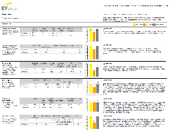
EY Yammer Group Scorecard
Back
Clarity of purpose – does the group serve a clearly defined and unique purpose?
Leader engagement – are leaders modeling the desired behaviors?
Community manager engagement – are there visible managers also modeling appropriate and expected behavior?
Diversity of participation – how broad is the involvement within the group?
Quality of conversation – are posts useful?
Business value – is the group generating tangible business value (which might be measured as questions answered, ideas generated, or resources exchanged)
Source: Steve Nguyen and Young Heck, “Gain Organizational Insights with Yammer Data Mining and Analytics” Ignite 2015 BRK2119
https://channel9.msdn.com/Events/Ignite/2015/BRK2119 (Tammy’s story starts at 20:00)

Slide 42
Yammer Analytics
Level 1: Office 365 Admin Console*
Level 2: Data Export
Level 3: Codename: Tosilog (Yammer + Power BI)
Level 4: Advanced Data Export
Level 5: Data Export & REST API
Level 6: 3rd Party Applications
Pros: Unified view of usage across Office 365 services
Pros: Ability to get granular with data
Cons: Need to use Pivot Tables or other BI software, No Access to Likes, Shares, File Views, etc.
Pros: Low Touch for Customer, Free
Cons: No Access to Likes, Shares, File Views, etc.
Pros: Access to Likes, Shares, File Views, etc.
Cons: Snapshot of data at a given time, Data needs to be shared outside of network.
Pros: Access to Likes, Shares, File Views, etc.
Cons: Requires Developer Expertise
Pros: Partners are able to provide sustainable and reliable analytics solutions
Cons: Requires some additional investment
Cons: Yammer Admins aren’t always Office 365 Admins so may not have access to these dashboards
Source: Ignite 2015 Session BRK2119 https://channel9.msdn.com/Events/Ignite/2015/BRK2119

Slide 43
Resources
Steve Nguyen and Tammy Young Heck, Gain Organizational Insights with Yammer Data Mining and Analytics – Ignite 2015 (BRK2119)
Dion Hinchcliffe: In Europe’s biggest firms, social business is all grown up, February 12, 2015. http://www.zdnet.com/article/the-growing-evidence-for-social-business-maturity/
McKinsey: Building the Social Enterprise, November 2013. http://www.mckinsey.com/insights/organization/building_the_social_enterprise
Tom Davenport, Deloitte Press, January 22, 2015. Why data storytelling is so important--and why we’re so bad at it http://dupress.com/articles/data-driven-storytelling/
Yammer Group Files (https://www.yammer.com/itpronetwork/#/groups/3944618/files)
Yammer “Pitch Deck” for Executives: https://about.yammer.com/success/wp-content/uploads/sites/13/Yammer-for-Executives-Pitch-Deck2.pptx
Successful Social Intranets: Creating business value through strategic alignment and adoption planning http://www.digitalworkplacegroup.com/resources/download-reports/successful-social-intranets/
Moving Beyond Marketing: Generating Social Business Value Across the Enterprise, MIT Sloan Management Review, July 14, 2014. http://sloanreview.mit.edu/projects/moving-beyond-marketing/
Deloitte research white paper “Social software for business performance - The missing link in social software: Measureable business performance improvements.” http://dupress.com/articles/metrics-that-matter/
Improve It! by lots of people, including Susan Hanley, May 2015 – download for free at http://www.improveit.how
How to Measure Anything by Douglas W. Hubbard, 2010
Essential SharePoint 2013 by Scott Jamison, Susan Hanley, and Chris Bortlik, 2013

Slide 44
Sponsors, Evals, and SharePint

Slide 45












Thanks to our Sponsors!!!

Slide 46
Session Info
The details can be found through the EventBoard Mobile app – http://app.spsdc.org -> SPSDC

Slide 47
Lanyrd
Only have a web browser?
http://lanyrd.com/2015/spsdc/

Slide 48

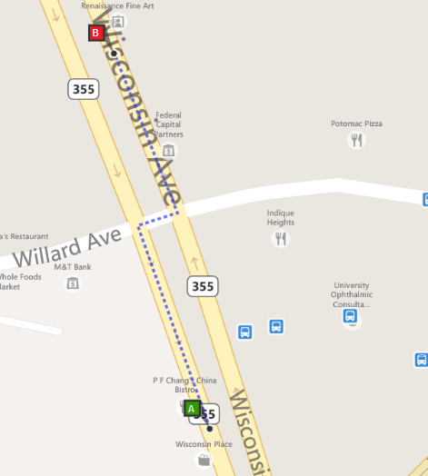

Join us at #SharePint sponsored by K2 at Clyde’s of Chevy Chase in the RaceCar Bar Downstairs
Why? To network with fellow SharePoint professionals
What? SharePint!!!
When? 6:00 PM
Where?
RaceCar Bar Downstairs
5441 Wisconsin Ave
Chevy Chase, MD 20815
Thanks to?
K2!

