Slide 1

We built it, but why won’t they come?
Susan Hanley
SharePoint Saturday Baltimore
20 May 2017
www.susanhanley.com
sue@susanhanley.com
Practical advice to overcome common user adoption and change hurdles

Slide 2


Slide 3


Slide 4



Slide 5
User Adoption
User Engagement

Slide 6

But wait, then why are we here?
Tip # 1: Adoption is not the end game
RESULTS

Slide 7
Results mean …
The average time to on-board a new employee went from 3 months to 3 weeks
Customer satisfaction scores increased by 20%
Average profitability per client engagement increased by 10%
Revenue increased by 10% with no increase in headcount
RESULTS
ADOPTION

Slide 8



We built it, why don’t users just come?
Big changes are the result of small steps
t once
WIIFM
The solution has to be worth adopting

Slide 9

Tip # 2: Adoptable solutions solve measurable problems

Slide 10

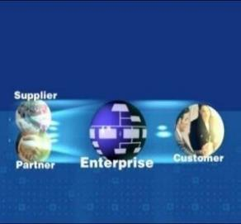
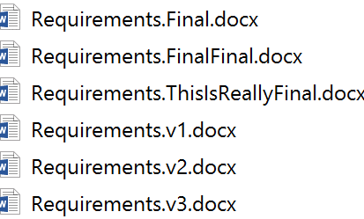

Communications and Collaboration Problems
Curing Versionitis
Finding Expertise
Sharing with Partners and Customers
Keeping People Informed

Slide 11


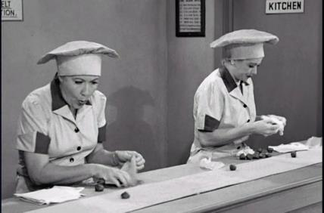
Business Process Problems
Collecting and Tracking Information
Managing Tasks and Projects
Automating Business Processes

Slide 12




Knowledge Transfer, Planning, and Crowd-sourcing Problems
Sales
Product Development
Resource Planning
Customer Support
Sales team on-boarding
Sales team training and mentoring
Engineer struggling with a problem – find answers quickly
Feedback “Crowd-sourcing”
Project Manager looking for the most qualified resources for a project
Services agent working trying to solve a customer problem
Building an “organic” knowledge base

Slide 13



Engaging content
Accurate, useful, timely, relevant
Well written
Written for the web
Scannable!
User fewer words!
http://bit.ly/2m7LHNA

Slide 14

Engaging content | more than just text
“Fortune Cookie” random pun generator at the bottom of most pages in JetBlue’s intranet
Created by Marketing
“Always getting back to our routes.”
“Let’s jet this party started.”
“Get a Blue lease on life.”
Can be turned off for pages where it is not appropriate

Slide 15

Tip #3: Make it personal

Slide 16
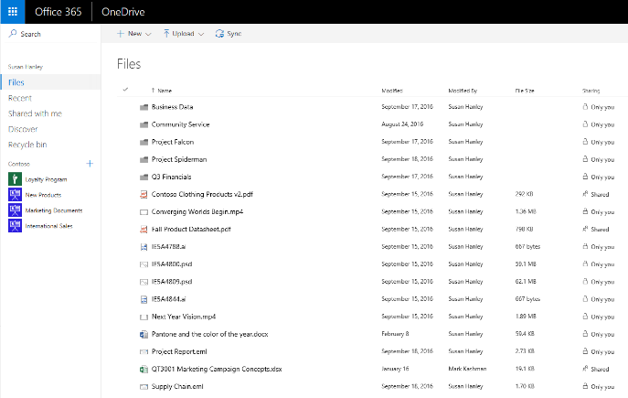
Personalization
OneDrive: center of gravity for your work
Targeted content
Role-based pages (destination)
Personalized content on pages (recognition)

Slide 17
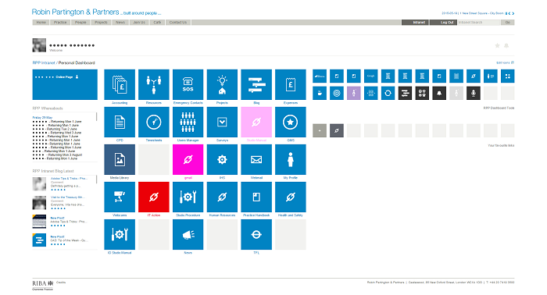
Customization
“Our intranet is a tool which allows us to make business decisions therefore it cannot be overcomplicated or distracting, making our designs concise, sharp and distinct.”

Slide 18

Tip # 4: It’s about change

Slide 19


Why are we in IT so bad at change?
Us
Deep experience with technology and concept
Seeing the solution for the first time
Recognize the need for the solution
Possibly unaware or unconvinced of the need
Convinced the product works
Skeptical about whether the product works
“Customer”

Slide 20

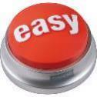


Ease in to change
Start small
Keep it simple
Consider your culture
Go for the “long wow”

Slide 21
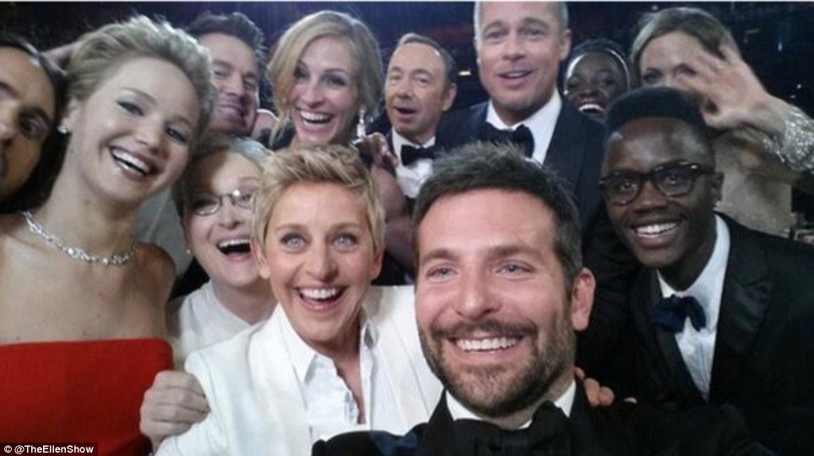
Tip #5: Engage some helpers

Slide 22

“No involvement by leaders, no commitment by employees. No exceptions.”
Vala Afshar, Chief Marketing and Customer Officer at Enterasys

Slide 23
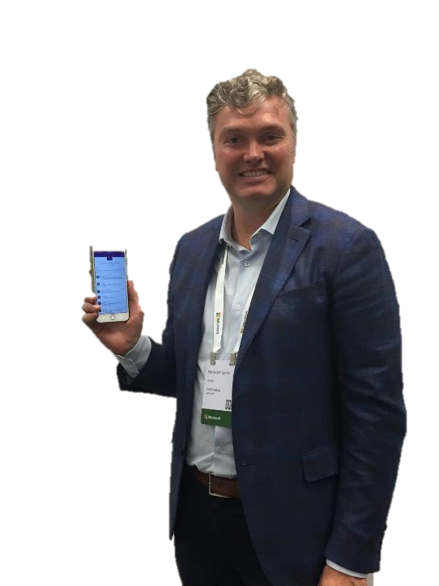
Tips for engaging leaders
Give one-on-one training
Make it easy – demo mobile
Provide examples for unfamiliar tools – travel log, interesting article, do a YamJam
Find an ally to go first
Seth Patton, General Manager of Product Management and Marketing for OneDrive and SharePoint, Microsoft

Slide 24
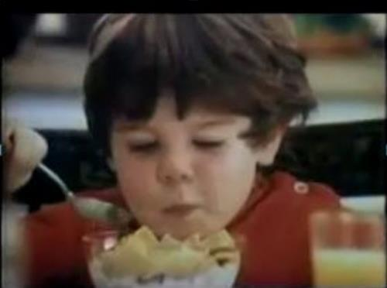
But it’s not just the leaders …
Identify and engage your Mikeys

Slide 25

Tip # 6: It’s all about comfort

Slide 26
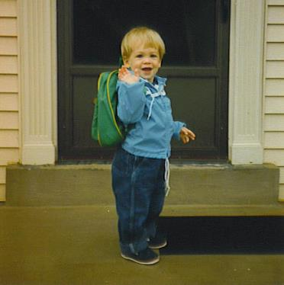



Plan a training roadmap – for comfort
Day 1: Get my job done
Don’t try to train all at once
One size does not fit all

Slide 27

This is not what successful training looks like

Slide 28

The most effective training happens just when you need it!

Slide 29

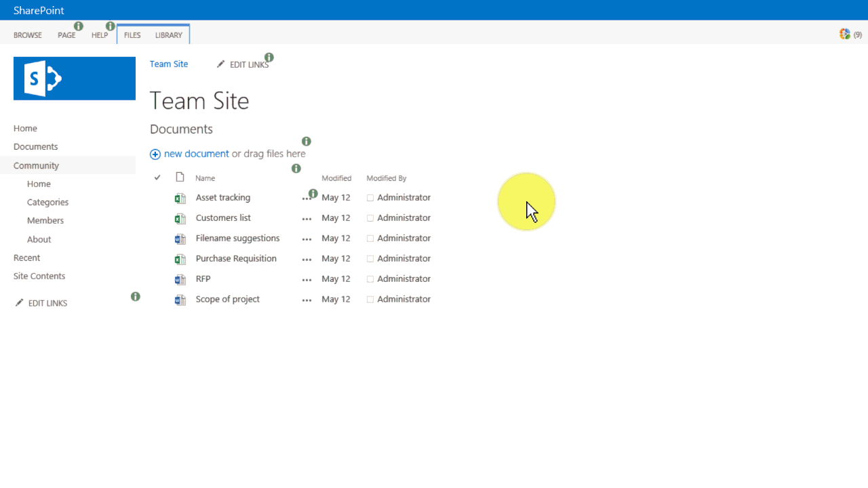
Step 7: Add Just-in-Time/In Context Delivery
www.visualsp.com

Slide 30
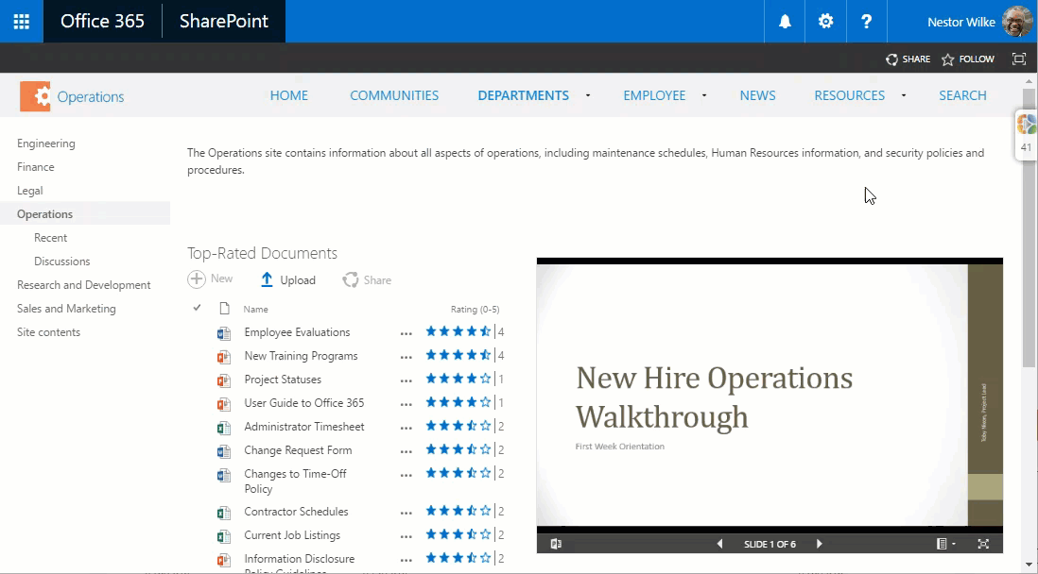
Step 7: Add Just-in-Time/In Context Delivery
www.visualsp.com

Slide 31


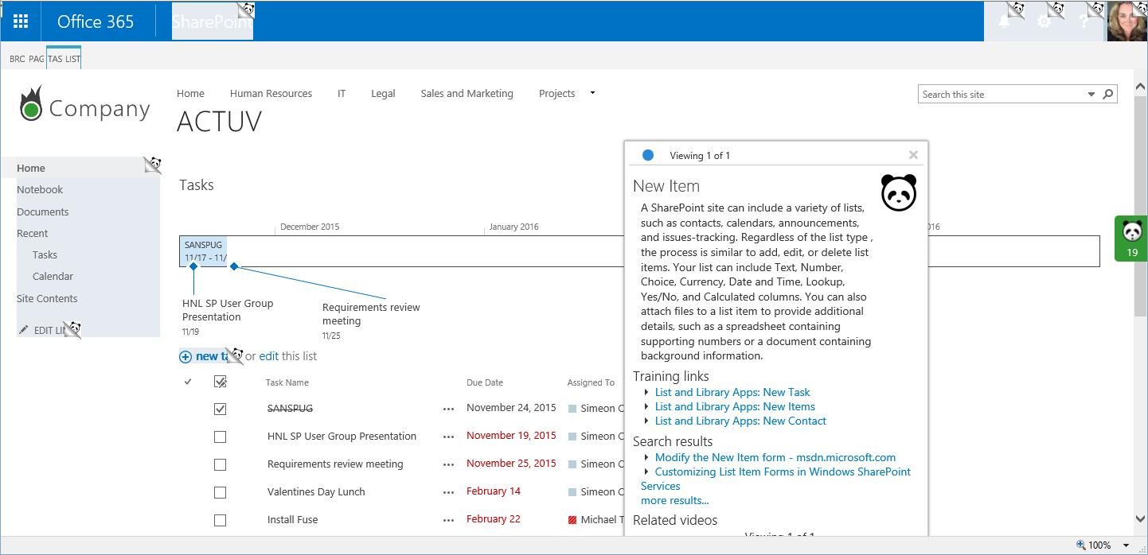
Step 7: Add Just-in-Time/In Context Training
www.contentpanda.com

Slide 32

Want training to be sticky?
Train teams together!

Slide 33

Tip # 7: It’s about communications

Slide 34
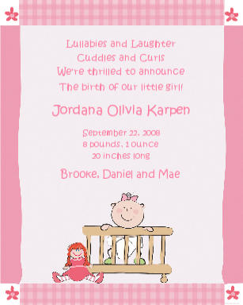
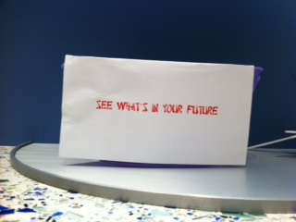

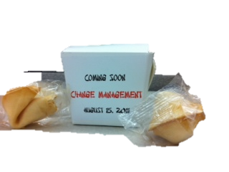
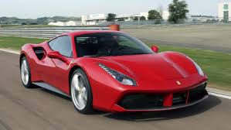
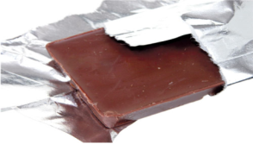
Launch ideas that worked … mostly

Slide 35



Photo Booth

Slide 36

Launch Surprise!

Slide 37

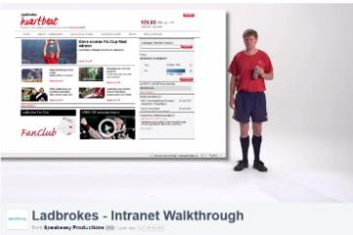
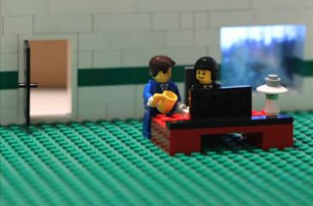
Launch Videos
http://www.scoop.it/t/intranet-launch-videos-and-teasers - comprehensive collection compiled by Ellen Van Aken
Additional examples: http://tiny.cc/ThreeSampleVideos
http://www.youtube.com/watch?v=PN1IyDvyA2o
MAN Diesel
http://vimeo.com/60729239
http://youtu.be/SinFM8hNcOg
Dartmouth-Hitchcock Intranet Home Redesign – watch the end for outtakes

Slide 38
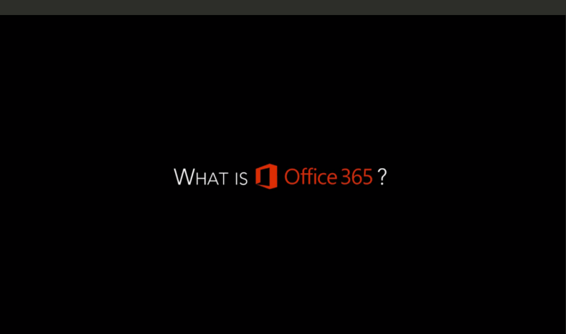
What is Office 365 Launch Video (Regis)
https://vimeo.com/regiscorp/review/125078501/68cd7832a8

Slide 39

Teaser Video – Beacon Health Options
https://vimeo.com/162603114 (1:23)

Slide 40
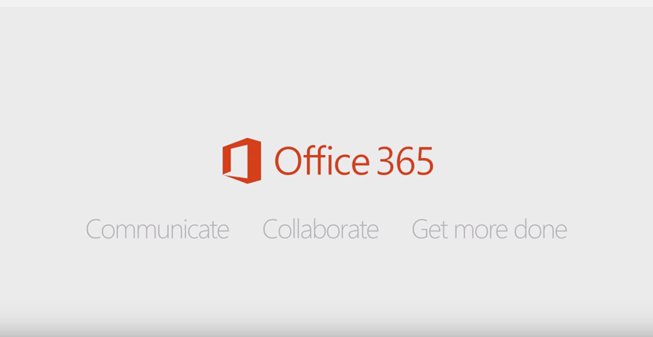
Office 365: Digital Workplace Overview
Showcases practical examples of how to use the complete suite of Office 365 applications
https://youtu.be/6jfpomYFCGU

Slide 41





30 for 30
Get Sharp on SharePoint
Predictable Content:
Polls on Mondays
Conversation Topic of the Week on Tuesdays
Employee Spotlights on Wednesdays
Trivia on Fridays
“Anecdote bank”
Tip of the Day/Week
Intranet “Learning Café”

Slide 42

Tip # 8: It’s about support

Slide 43
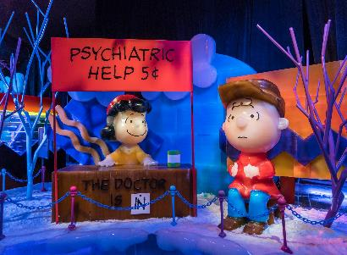




It takes a village
Seed the organization with evangelists
Plan ongoing support
Make sure the help desk is prepared
Pilot team
Volunteers
Employee advocates
Office Hours
Center of Excellence
(Just-in-Time) Training and Documentation

Slide 44

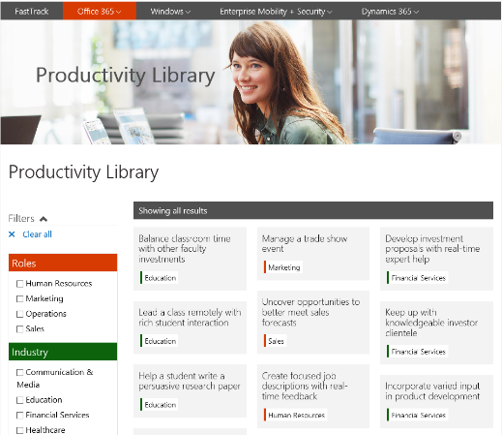
Adoption Planning Support
fasttrack.microsoft.com/office
http://bit.ly/2mitr2O
http://fasttrack.microsoft.com/office/envision/productivitylibrary

Slide 45

Tip # 9: Don’t forget the fun!

Slide 46

Fun activities can help kickstart
Scavenger Hunt
Points, Badges, Prizes
FOOD!

Slide 47



People-based scavenger hunt
https://www.thoughtfarmer.com/blog/pennstate/

Slide 48
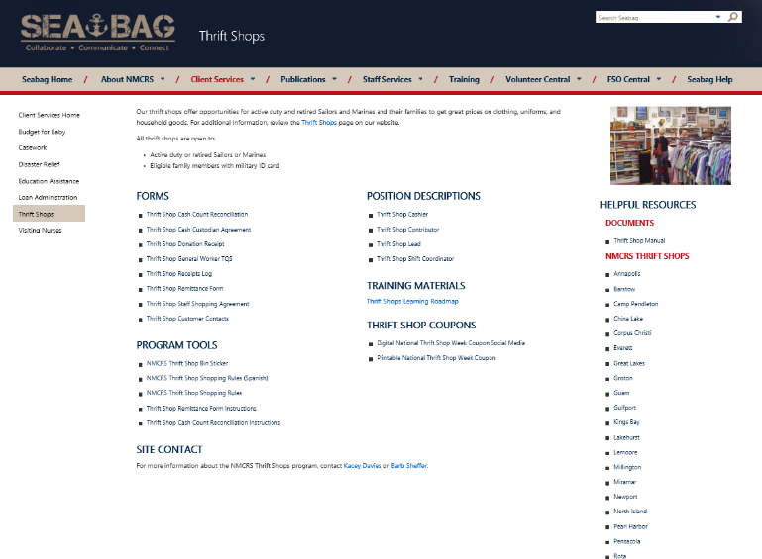


Millennial-friendly scavenger hunt

Slide 49


Fun with food
SharePointoberfest - inebriate while you collaborate!
CollaBOOration - A Ghoulish Guide to Metadata
SharePointgiving –
Give thanks to document workflow and approval

Slide 50

Tip #10: Align with performance goals

Slide 51

Tip # 11: You’re never done – lather, rinse, repeat

Slide 52

Listen and …

Slide 53
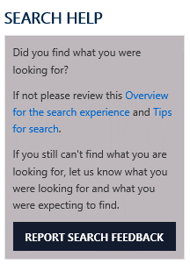


...allow users to provide feedback …
Feedback identifies challenges
Ask for feedback-everywhere
Conduct
usability tests,
LISTEN and OBSERVE

Slide 54

… but don’t be afraid to enforce

Slide 55

Not everyone will be happy (initially) - look for the wins!
Keep it “organic” - have a plan for change
It’s not once and done

Slide 56

Tip # 12: It’s about sharing

Slide 57












The Tips
Results are the end game
Solve a meaningful problem
Make it personal
Think about change
Engage some helpers
Make users comfortable
Communicate
Provide help and support
Don’t’ forget to have fun!
Align with performance goals
You’re never done
Learn from others

Slide 58











About Me
sue@susanhanley.com
susanhanley
www.susanhanley.com
www.networkworld.com/blog/essential-sharepoint
Information Architecture
User Adoption
Governance
Metrics
Knowledge Management
Intranets & Collaboration Solutions

Slide 59
Helpful Resources
General
Read User Adoption Strategies: Shifting Second Wave People to New Collaboration Technology by Michael Sampson
Jakob Nielsen’s Alertbox: http://www.useit.com/alertbox/ (Current Issues in Web Usability)
Reference article about social features on intranets: http://www.nngroup.com/articles/intranet-social-features/
Launch Videos: http://www.scoop.it/t/intranet-launch-videos-and-teasers (Ellen van Aken)
SharePoint and Office 365
Re-Imagining Productive Work with Office 365 by Michael Sampson
Fasttrack.microsoft.com/office
Microsoft Tech Community – Driving Adoption
Driving Office 365 Adoption White Paper by Richard Harbridge and Kanwal Khipple
Essential SharePoint 2013
Practical Framework for SharePoint Metrics
ImproveIT

