Slide 1

It’s all About that Case – the business case, that is!
Making the case for enterprise social …
and selling it to your executives
Susan Hanley
SharePoint Fest Chicago
December 9, 2015
www.susanhanley.com

Slide 2
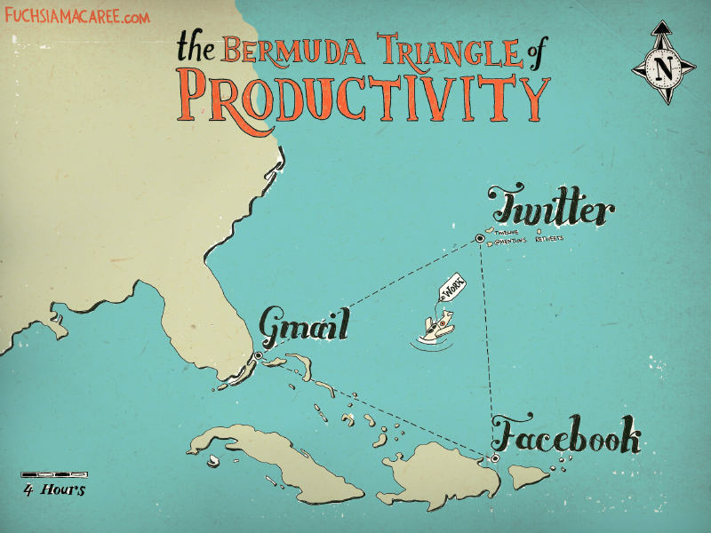
What do your executives think about when you talk about enterprise social?

Slide 3

“Collaborative working”
“Employee engagement”

Slide 4

Engagement really matters …
According to Gallup, engaged employees exhibit:
Engaged
37% less absenteeism
25-49% less turnover
27% less employee theft
18% higher productivity
16% higher profitability
Productive
Profitable
Source: http://www.gallup.com/consulting/121535/employee-engagement-overview-brochure.aspx

Slide 5
… and so does Collaboration
Organizations with a strong learning and collaborative culture are:
Engaged
92% more likely to develop novel products and processes
52% more productive
56% more likely to be first to market with their products and services
17% more profitable than their peers
Productive
Profitable
Source: David Mallon, High-impact learning culture: The 40 best practices for creating an empowered enterprise. Bersin by Deloitte, June 10, 2010. <http://www.bersin.com/Store/Details.aspx?id=12171>

Slide 6
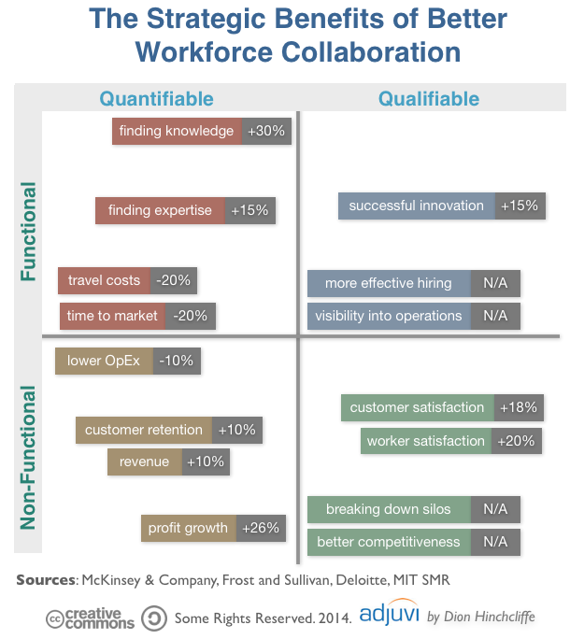
Collaboration has strategic benefits
Finding information and experts faster
Lowering operational expenses
Higher customer satisfaction and retention
Increased productivity
More successful innovation
Reduced communications costs
Lower “time to talent”
http://dionhinchcliffe.com/2015/02/05/the-strategic-value-of-social-business-what-weve-learned/

Slide 7


Have you heard the one about?
Cost of inefficiencies due to inability to find resources greater than US $5,850 per worker per year
IDC “The High Cost of Not Finding Information,” 2001.
Average worker spends 20% of the work week looking for internal information or people
McKinsey, “The social economy: Unlocking value and productivity through social technologies,” 2012.

Slide 8

Enterprise social success is about organizational change …

Slide 9

… and improving the velocity of information that informs decisions
Getting Work Done!

Slide 10

Case Study: Organizational change – in the context of measurable critical decisions
Business Goals
Minimize cost and risk of reinventing the wheel in a global organization
Build inventory of best practices and expertise on core topics
Leverage expertise across the globe

Slide 11

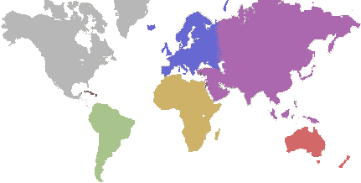
A relatively new production plant manager in Egypt had some questions about the best ways to handle green corn during a delicate stage of the process.
Late in his day, he posted a query in the Production Technologies community because he wasn’t sure to whom he should send an email (and his boss was out of the office).

Slide 12

When the plant manager returned to work the next morning, he found 10 responses.
Three responses were about two proposed solutions to his problem. The rest were commentary and shared experiences from others.
Meanwhile, colleagues from around the world saw the post and offered suggestions.
Benefit: Solutions offset the risk of losing $120,000 of pre-commercial seed value.

Slide 13

Senior manager’s email made it not only safe to ask questions – but admirable.
Community became one of the busiest in the company.
Other communities follow the lead – taking a cue from what worked and what was recognized and valued.
“Thanks for posting your question. Now we have more searchable data in the system on green corn processing. I’d love to see this happen more often in the future.”

Slide 14



Case Studies: Changing the culture by example
 | Community management has become a formal career path with a 10 week certification process Improvements such as shrinking some processes from 4 weeks to 6 days¹
 | Focus on reducing the confusion of which tools for which type of collaboration Used training program and reverse executive mentoring to shift corporate mindset 50% of employees routinely active after 18 months¹
 | “Connections Geniuses” to spur adoption of IBM Connections Evangelized impact on day-to-day work, making the impact more relevant to individual users²
¹Source: http://www.zdnet.com/article/the-growing-evidence-for-social-business-maturity/
²Source: http://www.mckinsey.com/insights/organization/building_the_social_enterprise

Slide 15

Your Measurement Roadmap
1. Identify the business problem
2. Understand the stakeholders
3. Identify the measures
4. Present results

Slide 16

1. Clearly identify the business problem
Which existing business processes would benefit from social capabilities?
What is the impact of improving the velocity, accuracy, or timeliness?
What information informs the decisions in that process?

Slide 17

We collaborate in the context of a business activity, process, or task.
We engage to solve problems – to get something done!

Slide 18




Which use cases? Critical moments of engagement, processes with bottlenecks, processes with lots of exceptions
Sales
Product Development
Resource Planning
Customer Support
Sales team on-boarding
Sales team training and mentoring
Engineer struggling with a problem – find answers quickly
Feedback “crowd-sourcing”
PM looking for the most qualified resources for a project – expertise location
Services agent working trying to solve an unusual customer problem
“Organic” knowledge base

Slide 19

Sales Agent Onboarding
Paycor Inc said it would have forecast $2 million more in 2015 revenue if it had hit its 2014 hiring goals for new sales reps in 2014. The time spent bringing new reps up to speed means the company doesn’t see the full benefit of their productivity until 12 to 18 months into their tenure.
Source: http://www.wsj.com/articles/why-its-so-hard-to-fill-sales-jobs-1423002730

Slide 20



Feedback Crowdsourcing
41,000 employees, 11,000 on Yammer
1,000,000 posts in 21 months
Problem: Galley issues on new Airbus A380
Employee in the field sketched recommended changes
Engineering incorporates feedback - exchange to days
Benefit: Enhanced productivity and customer service on new flights
Problem: Customer experience team proposes changes to amenity kit
Flight attendants provide real time feeback about customer preference
Benefit: Voted one of the “best amenity kits in the sky”

Slide 21

Customer Support

Slide 22

2. Understand the stakeholders
Who are they?
What keeps them up at night?
How are they already measured?
What do you need to tell them?

Slide 23



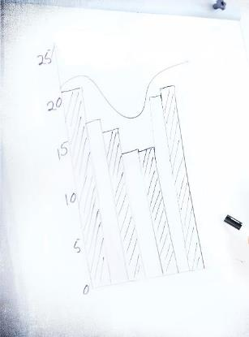
3. Identify the measures
Aligned with lifecycle
Relevant to stakeholders
Balanced
Initial Launch: Adoption and Engagement
Planning: Future Stories
Established: Business Value

Slide 24

QUANTITATIVE
QUALITATIVE
Performance between points
Spot trends
Provide context
Used when numbers aren’t easy
Used at early project stages
Richer (stories)

Slide 25


Make sure your measures are SMART
S
Specific
Clear and well-defined. Answers who, what, why, and where?
M
Measurable
Quantifiable and comparable. Is this something we can really measure?
A
Achievable
Realistic and actionable. Answers the question: “How can this be accomplished?”
R
Relevant
Is this worthwhile? Does this match our needs?
T
Time-bound
Deadline driven. Grounded to a specific target date.

Slide 26
Quantitative Business Metrics
Hours per week/year to execute a process
T x E x N x S
Time on Task (in minutes)
Number of Employees performing the task
Number of times per week/year a typical employee performs that task
Average loaded Salary per minute
Number of proposals/contracts per year
Average application training costs
“Time to Talent”

Slide 27
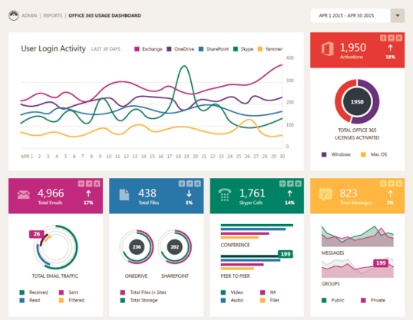
Quantitative System Metrics
Native Metrics (O365 Admin Console)
Third-Party Metrics (e.g. TyGraph)
Number of New Likes (for the monitoring period)
New Members
New Messages
New Private Messages
New Messages in Groups
New Files
New Pages
Total Members
Views and Downloads by Person
Percentage of Threads Responded to by User Not Mentioned
Percentage of Threads with No Replies
Groups Dashboard
YamJam Dashboard
Top Contributors

Slide 28
Look for system metrics that might be a proxy for something more valuable
Conversations that include participants who weren’t addressed or @mentioned
These are connections that would never have happened in email – which is inherently private.
Conversations with an ask for examples (that have an answer)
These shared assets might have only been exchanged privately – with more limited reach.
Conversations with a value tag
E.g. #YamWin
Posts with a lot of activity
These are the topics that people care about in the organization – which could provide insight into opportunities for change or innovation

Slide 29
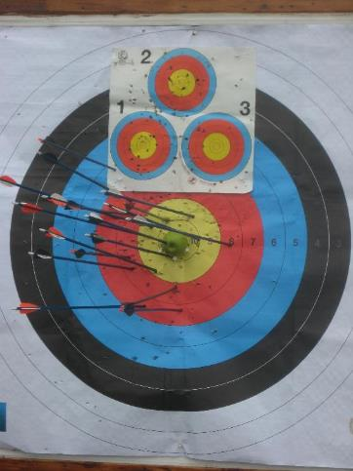
Establish a baseline
Evaluate where you are before getting started
Use surveys, benchmarking, and existing key performance indicators
If you don’t know where you are starting, how do you know where you are going and if you are making progress?

Slide 30

Qualitative Metrics: We need story!
Narrative is the way we simplify and make sense of a complex world.
You can’t compel change if your stakeholders don’t understand what you have done.
Stories with data provide evidence - “serious anecdotes”

Slide 31



Case Study: The Power of Story
A scientist with Thrombotic & Joint Diseases in Germany began at to isolate and culture macrophages and needed some help.
Meanwhile, two scientists in the US had deep experience in protocols for this area.

Slide 32
The German scientist consulted the network and found that expertise existed within the company and contacted the two scientists his search identified.
Both scientists quickly responded with assistance. One helped him with culturing protocols and the other helped him with information on magnetic cell sorting.
Benefit: The German scientist was able to leverage existing internal expertise and, in the process, reduce his research effort by four weeks.

Slide 33

“… not everything that can be counted counts,
and not everything that counts can be counted.
-- William Bruce Cameron (sociologist)
[Informal Sociology: A Casual Introduction to Sociological Thinking (1963)]
Measure what matters

Slide 34

Focus on results
“Adoption metrics do not address what matters most to each tier of participants (employees, managers, and executives). As long as adoption is the primary measure of success, resistance, at all levels, can block successful social software deployment.”
Source: John Hagel III, John Seely Brown, Duleesha Kulasooriya & Aliza Marks. Metrics that Matter.
<http://dupress.com/articles/metrics-that-matter/>

Slide 35
“Sometimes, the thing that matters doesn't make it easy for you to measure it.”
Number of users?
Number of activities?
Amount of time they spend on Yammer?
OK, but not as important as what those users DO with the information that they exchange!
Quote from Seth Godin: http://sethgodin.typepad.com/seths_blog/2015/02/measure-what-you-care-about-avoiding-the-siren-of-the-stand-in.html

Slide 36
Gathering metrics that matter
Try not to over-achieve
Automate where possible – look for good proxies in system metrics
Look at the process KPIs that your organization already captures
Remember that the measures will change as your enterprise social initiative matures
Get creative
Surveys, Usability Testing, Active Listening
Send out a “journalist”
Track by type, department, storyteller value metrics

Slide 37
Example Survey Questions
Were you able to solve a critical business problem? If so, please describe. (Or, can we talk to you?)
If given the choice, would you KEEP [the enterprise social tool]?
“Don’t take it away”
How does this COMPARE to other tools?
“User-friendliness” Rating
How easy was it to …?
“Intuitiveness” Rating

Slide 38
4. Present Results
Balanced Scorecard
Dashboard – measures plus story
Talk in the language of your executives!

Slide 39



Balanced Scorecard
Health
Capabilities
Business Value
Are users participating?
Is usage sustained over time?
What features are being used?
Are users leveraging the features that support the business use cases?
Do the users report that they are getting benefits from using the solution?
Is there a clear connection to a business KPI?

Slide 40
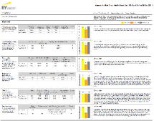
EY Yammer Group Dashboard
Clarity of purpose – does the group serve a clearly defined and unique purpose?
Leader engagement – are leaders modeling the desired behaviors?
Community manager engagement – are there visible managers also modeling appropriate and expected behavior?
Diversity of participation – how broad is the involvement within the group?
Quality of conversation – are posts useful?
Business value – is the group generating tangible business value (which might be measured as questions answered, ideas generated, or resources exchanged)
Source: Steve Nguyen and Tammy Young Heck, “Gain Organizational Insights with Yammer Data Mining and Analytics” Ignite 2015 BRK2119 https://channel9.msdn.com/Events/Ignite/2015/BRK2119 (Tammy’s story starts at 20:00)

Slide 41
Keep in mind …
Align where work gets done
Focus on business results-talk in business terms
Make sure someone is paying attention to metrics
Use metrics to plan change

Slide 42
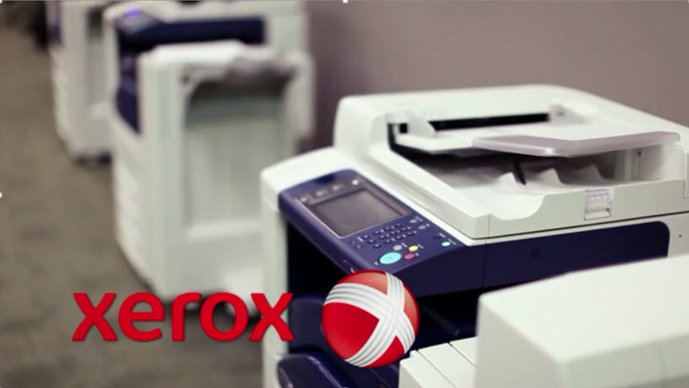
Xerox Case Study: Building Community for Productivity using Yammer
https://vimeo.com/47956216

Slide 43









About Me
President, Susan Hanley LLC
Led national Portals, Management Collaboration, and Content practice for Dell
Director of Knowledge Management at American Management Systems
Information Architecture
User Adoption
Governance
Metrics
Knowledge Management
Intranets & Portals
Collaboration Solutions
www.improveit.how
sue@susanhanley.com
susanhanley
www.susanhanley.com
www.networkworld.com/blog/essential-sharepoint

Slide 44
Examples and Resources

Slide 45
Resources
Websites and Articles
Fasttrack.office.com – Measuring Success Guide
Steve Nguyen and Tammy Young Heck, Gain Organizational Insights with Yammer Data Mining and Analytics – Ignite 2015 (BRK2119)
Improve It! by lots of people, including Susan Hanley, May 2015 – download for free at http://www.improveit.how
Dion Hinchcliffe: In Europe’s biggest firms, social business is all grown up, February 12, 2015. http://www.zdnet.com/article/the-growing-evidence-for-social-business-maturity/
McKinsey: Building the Social Enterprise, November 2013. http://www.mckinsey.com/insights/organization/building_the_social_enterprise
Tom Davenport, Deloitte Press, January 22, 2015. Why data storytelling is so important--and why we’re so bad at it http://dupress.com/articles/data-driven-storytelling/
Yammer Group Files (https://www.yammer.com/itpronetwork/#/groups/3944618/files)
Yammer “Pitch Deck” for Executives: https://about.yammer.com/success/wp-content/uploads/sites/13/Yammer-for-Executives-Pitch-Deck2.pptx
Successful Social Intranets: Creating business value through strategic alignment and adoption planning http://www.digitalworkplacegroup.com/resources/download-reports/successful-social-intranets/
Finding the Value in Social Business, MIT Sloan Management Review, March 18, 2014. http://sloanreview.mit.edu/article/finding-the-value-in-social-business
Moving Beyond Marketing: Generating Social Business Value Across the Enterprise, MIT Sloan Management Review, July 14, 2014. http://sloanreview.mit.edu/projects/moving-beyond-marketing/
Deloitte research white paper “Social software for business performance - The missing link in social software: Measureable business performance improvements.” http://dupress.com/articles/metrics-that-matter/
Intranet Metrics – Discovery, Satisfaction and Impact 30 July 2015 Martin White http://www.intranetfocus.com/archives/2294
Business Practices that Refuse to Die – Email Trees: https://www.youtube.com/watch?v=BE_fZqcdJnc
Books
How to Measure Anything by Douglas W. Hubbard, 2010
Essential SharePoint 2013 by Scott Jamison, Susan Hanley, and Chris Bortlik, 2013

Slide 46
Yammer Analytics
Level 1: Office 365 Admin Console
Level 2: Data Export
Level 3: Codename: Tosilog (Yammer + Power BI)
Level 4: Advanced Data Export
Level 5: Data Export & REST API
Level 6: 3rd Party Applications
Pros: Unified view of usage across Office 365 services
Pros: Ability to get granular with data
Cons: Need to use Pivot Tables or other BI software, No Access to Likes, Shares, File Views, etc.
Pros: Low Touch for Customer, Free
Cons: No Access to Likes, Shares, File Views, etc.
Pros: Access to Likes, Shares, File Views, etc.
Cons: Snapshot of data at a given time, Data needs to be shared outside of network.
Pros: Access to Likes, Shares, File Views, etc.
Cons: Requires Developer Expertise
Pros: Partners are able to provide sustainable and reliable analytics solutions
Cons: Requires some additional investment
Cons: Yammer Admins aren’t always Office 365 Admins so may not have access to these dashboards
Source: Ignite 2015 Session BRK2119 https://channel9.msdn.com/Events/Ignite/2015/BRK2119

Slide 47
Balanced Scorecard Example – Health Perspective
Perspective | Key Question | Measures
Health | Are people using the solution? How many? Who (which departments or roles)? | Number of users with complete profiles (overall and by department) Number of posts Number of profile searches Number of blog entries Number of likes Number of replies Number of replies by users not mentioned directly
 | Is usage sustained? | Trends over time for each of the key measures above
 | What features are used the most? | Comparison of features such as blog posts, activity posts, likes, replies

Slide 48
Balanced Scorecard Example – Capabilities Perspective
Perspective | Key Question | Measures
Capabilities | Is usage supporting the identified business use cases? | “Serious Anecdotes” – stories from user surveys where users report specific use cases and value measures based on the moments of engagement identified in the deployment plan
 | Do users perceive that they are getting value? | Survey questions asking users whether they feel that they can collaborate more easily and resolve issues more quickly Survey questions asking whether users can find people with the expertise that they need Survey questions asking users to rate whether they would like to take the tool away (what I like to call the “Don’t Take it Away” metric)

Slide 49
Balanced Scorecard Example – Business Value Perspective
Perspective | Key Question | Measures
Capabilities | Is there a clear connection with respect to the overall business strategy? | What has happened with business key performance metrics since the social tools have been deployed? Average time for call centers to resolve customer issues Average time-to-market for new products Average proposal response time Average “time to talent” for new employees (cost/time for on-boarding) Annual staff turnover Customer satisfaction Ability to handle “exceptions” – situations that don’t fit standard processes and require reaching out to experts or multiple departments for resolution What content is used the most?

Slide 50
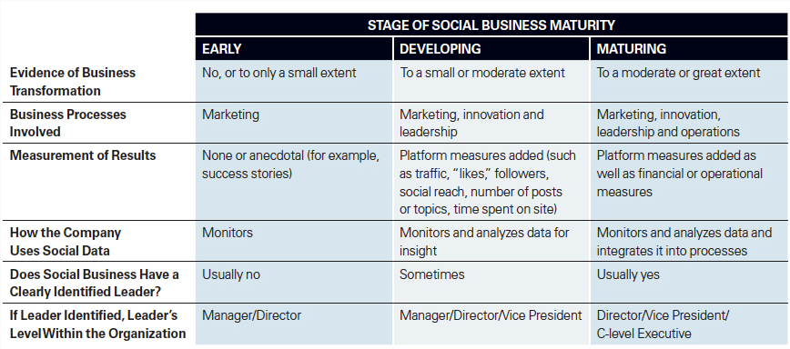
Measures change as your social business practices evolve
Source: http://sloanreview.mit.edu/article/finding-the-value-in-social-business

Slide 51

Tips from Stan Garfield at Deloitte Global Services:
Share a link. “Here is a link to the latest Forrester Wave report on social networking.”
Ask a question. “Has anyone encountered this problem before, and if so, how was it solved?”
Find a resource. “Looking for a specialist in retirement benefits to help win a bid in Calgary.”
Answer a post. “Here are links to three relevant quals in the quals database.”
Recognize a colleague. “Thanks to @dpalmer for hosting an excellent planning session today.”
Inform about your activities. “Will be in the Philadelphia office today; does anyone wish to meet?”
Suggest an idea. “Local office TV screens should display the global Yammer conversation stream.”
In order to deliver value, you need to get started.
Try SAFARIS!

