Slide 1
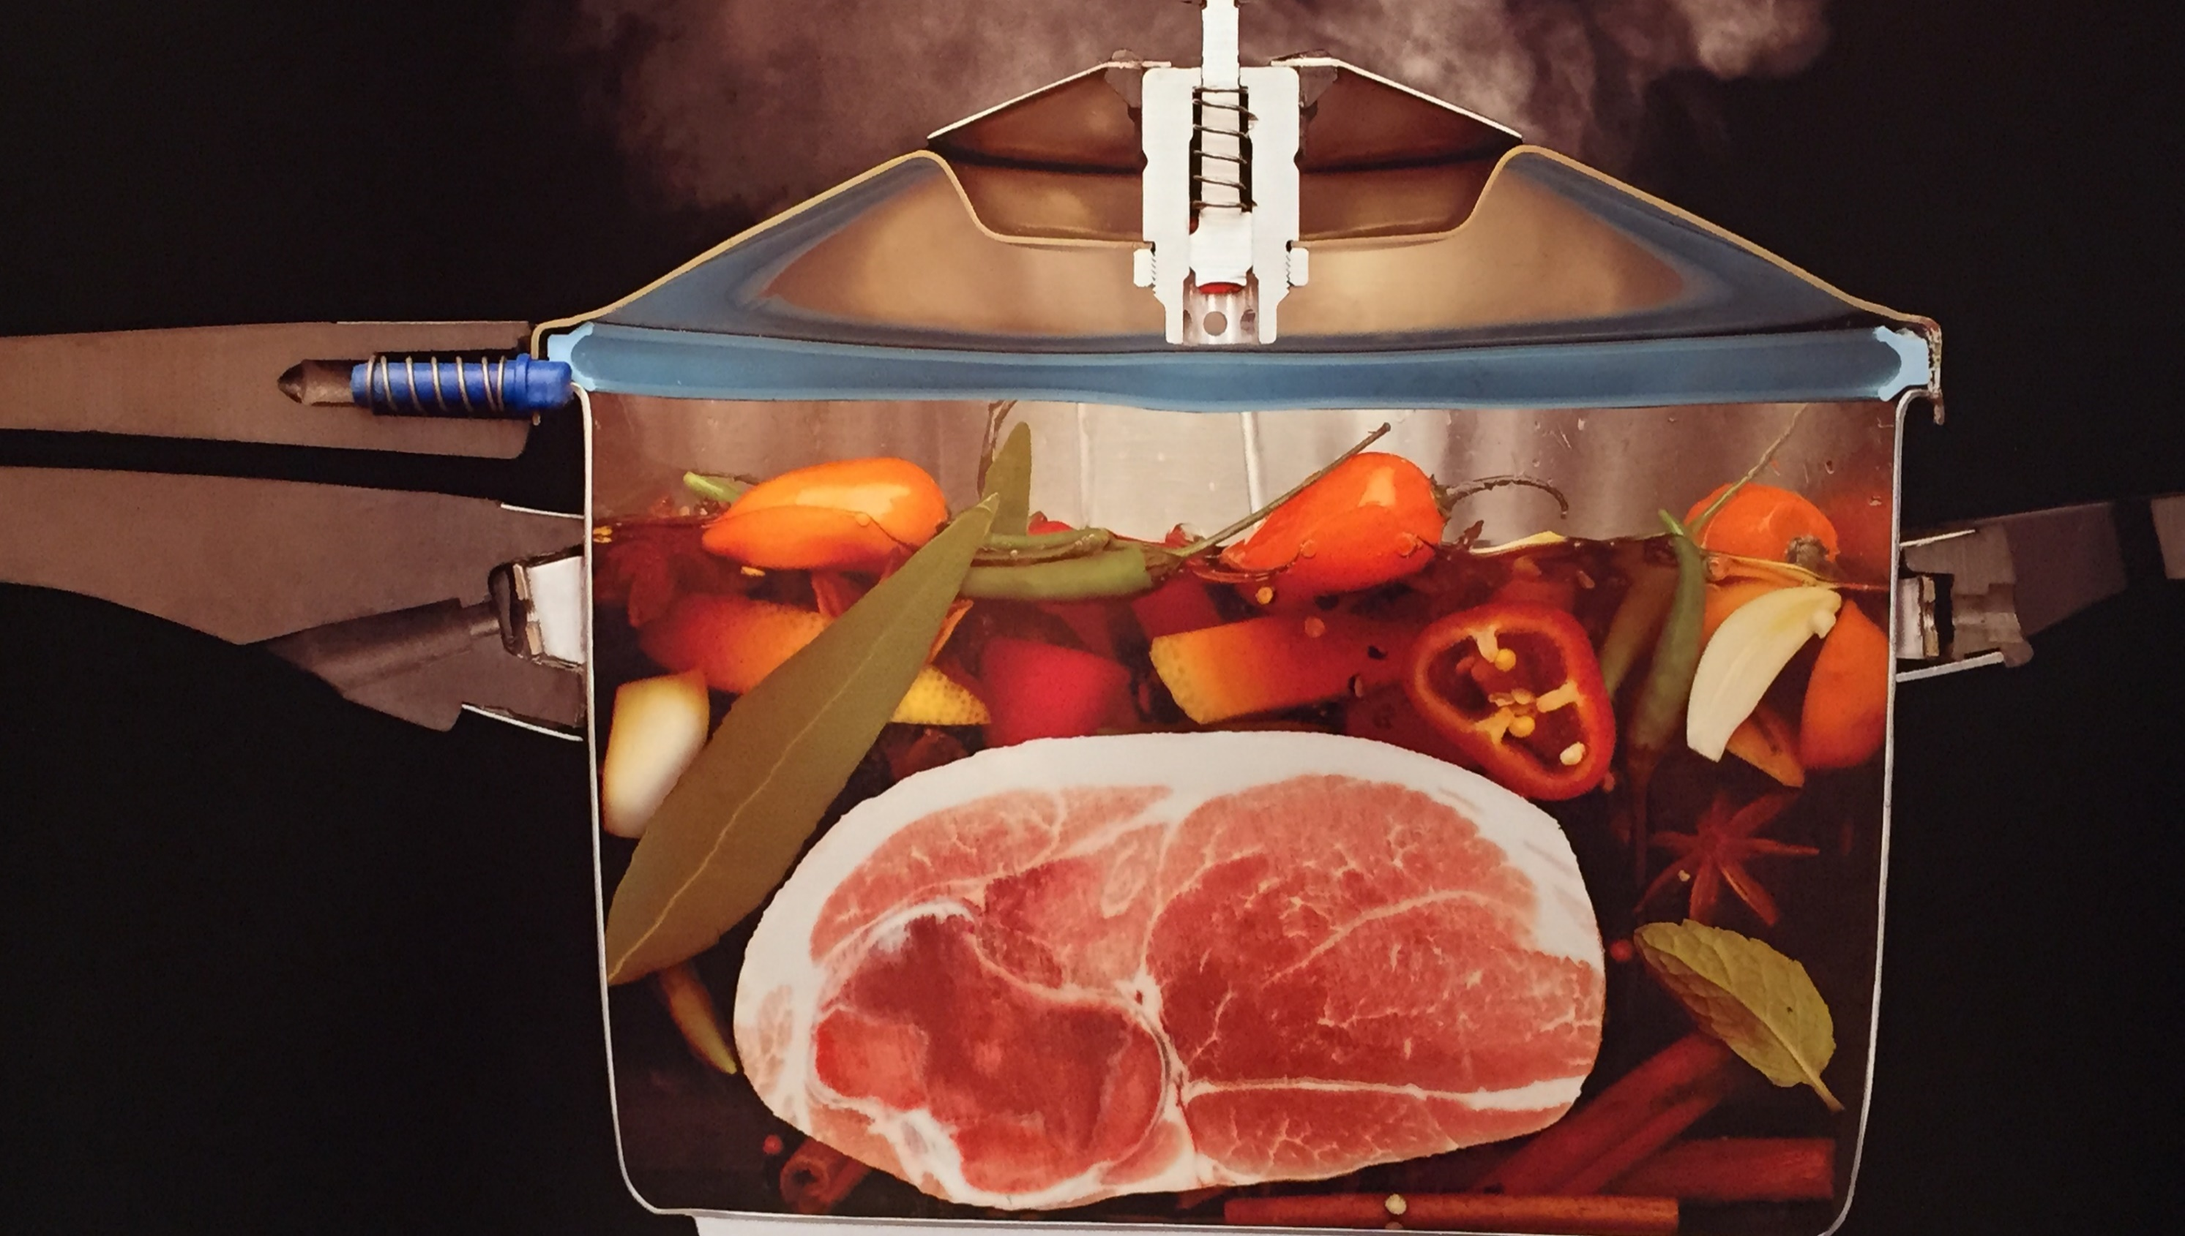
Step by Step Approach to Create Your Own Consumable SharePoint Governance Plan
Susan Hanley
SharePoint Saturday Twin Cities
October 24, 2015
www.susanhanley.com
©2015 Susan Hanley LLC

Slide 2



Typical Governance Plan
Notes:
What does it mean to have a consumable governance plan?
A typical governance plan is a BIG FAT DOCUMENT.
What’s the problem? No one wants to read it!!! Forget WANTS, no one DOES read it!
So, what happens? You end up with the wild, wild west!!
Images: Microsoft royalty free images

Slide 3

Why does governance need to be “consumable?”

Slide 4

Understand what your end state goal really is!
The end game for governance is BUSINESS RESULTS!
Notes:
To set the stage when talking about governance, it’s important to focus on the purpose of your governance plan. Why do you need one? What is the end game?
The reason we need a governance plan is to ensure that we get the BUSINESS RESULTS we are trying to achieve. Practical GOVERNANCE is the plan to get there. Consumable governance means that the path is clear. We want JUST ENOUGH and JUST IN TIME!
Governance Goals:
Avoid sprawl
Ensure quality
Deliver a great user experience
Provide clear decision making authority
Align with business objectives
Comply with record retention and regulatory policies
Communicate best practices
ACHIEVE BUSINESS RESULTS
Governance is the means to the end.

Slide 5

Notes:
So the real question is: What do we do about this? The answer – SOMETHING DIFFERENT!!!

Slide 6
Demo

Slide 7
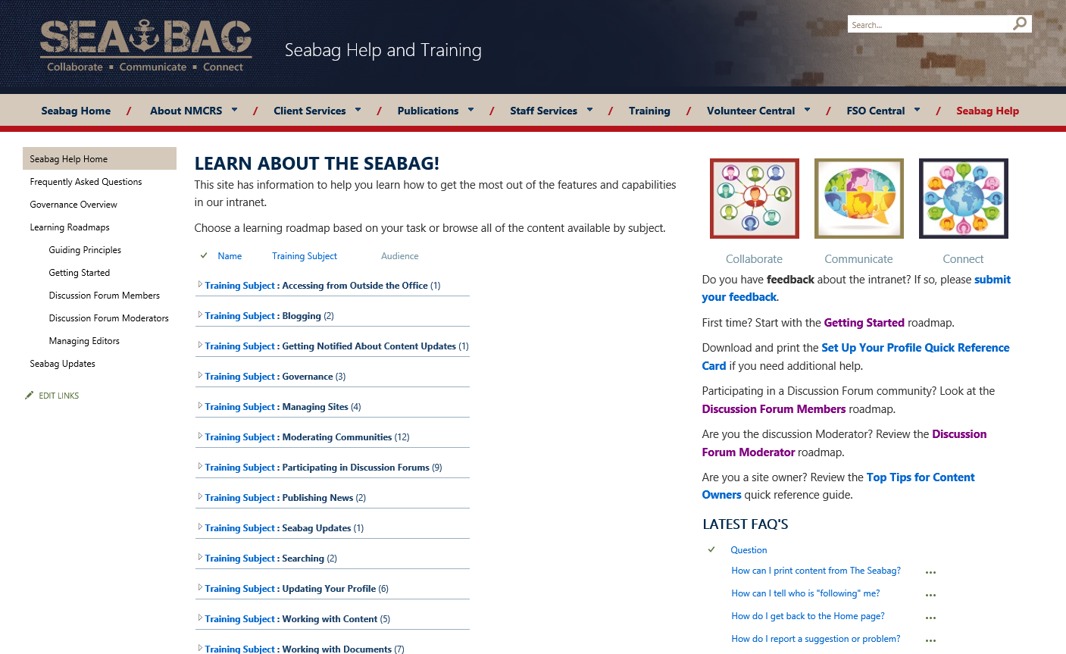
Demo Fail Backup Slide ☺
Training and governance content in one place
Content grouped by “topic”
“Learning Roadmaps” to get people started

Slide 8
Understand and Plan
Understand what needs to be governed
Create the governance content
Deliver the content when and where it is needed
Notes:
Now you have the target – we can focus on how to get there!

Slide 9
Understand What Needs to be Governed
Governance Planning Tool
More than 100!
Updated Regularly
What are we going to allow?
Who is responsible for what?
What kind of training do I need for what type of privileges?
Who is in charge of keeping everyone in line?
What happens to the bad kids?
SharePoint/Office 365/Yammer Governance Questions
http://tiny.cc/SharePointGovQuestions
Key Governance Question | Decision/Answer | Reference
What types of overall corporate policies for information management, business, or technology management apply to the solution? Are there existing legal, IT and information management policies that Communities must follow? Use of IT Resources Electronic Communications Social Media Policy Protection of Personally Identifiable Information Records Management
SharePoint-ish, but not exclusively
On prem and
cloudy
Notes:
Check out other presentations on my website to learn more about my suggested approach for creating the content.
Once you understand what needs to be governed, you need to ask the right question to understand the key ELEMENTS of the content you need to create. This means understanding WHO it is for and WHAT they need to know.
To make this easier, I’ve created a set of governance questions that I use in my consulting practice – and that I share with the community. You can use this to help guide the conversations you will want to have to understand want needs to go in your governance content.
Key decisions
What are we going to allow?
Who is responsible for what?
What kind of training do I need for what type of privileges?
Who is in charge of keeping everyone in line?
What happens to the bad kids?

Slide 10
Create the Governance Content
Policies
Build in templates
Automate validation
Guidelines
Automate validation where possible
Support with training
Remind in context
Roles and Responsibilities
Add to job descriptions
Align with training
Review on a regular basis
Notes:
Your content will basically consist of three main types of things: Policies, Guidelines, and descriptions of Roles and Responsibilities. In this session, we’re not going to focus on CREATING the content. What I want to talk about is the THIRD element of the process I outlined earlier – delivering the content when and where it is needed. And that basically requires THREE THINGS.
Policies – mandatory rules that are required for compliance
Guidelines – recommended best practices that should be followed unless there is a valid business reason not to
Roles and Responsibilities – people and tasks that promote the guidelines, educate users, and monitor compliance

Slide 11
Content principles
Single focused pages - one “page” per topic
Write for the reader – use header styles to emphasize and make the pages scannable
You HAVE more time – so write the shorter letter!
“Je n’ai fait celle-ci plus longue que parce que je n’ai pas eu le loisir de la faire plus courte.”
--Mathematician/Philosopher Blaise Pascal
Notes:
Though people want to attribute this quote to Mark Twain, if you want to know some useless trivia, it’s original source is more likely to be Blaise Pascal. A modern translation of this text is: “I have made this [letter] longer than usual because I have not had time to make it shorter.”

Slide 12
Deliver Just-in-Time
Content
Container
Delivery Mechanism

Slide 13
Building the container
A library of content based on your decisions
  Publishing or Team Site? It depends.
Metadata to organize the content
Web parts to “connect” the content

Slide 14
The Steps: Overview
Step 1: Create the Site (Container)
Step 2: Create Columns and Content Types
  Create the columns
  Create the content type
Step 3: Edit the Site Pages Library and Create Views
  Add the content type to the Site Pages Library
  Create Custom Views
Step 4: Add Content Pages
  Add the page and select the layout
  Assign metadata – don’t forget the Title
Step 5: Connect Related Pages
  Link
  Content Query
Step 6: Create Roadmaps
Step 7: Add Additional Just-in-Time Delivery

Slide 15
Step 1: Create the Site
Choose Publishing or Team Site
OR, start with the template site (a team site) and you don’t have to do Steps 1-3.
If Team Site:
  Remove the Getting Started links from the home page
  Delete the Newsfeed web part on the home page
  Deactivate the Newsfeed Site Feature
  Delete the Documents library on the home page
  Delete the Site Notebook (from the Site Assets library) and deactivate the Site Notebook feature

Slide 16
Step 2: Site Columns and Content Types
Create your Site Columns
Create a Site Content Type called Training Page
Add the 3 Site Columns
Change the Column Order
See next page for Site Column definition
Content Type – Governance and Training Page
  Name: TrainingPage (rename Governance and Training Page in a second pass)
  Description: Create a new Governance or Training page.
  Select parent from: Document Content Types.
  Parent Content Type: Wiki Page
  Group: Training and Governance Content Types
  Site Columns:
    Page Type
    Training Subject
    Audience
  Column Order:
    Name, Page Type, Training Subject, Audience, Wiki Content

Slide 17

Site Columns
Page Type (dropdown)
  Governance
  Training
  Roadmap
Training Subject (dropdown)
  Blogging
  Complying with Governance Requirements
  Complying with Records Management Requirements
  Managing Sites
  Moderating Communities
  Searching
  Using Social Tools
  Working with Documents
  Working with Images
Audience (checkbox)
  All Users (default)
  Community Moderator
  Content Contributor
  Managing Editor/Content Manager
  Site Sponsor
These are examples of Training Subjects. You will likely have more – but try to see if you can keep the number under 20.
Notes:
For Page Type, you can choose to leave a default value or not.
Description: Type of page.
For Training Subject, I like to use verb phrases. If you want to do “group by” views, this will need to be a dropdown choice field. Be sure to add a Description such as: Primary subject for this page. I usually erase the default value.
Description: Primary subject for this content.
For Audience, keep the list simple and make sure that these roles are aligned with the Roles that you define in your governance plan.
Description: User audience(s) for whom this content applies.

Slide 18
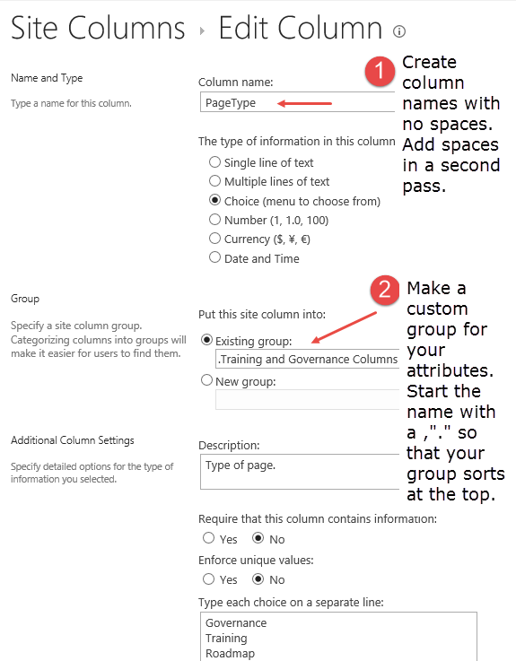
Tips for Creating Site Columns
Notes:
Gear > Site Settings > Site Columns
Decide if you need a default value. If not, be sure to erase the automatic default.
The reason you want to create column names in “CamelCase” is that spaces in the names get encoded with a long string of characters (x0020) replacing each space in the “behind the scenes” name. If you create your columns in CamelCase, it will be easier to use them in Content Query and Content Search web parts.

Slide 19
Step 3: Edit the Library and Create Views
Add your custom Content Type to the Site Pages library
Edit the All Pages view to make sure it shows Title and your custom columns
Make your custom Content Type the default by placing it in position 1
Suggested column display order for the All Pages view:
  Type - 1
  Name - 2
  Title - 3
  Page Type - 4
  Training Subject - 5
  Audience - 6
  Modified By - 7
  Modified - 8

Slide 20
Step 3: Library and Views, continued
Create a view that filters for just Training pages and another that filters for just Governance pages.
In the Training page view, Group By: Training Subject.
View tips:
  In these views, you do not need to display the Page Type since you are filtering for Page Type. You also don’t need to show Title.
  Choose Name (linked to document) instead of Name (lined to document with edit menu)
  Sort by Name, ascending
  Filter: Page Type = Training (or Governance)
  Training pages view: In this view, I typically do not show Type, Title, Modified By, or Modified because this is the view that I’ll use on the home page of the site. I also un-check Training Subject since that is used in the Group By.

Slide 21
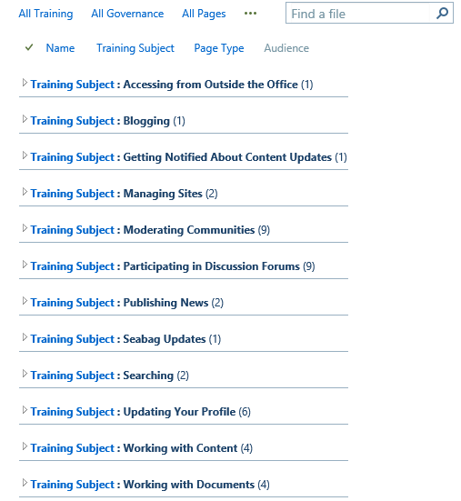
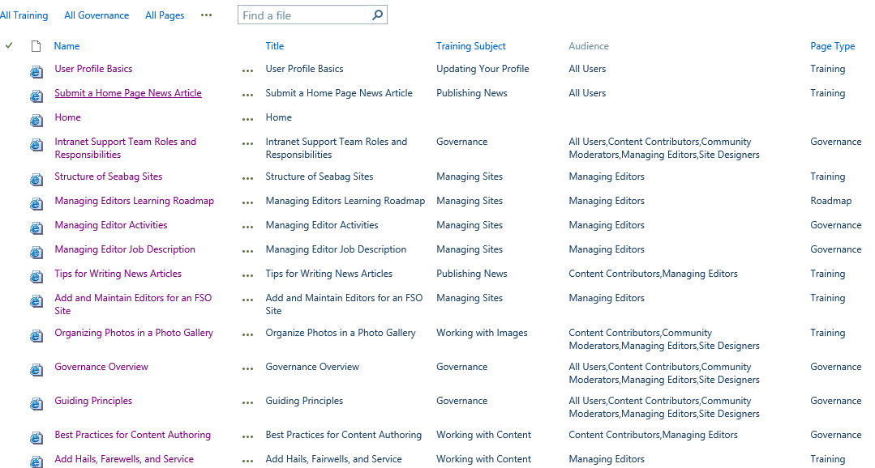
Create different views of your library for different contexts –for people managing content as well as consuming

Slide 22
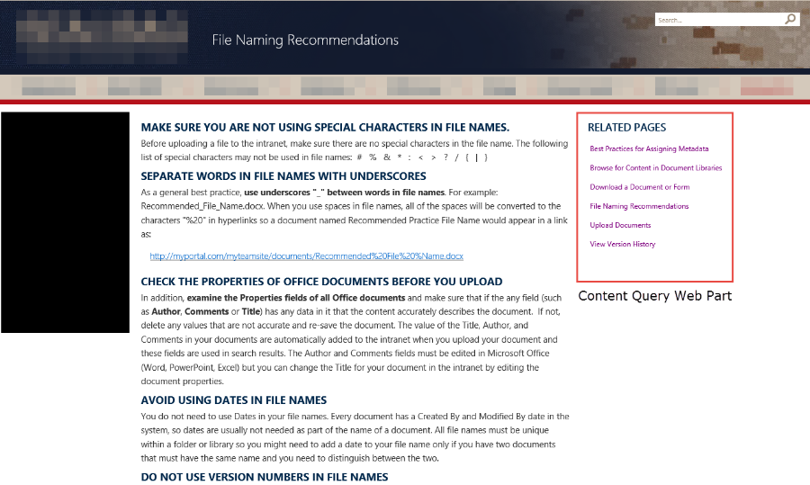
Step 4: Add Content Pages

Slide 23
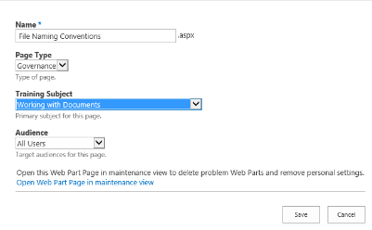
Step 4: Add Content Pages
Gear > Add page
Give the page a name – it’s OK to use spaces
Choose the Text Layout
Edit the Page Properties in the Ribbon
  PAGE > Edit Properties
Give the page a Title from the Quick Edit view in Library Settings.
Note that you can’t edit the Title from the properties page. This can only be done using Quick Edit in Library Settings.
Use “one column with sidebar” for the Text Layout of pages.
The reason you want to add a “clean” title to each page is for the CQWP to show related content.

Slide 24

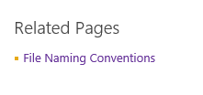
Here’s why you want to add Titles to pages
Before
After

Slide 25
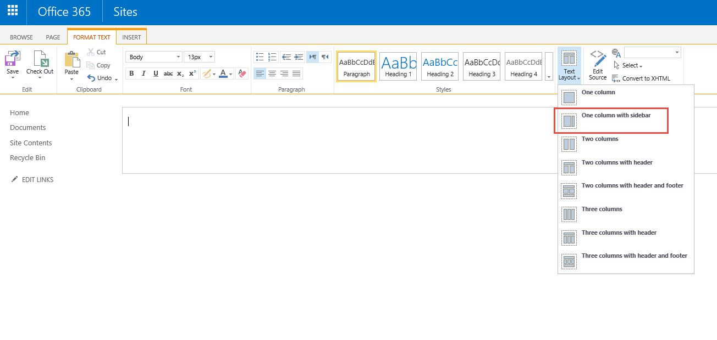
Text Layout for Content Pages
Notes:
When you create Wiki pages, it doesn’t matter whether you create the page name with spaces or without – SharePoint is going to replace the spaces in the URL with %20 no matter what you do.

Slide 26
Step 5: Connect Related Pages
Use inline hyperlinks to provide details or more information about a specific topic referenced on a page.
Use related pages to group content that is about the same topic.
Keep content pages focused and short.
Keep your pages “scannable.” Don’t use “click here for more information.” Add a hyperlink directly to the topic.

Slide 27
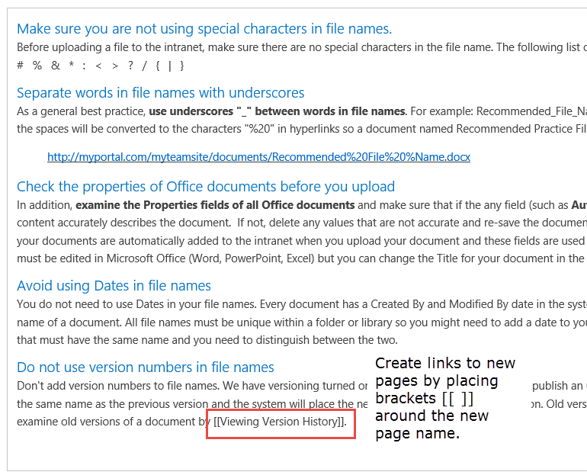
Step 5: Connect Related Pages – Inline hyperlinks
If you want to create a link to a page but you don’t want to use the exact name of the page as your hyperlink, use a Pipe character to separate the terms.
For example, if this is what you want the text to read
… by creating an alert for that document.
but the page is called Setting Up an Alert, you can create a link using the following syntax in Edit mode:
…by [[Setting Up an Alert|creating an alert]].

Slide 28
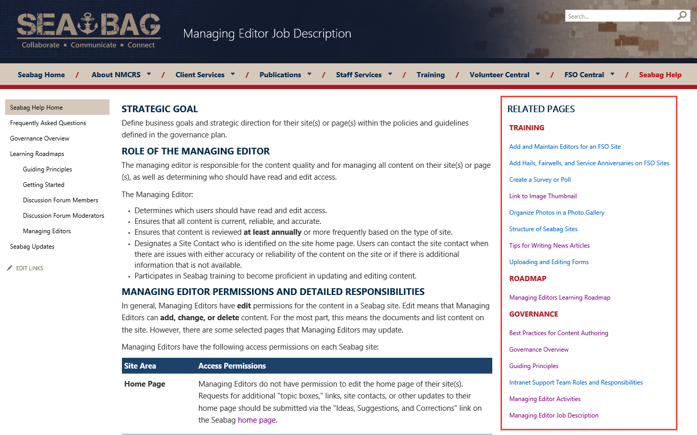
Step 5: Connect Related Pages – Content Query Web Part
Shows “more like this
Dynamic
Like Amazon recommendations – if you like this page, you’ll probably like this one too!
Notes:
Note: Publishing features must be enabled for the Site Collection in order to see the Content Query Web Part as an option. They do not have to be enabled on your individual site.

Slide 29
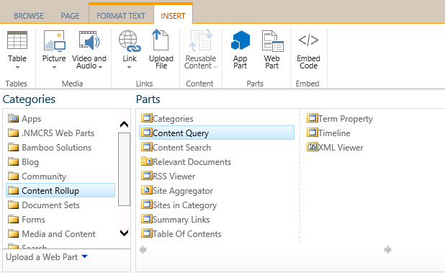
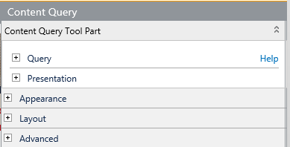
Create a Content Query Web Part
Insert Web Part>Content Rollup>Content Query
Edit Web Part in the tool pane
  Query Source: point to the Site Pages library on the site you are on
  Additional Filters:
    Show items when Training Subject is equal to [Subject for the page you are creating]
    Add other filters if needed (for example, in some contexts, you may want to filter by Page Type)
  Presentation
    Uncheck the box that limits the number of items to display
    Sort by Name, Ascending
  Style
    Choose an Item Style that aligns with your other lists and branding. I usually pick Bulleted Title.
  Appearance
    Pick a title like Related Pages. If you are going to save the web part to re-use, make sure that you give it a unique title, such as Related Pages-Documents, so that you can easily find the web part in a list. You can always change the default title each time you use the web part on a page.
Notes:
After you create a content query web part, you can export it so that you can re-use it in other similar contexts. Yes, you will create one CQWP for each context but you will not need any custom code – or a developer to do this (and you only make each web part one time – and you can re-use existing web parts to create new ones).
Note: Publishing Features must be activated for the Site Collection in order to use CQWPs.

Slide 30
Step 6: Create Roadmaps
Provide overview guidance on the Governance and Training site home page
Create a roadmap to guide users by role
View of content to collect content by type (e.g. all Governance, all Training)
Assume that users play multiple roles on different sites, but when they come to the home page, they know what “hat” they are wearing (or want to wear).

Slide 31
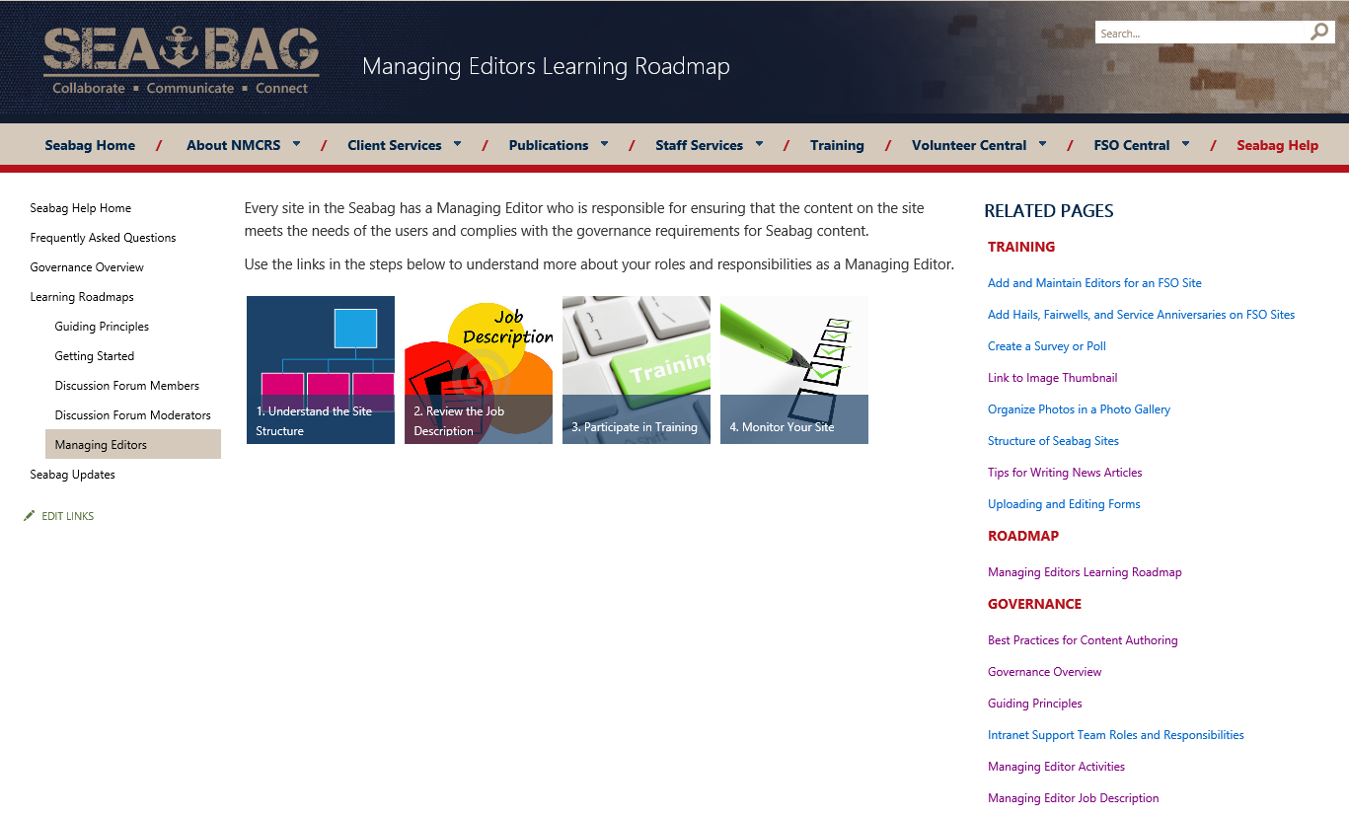
Roadmap Example

Slide 32
Tie it together
Design a home page – consider multiple scenarios
Incorporate your guiding principles
Consider your “in context” delivery options

Slide 33
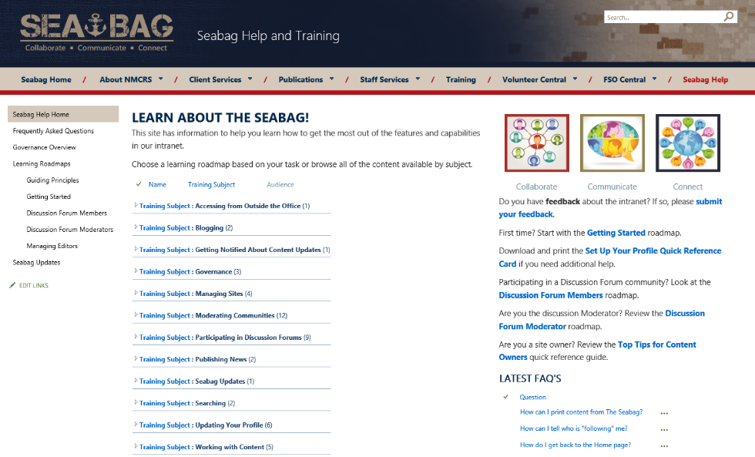
Sample Home Page User Scenarios
Search: I know what I want but I don’t have a clue where it might be
By Subject View: I know what type of action I want to take and I want to see what my options are
Roadmaps: I’m trying to get an overview of what I need to do for this role I’ve signed up for OR I need a “one stop shop” for a point in time – e.g. Getting Started.

Slide 34
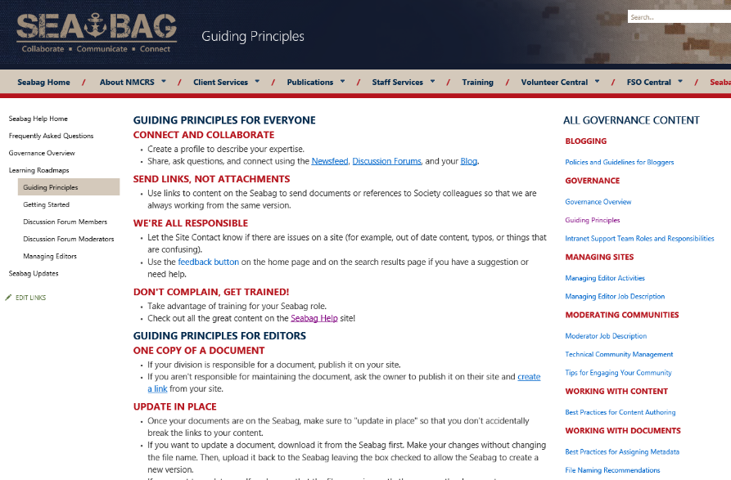
Sample Guiding Principles

Slide 35



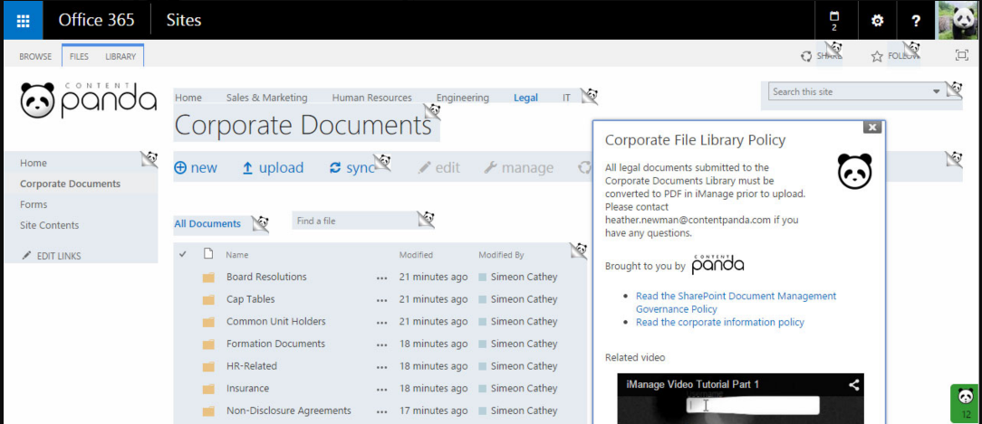
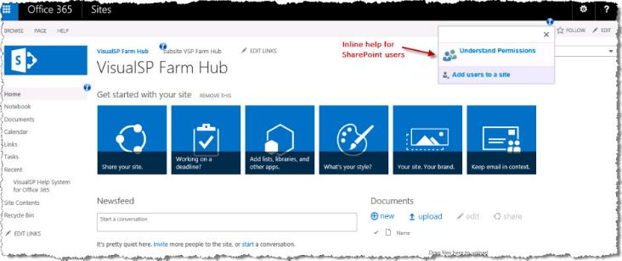
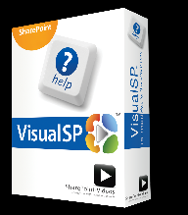
Step 7: Add Just-in-time/In Context Delivery
Point users to the site in top navigation
Add links in context to relevant pages
Use a third party tool to contextually deliver your content (plus more)

Slide 36
Key Take-aways
Consumable content is not delivered in long documents
  Short pages
  Supplement text content with short video where you can
Guide users to related content using shared metadata, related pages “roll ups”, and hyperlinks
Deliver “in context” where possible
  It won’t be enough just to have the site.
  You need to be able to deliver what people need just when they need it.

Slide 37























Thank you #SPSTC sponsors!

Slide 38









Connect with me!
President, Susan Hanley LLC
Led national Portals, Management Collaboration, and Content practice for Dell
Director of Knowledge Management at American Management Systems
Information Architecture
User Adoption
Governance
Metrics
Knowledge Management
Intranets & Portals
Collaboration Solutions
www.improveit.how
sue@susanhanley.com
susanhanley
www.susanhanley.com
www.networkworld.com/blog/essential-sharepoint
Notes:
Want some templates for Excel and OneNote to help with wedding planning? Visit IT Unity:
http://www.itunity.com/article/office-wedding-spreadsheets-820
http://www.itunity.com/article/office-wedding-onenote-836

Slide 39
Resources

Slide 40
Library Decision: Wiki Pages or Publishing Pages?
Capability | Wiki Site | Publishing Site
Page Layout | Easily changed using Text Layout – but not easy to make consistent. | Easy to enforce consistent page structures using page templates, but harder to create page templates since they need to be configured in advance, often by a developer.
Modifying Page Layout Based on Content | Easily changed – assuming that available Text Layouts meet the need. | Harder to change since a new page layout would have to be developed (unless one of the “out of the box” structures happens to meet the need).
Reusable Content | Use hyperlinks to direct users to the shared content – but that takes the user to a different page. | Content that is shared on multiple pages can be stored once as Reusable Content at the root of the site and the “inserted” in as many pages that need it using variables. To the end user, this looks as if the content is on the same page. Better approach if there is a lot of reusable content.
Hyperlinks Between Pages | Easy to create using the standard [[ approach to add or link to new wiki pages. Super easy for content managers if there are lots of interconnected pages. | User must use Insert Hyperlink for each link and find the page to connect to. (More steps than for a wiki page. Less convenient than the wiki page approach if there are a lot of hyperlinks between pages.)
Notes:
There are pros and cons to both options. I prefer a Team Site with wiki pages, but your mileage may vary.

Slide 41
Library Decision: Wiki Pages or Publishing Pages?
Capability | Wiki Site | Publishing Site
Reviewing Content Prior to Publishing | Can add formal workflow if required, but can also save major and minor versions for a simple workflow process. Manually have to check in and publish pages on the day you want them to “go live.” | Built in formal workflow as well as formal scheduling (using automated process) of when pages “go live.”
Adding Images to Pages and Controlling Layout | Much easier for content creators – but you do need to have a plan for where images will “live.” | More formal process to add images to pages.
Adding Metadata to Pages | All done in the Page Properties view. New metadata is automatically visible to the content manager when it is added to the Site Pages library. | Can be added to the editing view of the page itself, but each new layout must be created in advance and every time you add a new metadata value, the page template needs to be updated.
Location of New Pages | Site Pages library. | Pages library.

Slide 42
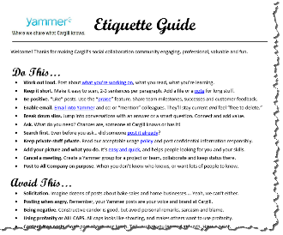
Sample Content
File Naming Recommendations
Sample Guiding Principles
Cargill Yammer Etiquette Guide (from Office 365 Yammer Network|Yammer & Enterprise Social Group):
  https://www.yammer.com/itpronetwork/uploaded_files/29825344

Slide 43
Links
Governance Questions: http://tiny.cc/SPGovQuestions
Content Authoring Quick Guide: http://tiny.cc/SPContentAuthoring
Governance Site .wsp http://tiny.cc/SPGovSiteTemplate
  Works only in Office 365 (see instructions on next page)
Sample Social Media Policies
http://socialmediagovernance.com/policies/
Notes:
Template will not work in on-prem but approach will. Just need to follow the steps in the presentation to re-create.

Slide 44
Using the Template (Office 365 only)
Create a new Site Collection using the Team Site template.
Enable the SharePoint Server Publishing Infrastructure site collection feature.
From Site Settings, go to Galleries > Solutions and upload the .wsp file to the solutions gallery and activate it.
Go to Site Contents and create a New Subsite using the Governance Site Template (found in the Custom tab.) You can use all the default site settings.
Your new site will have a home page and 3 content pages. You will need to “re-point” the Related Pages web parts to the Site Pages library on your site per the instructions in this deck.
All of the Site Columns and Content Types described in this presentation will be there.

Slide 45
Tips for Content
Try to keep all content to one page
If you need to use more pages, use in-page anchor links and create a summary at the top
Create [[ ]] links to other pages if you need to expand an explanation
Use tables if you need to get more control about the display of text
Assign a target role to each page – so that you can create role-based learning roadmaps

Slide 46
Tips for Using Images on Pages
Create images that you want to use on your pages and store them on your computer or in a file share until you are ready to use them on your page.
Upload them to the page when you are creating the content.
SharePoint will automatically create a Folder with the name of the page in the Site Assets library and store your images in that folder.

