Slide 1

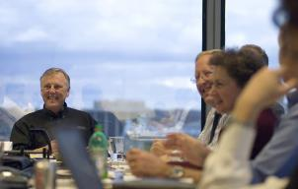


Sometimes, you have to kiss a few frogs:
A SharePoint Upgrade Story … with a few warts!
SPTechCon Boston
September 18, 2014

Slide 2
Once upon a time, …
There was a company called SSOE.
The Current Environment included several key solutions
But, all was not well, so Project and Business Goals were established.
We established a team to Understand Critical Business Needs.
And brought in a development partner to help us execute.
Uh Oh! Problems ensued!
But we worked them out and learned some Key Lessons.
Take a look at where we are today …
… and our evolving happy ending.

Slide 3







Your Storytellers
Susan Hanley
Tony Hiss
sue@susanhanley.com
ahiss@ssoe.com
www.susanhanley.com
www.ssoe.com
susanhanley
anthonyhiss
susanhanley
www.slideshare.net/susanhanley
http://www.networkworld.com/blog/essential-sharepoint/

Slide 4
SSOE specializes in managing design, procurement, and construction management
Full-service, global EPCM firm
Founded in 1948
Privately-owned
ISO 9001:2008 certified
1,000+ associates
Core competency: project management and project delivery systems
Leaders in Virtual Design & Construction

Slide 5
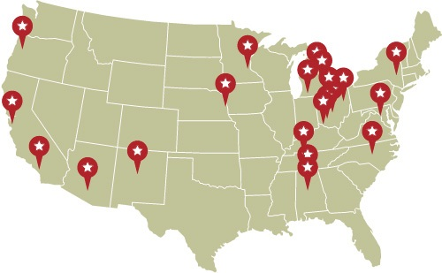
SSOE Office Locations – U.S.

Slide 6

Global Locations
Brazil
Canada
China
India
Malaysia
Mexico
Singapore
United States
8
Offices in countries

Slide 7


Once upon a time, team collaboration was messy
Key goals:
Create a consistent user experience
Make information “findable”
Simplify collaboration

Slide 8

Users needed and expected …
Intuitive paths to information for teams, disciplines and SBUs
Reliable and relevant search experience
Better access to experience and expertise
Simple content management processes to keep content alive

Slide 9

So, we began an adventure … to SharePoint 2013 and beyond!
What does this mean for our users?
Easily find what you need with improved browse and search:
Consistent user experience and fast and reliable search results
Integrated social experience:
Find and connect with people, not just documents
Quick start templates aligned to business purpose:
Different templates for different scenarios – with features that you need built in

Slide 10
We sold and told the story internally …
Find what you need when you need it
Manage SSOE’s exploding volume of data
Enable more efficient knowledge transfer
Simple access to critical business information across the company.
An easy way to access and collaborate on documents.
Build communities that span SBUs, disciplines, and locations.
This overload of data makes it difficult for employees to find, use or share information that is critical to their jobs.
We’re taking action now to manage information and boost our productivity.
Search for a topic and find experts in this area.
Help connect you to the information you need to avoid re-inventing the wheel.
Retain valuable knowledge from long-time employees.
Help newer employees learn quickly.

Slide 11
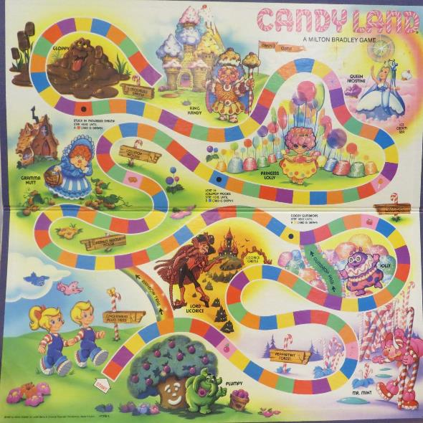
… and began a journey that felt a little like a board game, not a fairy tale
Starting out on the way to the Peppermint Forest
Drawing a card sending us back to the beginning
Occasionally getting stuck in the Molasses Swamp

Slide 12

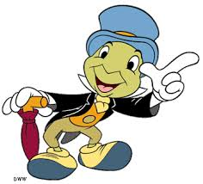
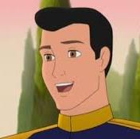


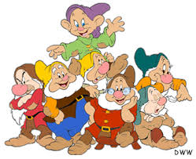
Introducing the characters in our story (aka the players in our game)
Staring Roles from SSOE
Supporting Players
Mary Stepnick
Director, Quality Systems
Executive Sponsor
Sue Hanley
KM and IA Strategy Consultant
Tony Hiss
Assistant Project Manager
SharePoint Lead
SharePoint Dev Company 1
Leslie Accardo
Project Manager
Project Manager, TeamSSOE
SharePoint Dev Company 2

Slide 13



Our Key Challenges: Drawing the right card!
Define the Problem
Select the Partner
Manage the Process
Guide the Deployment

Slide 14
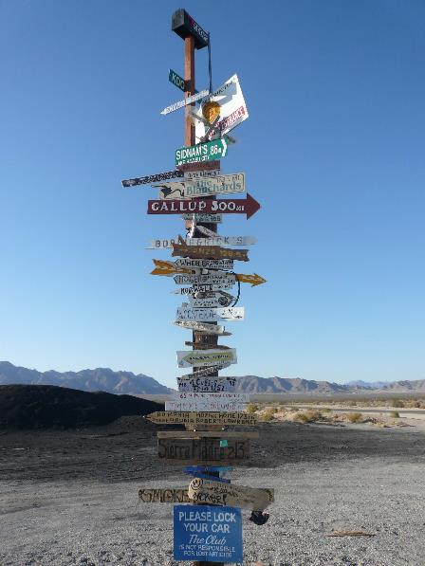
Define the Problem: They can’t know what you don’t know
If you don’t know what you want, it’s hard to ask for help
If you don’t know what you want, it’s hard to find it

Slide 15

Wart removal technique: Do your homework
No matter how hard it is, you have to define the outcomes

Slide 16
Selecting the right partner put us in to an entirely new story: SSOE and the three bears!
The story had the wrong ending
The first partner proposed the wrong solution.
It just didn’t fit in the longer term context – though it might have solved a point solution.
The proposal didn’t make sense
The numbers didn’t add up.
The numbers seemed REALLY high for tasks that seemed simple.
It didn’t feel like we were speaking the same language.
Every conversation seemed to have a disconnect.
This was our fault too!
Know what you are asking for – or take the time to figure it out.

Slide 17

Wart removal technique: Trust your gut.
If it doesn’t smell right, it doesn’t smell right.
If it doesn’t make sense, ask for a do-over – even in the proposal stage.
If it doesn’t seem right, act – don’t wait.

Slide 18
Manage the Process: Teams first
SBU
Discipline
Internal Committee
Internal Team
Access reports secured by role
In the future, access an interactive reporting dashboard
Find best practices
Engage in conversations with experts
Share and collaborate on documents in one place
Publish and share calendar events
Share and collaborate on documents in one place
Publish and share calendar events

Slide 19
We started out with the right tasks …
Review existing solution and work processes
Interview and observe key stakeholders
And then we waited.
And waited.
And waited.

Slide 20
Wart removal technique: Hold the partner accountable for deliverables … the kind that are written down!
Hold your partner accountable
We should have had much more clarity about the structure and format of each deliverable … and held the partner accountable when the written deliverable never showed up.
It doesn’t exist if you can’t “touch” it
Written deliverables allow you to make sure that you are on the same page … we ended up appearing to be in completely different novels!
Be reasonable
Don’t ask for deliverables that are impossible for your partner to deliver. Challenge, but know when to back off.
But, make sure the deliverables you are going to get are clear.

Slide 21

Wart removal technique: Find a trusted advisor

Slide 22

Wart removal technique: You’re talking – make sure they are listening
It’s a relationship, listening goes both ways.

Slide 23
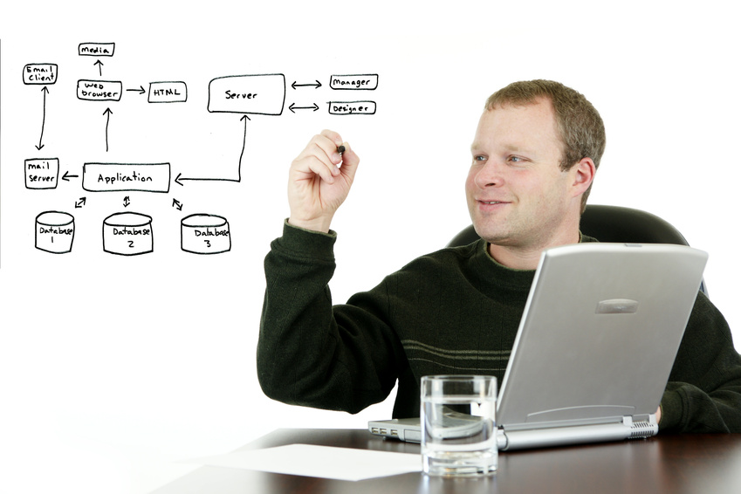
Wart removal technique: Preview executive presentations first!
Any time you ask someone to present to your executives, do a preview first!
Make sure they are able to deliver the right message in the right language!

Slide 24

Wart removal technique: Don’t be afraid to change out the players
The project is the team; the team is the project.
If one player isn’t working, bring in a replacement.

Slide 25
If we had to do it again, would we go back?
Definition of the Technical Architecture
Very knowledgeable
Reassured us that our design was sufficient for our current and future needs
Installation of the Development and Production Environments
Not that our IT was incapable or unwilling, they were simply just too busy with several acquisitions , IT- project rollouts, etc.

Slide 26

Guide the Deployment
Don’t underestimate
the importance
of training

Slide 27



Communications: “Social” vs. E-mail Guidance Campaign
Private
Assign a Task
External
Q & A
Not sure who knows
FYI

Slide 28
Where to Post Guide
 | Announcements | Public Newsfeed (Visible to Everyone in their Everyone view) | Site Newsfeed (Following, @ mention) | Discussion Board (@mention) | Email | IM
Target Scenario | Team (Site Specific) | Serendipitous chatter with your network and/or company-no long term preservation of content | Focused chatter with an audience of people with read access to the site only | Q&A and discussion with a group of people sharing an interest | Private conversation, either 1:1 or with a small exclusive group | Urgent 1:1 or small group chat in real time
Examples | "Congratulations to Mickey Mouse for earning his registration" (Civil & SBU Site) | "Congratulations to the following employees who have received their registrations this quarter, Mickey Mouse, Donald Duck and Goofy. #registrations" | "Congratulations to Mickey Mouse for earning his registration #civil" (#Civil followers) | "The 2012 licensing procedures have changed; has anyone reviewed the new guidelines to see how this affects future registrations? #Civil" (Post on Civil Site) | "Congratulations Mickey on earning your registration. Your compensation will be in your next paystub." (Direct email to Mickey from HR) | "Hey Mickey! Awesome job earning your registration! Congratulations! Let's go out after work to celebrate!" (IM from co-worker)

Slide 29

Tips from Stan Garfield at Deloitte Global Services:
Share a link. “Here is a link to the latest Forrester Wave report on social networking.”
Ask a question. “Has anyone encountered this problem before, and if so, how was it solved?”
Find a resource. “Looking for a specialist in retirement benefits to help win a bid in Calgary.”
Answer a post. “Here are links to three relevant quals in the quals database.”
Recognize a colleague. “Thanks to @dpalmer for hosting an excellent planning session today.”
Inform about your activities. “Will be in the Philadelphia office today; does anyone wish to meet?”
Suggest an idea. “Local office TV screens should display the global Yammer conversation stream.”

Slide 30
DEMO

Slide 31
What’s working really well now?
Search
The “appearance” of new software!
OOB Solutions
Details Catalog
Purpose – Allows non-CAD users to quickly find standard templates and mark them up for designers
CSWP, Site Columns, Design Templates, CSS
Site Listings
Purpose – Quickly see all sites a user has access to (with a nifty site icon)
CSWP, Design Templates, CSS

Slide 32
What do we need to fix?
Branding
Custom vs. OOB
Managed Metadata
Best practices and best place to leverage
Social
Native tools
Culture change

Slide 33
And they lived happily ever after
Plans for the future:
Client project team sites
Integrated with a new and engaging SSOE intranet
Business intelligence, business process workflow, and comprehensive search with line-of-business applications
Integrated with PeopleSoft for one view of talent and expertise

Slide 34
Summary of Our Wart Removal Techniques
Define the Problem
Manage the Process
Guide the Deployment
Do your homework
Hold the partner accountable for written deliverables
Have a trusted advisor
Make sure everyone is listening
Preview executive presentations
Don’t be afraid to change out the players
Don’t underestimate the importance of training
Select the Partner
Trust your gut – and your math!

