Slide 1


Three Essential Tips for User Adoption
Sue Hanley | Asif Rehmani
Tweet this talk
#UConnect
@susanhanley
@asifrehmani

Slide 2



Three Essential Tips
Solve a critical problem: Make sure the solution is worth adopting
Provide “just in time,” contextual help and training for all users
Ensure that leaders model desired behaviors

Slide 3

Adoptable solutions solve measurable problems

Slide 4



Real World Collaboration Challenges
Curing Versionitis
Finding Expertise
Sharing with Partners and Customers

Slide 5




Real World Enterprise Social Challenges
Sales
Product Development
Resource Planning
Customer Support
Sales team on-boarding
Sales team training and mentoring
Engineer struggling with a problem – find answers quickly
Feedback “Crowd-sourcing”
Project Manager looking for the most qualified resources for a project
Services agent working trying to solve a customer problem
Building an “organic” knowledge base

Slide 6

Don’t make it hard and painful … keep it simple and easy … don’t make people have to think!

Slide 7

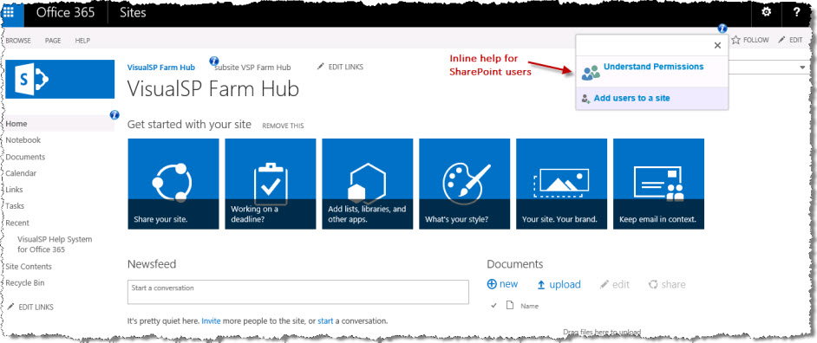

“Just-in-time” and “Just Enough” Help
Do you want users to follow blindly the advice they find on the internet?
End users are not motivated to look elsewhere - deliver help in-place.
Don’t overwhelm users with too much information.

Slide 8

Leaders model the behavior
“No involvement by leaders,
no commitment by employees.
No exceptions.”
Vala Afshar, Chief Marketing and Customer Officer at Enterasys

Slide 9

Pay attention to what is important to your leaders
What keeps them up at night?
How are they measured?
How can you help them with their key business issues?

Slide 10
Tips for getting leaders engaged
Make it easy – mobile, email
Focus – Jams, Travel Logs
Find an Ally – someone to lead
One-on-one Training – Technology Coach

Slide 11
Summary
1
Solve a problem users care about
2
Provide help in context
3
Engage leaders

Slide 12





Connect with us
  sue@susanhanley.com asif@visualsp.com www.susanhanley.com www.visualsp.com
My Connect
  On the page for this session, you’ll find
  Ask a question to the speaker(s)
  Slides
  Resources
  Recording*
  Feedback form
Sue Hanley
Asif Rehmani

